Slide 1


Reception Parents
Meeting

Slide 2
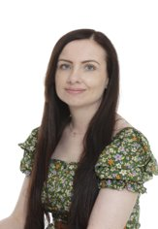
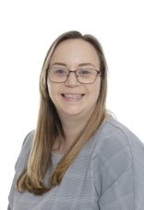
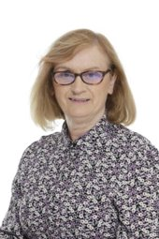

Meet the team

Slide 3
Early Years Foundation Stage (EYFS):
The areas of our curriculum
The Early Years Foundation Stage (EYFS) is a curriculum for children from birth to 5 years.
Reception is the end of the curriculum where we assess the children against the Early Learning Goals.
There are 3 prime areas: Communication and Language, Personal, Social and Emotional Development Physical Development.
There are 4 specific areas: Mathematics, Literacy, Understanding of the World and Expressive Arts and Design.

Slide 4
Communication and language
Speaking | Listening, Attention and Understanding
Answering in full sentences, having discussions or conversations and asking questions. Introducing new vocabulary and encouraging children to use it. | Encourage careful listening through the use of stories and conversations. Following listening rules during lessons so children are engaged with learning.
What you can do to help
Talk to your child and encourage them to answer in sentences rather than accepting one-word responses. Read your child stories and check they have listened by asking them questions about the story. Talk to your child about the topics they have learnt at school to extend and reinforce their vocabulary and knowledge.

Slide 5
Personal, social and emotional development
Self- Regulation | Managing self | Building Relationships
Talking about our feeling. Learn to think about the feelings of others before acting. | Talking about 'Stay on Green' and the rules we follow. Encouraging children to get dressed and undressed independently for PE. Encouraging children to keep trying when they find a task challenging. | Playing turn taking games. Talking about being kind. Playing cooperatively with others.
What you can do to help​
​Having consistent rules to follow at home. Play board games and card games where children have to take turns, follow rules and keep trying. Encouraging your child to put on their own coat independently and to zip it up and to dress for school by themselves. Ensure your child can use a knife and fork, cut their food themselves and eat independently.

Slide 6
Physical development
Fine motor | Gross motor
​Fine motor skill activities such as construction, threading, using tweezers. Scissor activities. Mark making and writing. | ​PE lessons. Access to physical activities in the Outdoor Classroom.
What you can do to help​
​Practise cutting with scissors at home. Drawing and painting. Going to the park to use monkey bars and other climbing equipment. Building with Duplo, Lego, stickle bricks etc. Practical tasks, such as pegging washing on a line and washing up with a sponge.

Slide 7
Literacy
Comprehension | Word Reading | Writing​
Answering questions about stories, re-telling them, talking about events and making predictions. | ​Teaching children sounds leading on to blending words and reading sentences. | ​Learning to form letters. Encouraging children to use the sounds they know to spell words moving on to writing sentences.
What you can do to help​
​Support your child to recognise their own name. Support your child to write their own name, moving on to other letters from the alphabet. Read at least 5 times a week with your child. Support your child to learn the sounds and words sent home. Read to your child and ask them questions about the story.

Slide 8
Mathematics
Number | Numerical Patterns
​Understanding numbers to 10 including finding 1 more/less, doubling, halving, adding and subtracting. Knowing all the number bonds and subtraction facts for five and some for ten. | ​Comparing quantities up to 10 knowing which group has more/fewer. Sharing equally. Recognising odd and even numbers.
What you can do to help​
​Support your child to recognise numbers 0-10 and put them in the correct order. Making repeating patterns with objects. Counting objects accurately to find the total. Adding 1 more or taking 1 away to find out how many are left. Sharing out food equally.

Slide 9
Understanding of the world
Past and Present | People, Culture and Communities | The Natural World
Learn about the past through topic work and stories, comparing part of our lives with how things were in the past. | ​Looking at differences and similarities between different environments and countries. Celebrating festivals and religious events. | ​Learning about farm animals, minibeasts and wild animals. Growing flowers and vegetables. Learning about lifecycles.
What you can do to help​
​Talk about events and people from the past as well as life in your past, e.g. what you did as a child, at school etc. In comparison to their lives. Pointing out aspects of the local environment. Talking about the festivals you celebrate with your child. Going on visits to see animals, such as a farm or zoo. Looking for minibeasts. Growing flowers or vegetables in your garden or in pots.

Slide 10
Expressive arts and design
Creating with Materials | Being imaginative and Expressive
​Painting, observational drawing, junk modelling etc. Using skills such as drawing, using scissors and joining materials. | ​Singing songs and rhymes. Providing role play and imaginative play opportunities. Acting out stories.
What you can do to help​
​Craft and drawing activities. Play imaginatively with your child with toys and props. Singing songs. Making music. Dancing.

Slide 11
Our topics and key texts
Topics and festivals | Key texts
All about me Autumn Harvest Diwali Guy Fawkes night Remembrance Christmas Winter People who help us Chinese New Year Easter Eid Growing Farm animals Minibeasts Summer Seaside Superheroes Wild animals | Boggity Bog The Three Billy Goats Gruff The Little Red Hen The Hungry Giant Once there were Giants Dear Santa One Snowy Night After the Storm The Rescue Party Mrs Wishy Washy Wishy Washy Day Mud Walk Meanies Meanies came to school The Toymaker The Gruffalo Lucy and Tom at the Seaside

Slide 12
How we assess whether children have achieved the Early Learning Goal
Through observation- getting to know the children and their abilities; these may be written observations and focus on communication skills. Also through watching children participating in adult-led and child-led activities.
Collecting examples of work that reflect the children’s progress.
Floor books- working with groups of children to record their learning in a class book. We will be encouraging children to reflect on what they have learnt to see if they have retained the vocabulary and teaching.

Slide 13
Our Routine
Lessons
Read, Write Inc. (RWI) Our phonics lessons that take place every morning
Mathematics- a new concept is taught each week, lessons are daily
Discovery time- Literacy/topic lessons taught 4 days a week which often include a focus book
PE- Taught in the hall once a week
Circle time- Exploring emotions, rules and festivals taught once a week
Music- involving singing, movement and instruments taught once a week
In order for the children to be able to achieve the Early Learning Goals they need to have a routine that will support them.

Slide 14
Other important aspects of our routine​
Indoor work and play- children have opportunities to take part in planned activities covering all areas of the curriculum in their classroom and Red Room. Some activities are independent, and some are adult-led.​
Outdoor Classroom- this is our garden where planned activities covering the areas of the curriculum are available for children to take part in.​
Assembly- Soon they will be joining assembly on the screen and then joining key stage 1 in the hall when they are ready​.
Lunch and playground​.
Story time- stories are a very important part of learning​.

Slide 15
A typical day
Registration
Read, Write Inc
Work and play
Mathematics
Lunchtime
Discovery time
Work and play
Story time
Home time

Slide 16
Read, Write, Inc (RWI)
This is our phonics programme that teaches children to read and write.
Phonics is taught every day for an hour.
The session includes learning a new sound, writing the sound and beginning to read and write words.
Homework will be sent home every week, please make sure your child practises this at home. Children will be assessed after they have learnt the single set 1 sounds and grouped according to their abilities.
If you have any questions about how to support your child at home, please speak to your child’s teacher.
Terms used | Definition
Fred Talk | Segmenting the sounds in a word and then blending them to read e.g. c-a-t, cat
Fred Fingers | Segmenting a word using your fingers in order to spell it

Slide 17
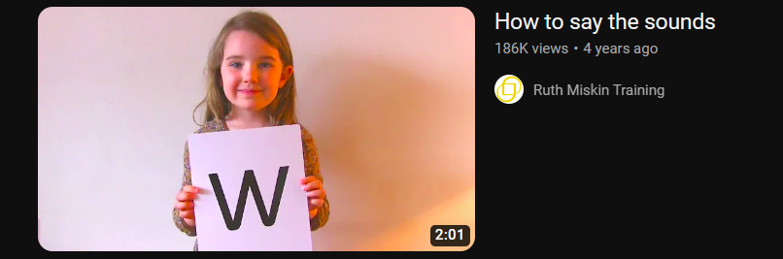
How to say the sounds - youtube
If you are unsure about how the sounds are pronounced, please view this video on YouTube or the Reception class page; it is also useful for your child to view to help them learn the sounds.

Slide 18
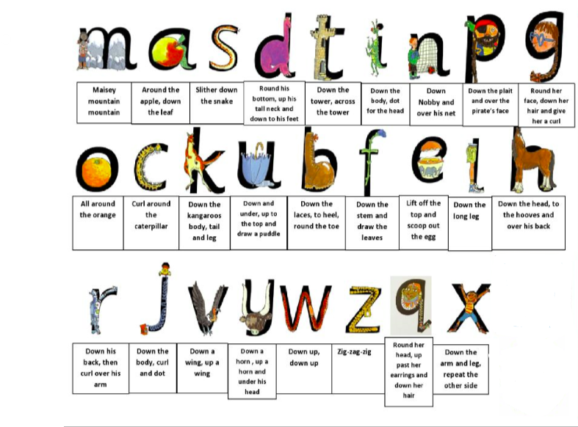
Supporting handwriting at home
Each sound has a picture with it and a rhyme that helps the child to write the letter. As the child writes the letter encourage them to say the rhyme in order for it to be formed correctly.
At this stage children do not need to form capital letters except for the first letter in their name e.g. 'Thomas'.

Slide 19
Reading at home with your child
Each week your child will receive a reading book with no words to take home.
Please write the name of the book in their reading record.
Our aim is for children to read 5 times a week.
If your child has 5 signatures in their reading record on Friday they will receive a sticker to put on the class reading rocket, if they get 10 stickers they will get a prize.
Please make sure your child has their reading record and their reading book in school every day and please look after the book sent home.

Slide 20
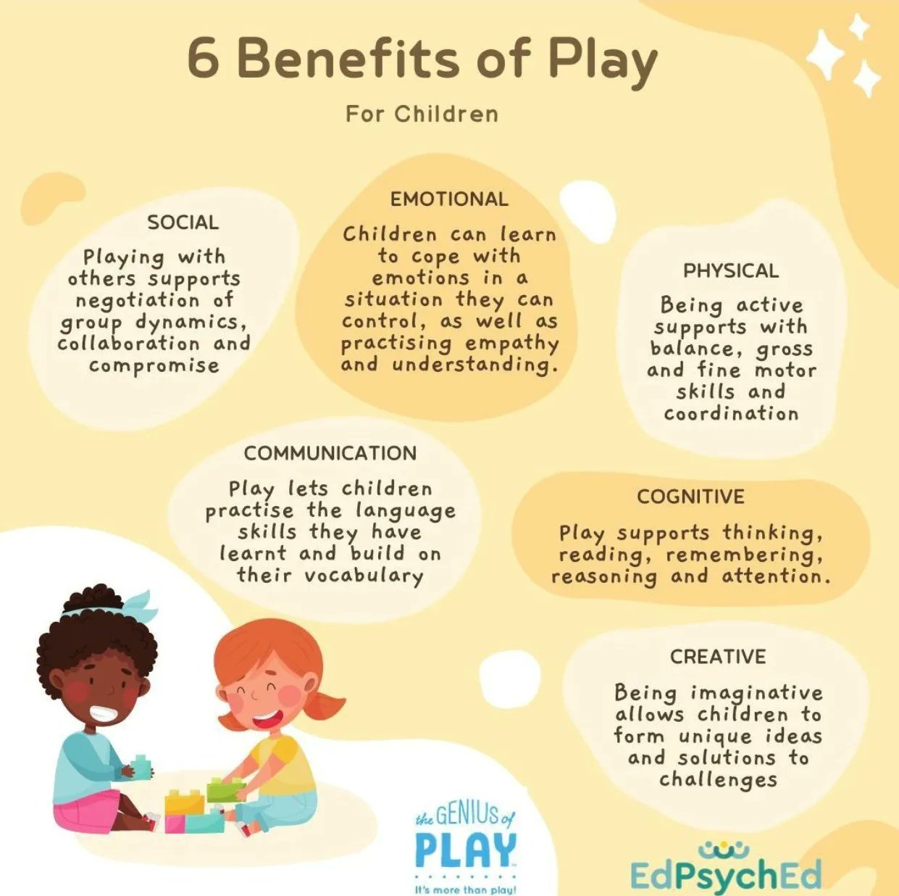
Play supports learning
Play takes place indoors and outdoors and it is in these different environments that children explore and discover their immediate world. They can practise new ideas and skills; take risks, be imaginative and solve problems on their own or with others.
Please play with your children at home to help develop these skills.

Slide 21

Play supports communication
Play is vital to support children’s communication and language skills, talking to children and having conversations during play, modelling good language and asking children questions will really support their communication skills.
Please make time for conversations with your child during play in order for your child to gain good communication skill and to make progress.

Slide 22
What your child will need for school
Please remember
Book bag- your child’s book may need to be changed, please ensure they have it with them every day.
Wellington boots- We have a digging area which children will need Wellington boots to access, they are also useful for rainy days.
Coat- When the weather is cold please make sure your child has a coat with them. Please support them to put their coat on and zip it up independently.
PE kit- your child will need a PE kit in a bag this should consist of black shorts or jogging bottoms, a white t-shirt and plimsolls or trainers- all items must be named. Please ensure all earrings are removed on PE days and long hair is tied up.

Slide 23

Attendance and punctuality
Attendance
It is vital that children attend school every day so they don’t fall behind or have gaps in their learning.
Less than 90% attendance is considered persistent absence.
If your child is unable to attend school please telephone the school to explain why or this will be recorded as an unauthorised absence.
Please refrain from taking your child out of school for holidays.
Punctuality
Children arrive through Red Room door between 8:40-8:50. Any child who arrives after this time MUST go to the office as they need to be registered and have their lunch recorded.
Our school day finishes at 3:20, please arrive promptly to pick up your child, any late children will be taken to the front of the school to be collected. Please let us know if someone different is collecting your child.

Slide 24
What to do if you have a question or concern
Check the school website, more specifically the Reception page, if it's a simple question the answer may be there.
Speak to your child's teacher, they work with your child every day and will have the most knowledge about your child.
If you need further support speak to the Assistant Headteacher for the EYFS.

Slide 25

Keeping Children Safe Online
A range of resources can be found in the link below:
https://www.godwinprimary.co.uk/online-safety-2/
We are planning to run some online safety workshops over the coming year so please keep an eye on the newsletter

