Slide 1

Year 4 Parents’ meeting
October 2024
Notes:
We are not expecting a fire-drill but… If you have any questions, please wait until the end. I may answer them as we go.

Slide 2


Keeping Children Safe Online
A range of resources can be found in the link below:
https://www.godwinprimary.co.uk/online-safety-2/
We are planning to run some online safety workshops over the coming year so please keep an eye on the newsletter

Slide 3

School Vision
Notes:
So that they can take any opportunities that they want to as adults and become whatever they want to be

Slide 4
Meet the team
Mrs Hall
Mr Galea
The adults supporting your child in Lower Key Stage 2 will be Mrs Brightman, Mrs Crickmar, Mrs Akthar, Mrs Ryan and Mrs Asagba
Notes:
If you have any concerns, please speak to your child’s class teacher. If it remains unresolved or you are unsatisfied regarding how it was managed, please speak to Mr Wade (AHT and phase leader for Year 3 and 4)

Slide 5
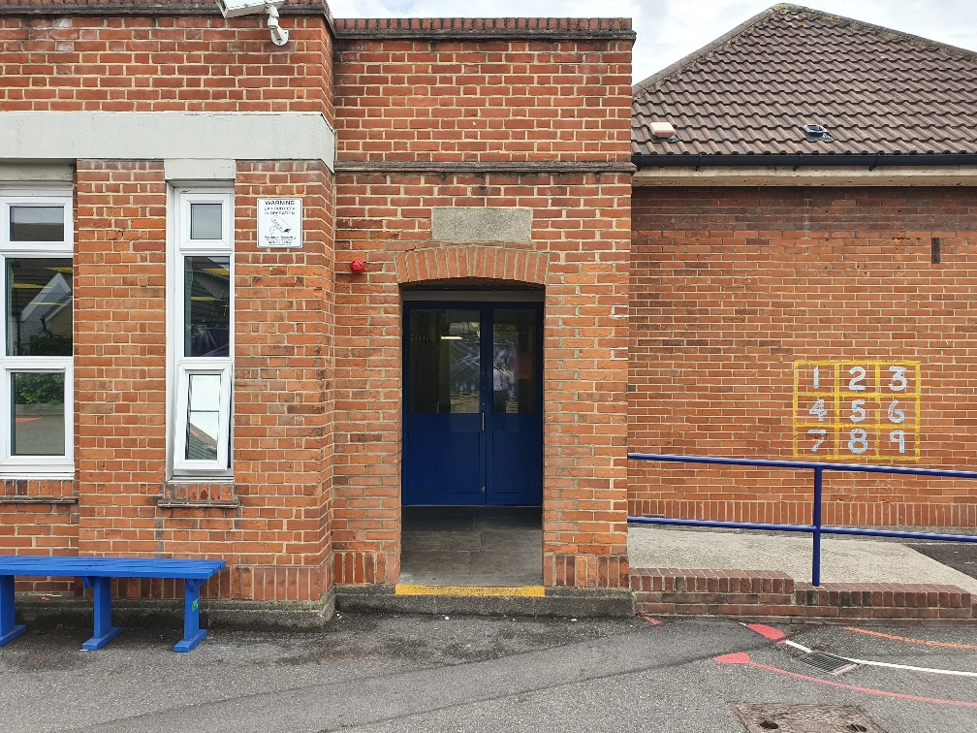
This is where the children enter the school between 8.40 and 8.50
Notes:
If you need to share any messages with your child’s class teacher, please speak to the person who is at the door. As teachers are in class, it is really difficult for them to leave their classes to come out to you.

Slide 6
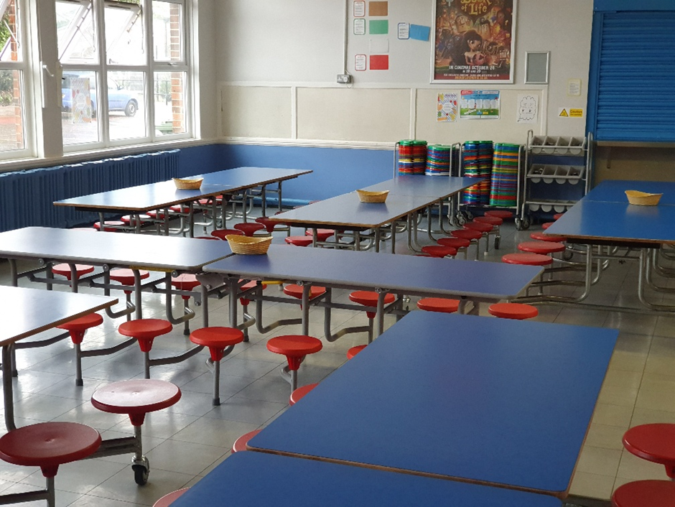
This is where the children eat lunch
Notes:
Lunchtime is at 12.15. The children in Year 4 go outside first and eat at around 12.45.

Slide 7
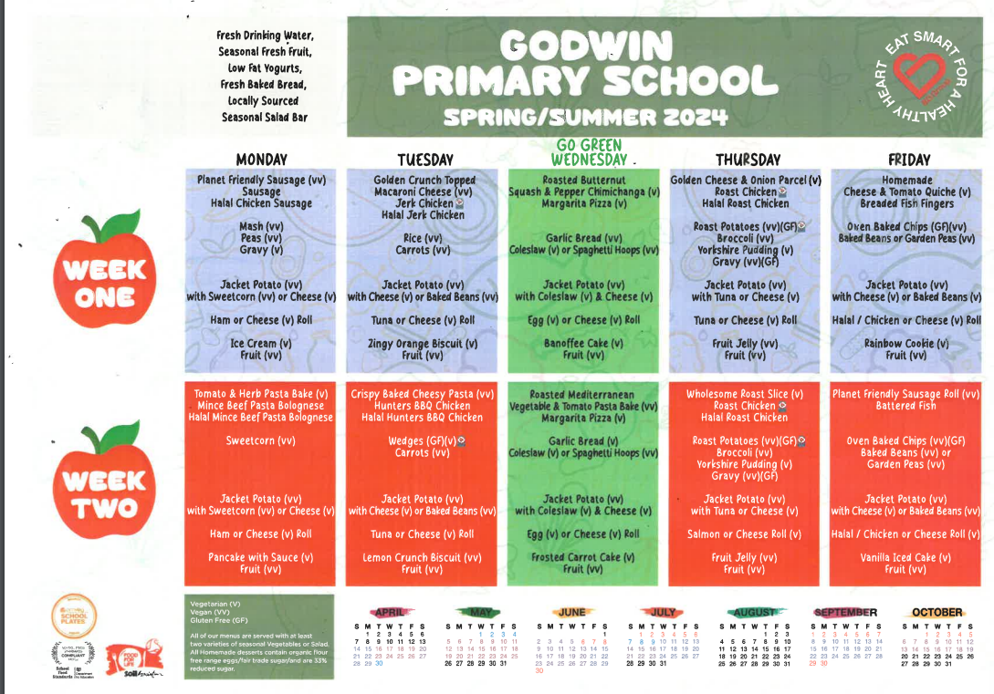
Lunch Menu https://www.godwinprimary.co.uk/school-meals/
Notes:
Throughout the PowerPoint, there are website links that will take you to referenced pages or documents. The PowerPoint can be downloaded from your child’s class page so you do not need to worry about taking notes.
You may wish to bare the menu in mind when planning evening meals.

Slide 8
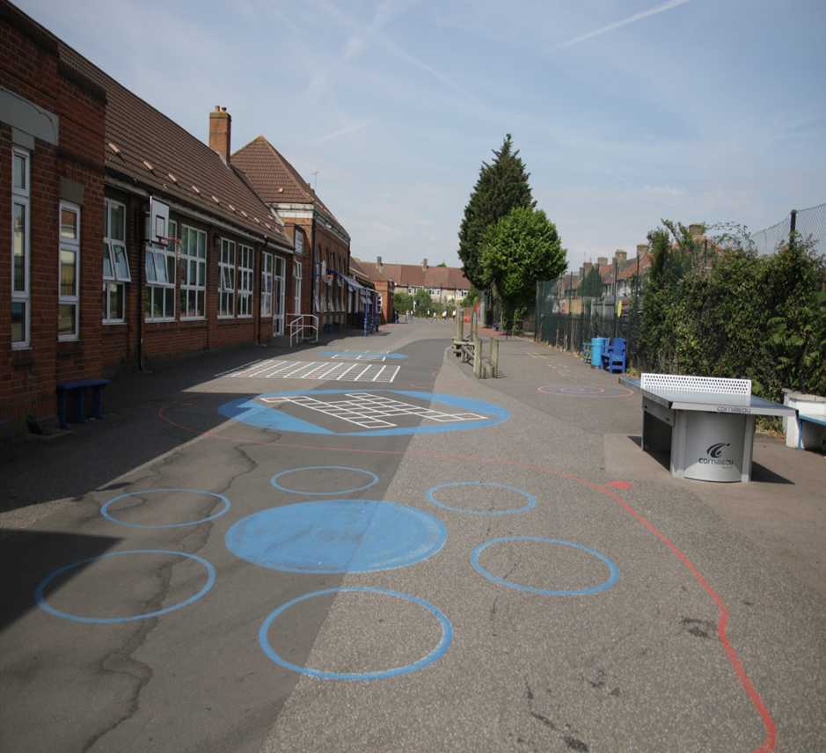


This is where the children play
Notes:
The children have a range of equipment including basketballs, table tennis equipment, hoops and skipping ropes. There are also markings in the playground for the children to use.

Slide 9
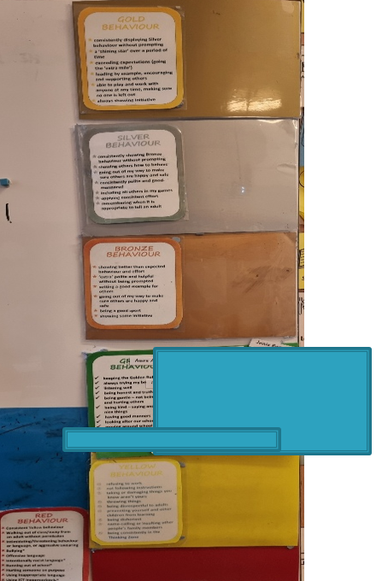
Stay
On
Green
Notes:
Stay on Green is the same as last year. Please praise your child for staying on green each day. Whenever a child finishes the day on green, bronze or gold, they earn points. Collectively, the class who earns the most amount of points within Year 3 and 4 get 30 minutes of ‘green time’ during the following week. The children help decide what this reward is. If a child can stay on green for each day during a half term, they earn a badge. If they can stay on green throughout the year, they earn a badge shaped like an ‘owl’ too.

Slide 10
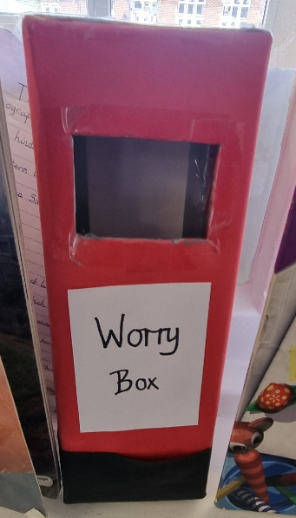
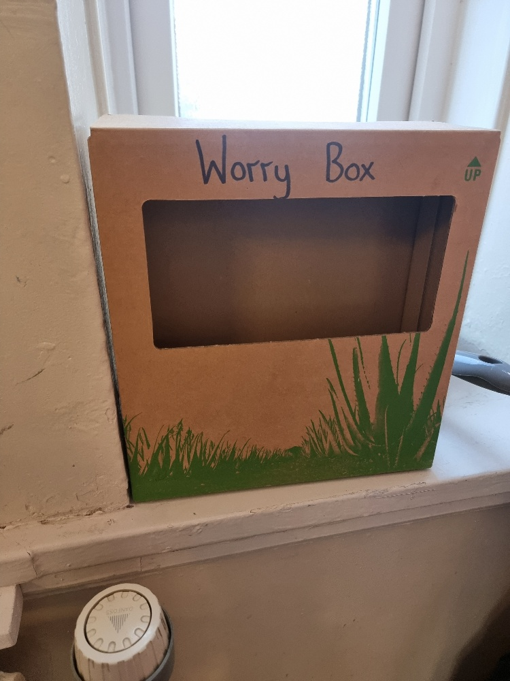
Worry Box
Notes:
A Worry Box is in each classroom. If your child is worried about something, they can speak to an adult. If they want to be more discreet, they can write their worry in the box. Adults check the class Worry Box every day.

Slide 11

Keeping Children Safe Online
A range of resources can be found in the link below:
https://www.godwinprimary.co.uk/online-safety-2/
We are planning to run some online safety parent workshops over the coming year so please keep an eye on the newsletter

Slide 12
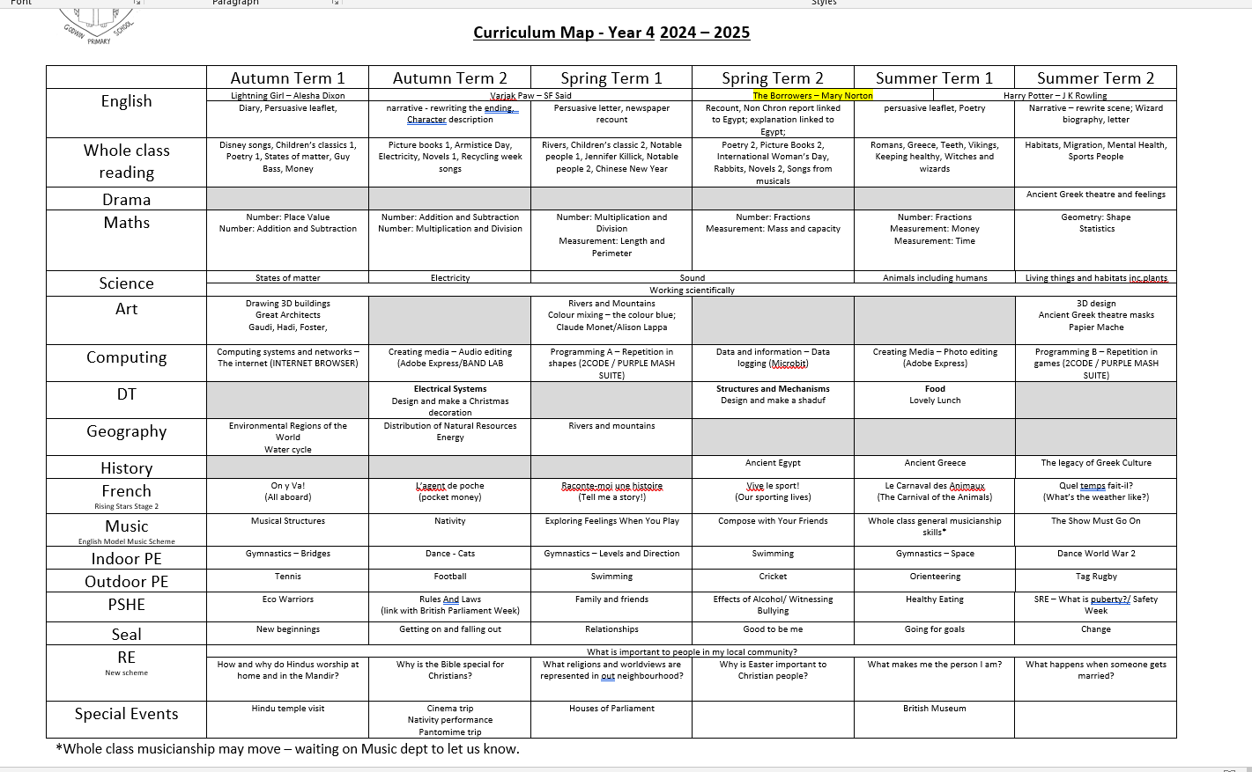
https://www.godwinprimary.co.uk/curriculum-maps-1/

Slide 13
Ongoing assessment
Children are assessed continually by adults
Assessments relating to the core subjects take place three times during the academic year

Slide 14
MTC
A formal test of multiplication skills takes place in the summer term of Year 4.
Primary-school children are expected to know all their times-tables up to 12x12.
Children will be tested using an on-screen check (on a computer or a tablet), where they will have to answer multiplication questions against the clock.
The test will last no longer than 5 minutes and is similar to other tests already used by primary schools.
Children will have 6 seconds to answer each question in a series of 25.
https://www.godwinprimary.co.uk/multiplication-times-tables-check/Times-Tables Check | Godwin Primary School

Slide 15
Guidance video
https://youtu.be/nxjkqhaNAAI?si=FBp1npFqxj3eO3sG

Slide 16
Understanding times-tables
https://www.youtube.com/watch?v=0UL4GFEevMcg
https://www.godwinprimary.co.uk/times-tables-support/Times-tables Support

Slide 17
Download it here

Slide 18

Your child can practice via the TTR app or by visiting https://ttrockstars.com/)
Notes:
Your child’s username and password should be in the back of their reading record. If it is not, ask your child to tell their teacher.

Slide 19
TTR MTC example video
https://youtu.be/-pxDXAN8qXI

Slide 20
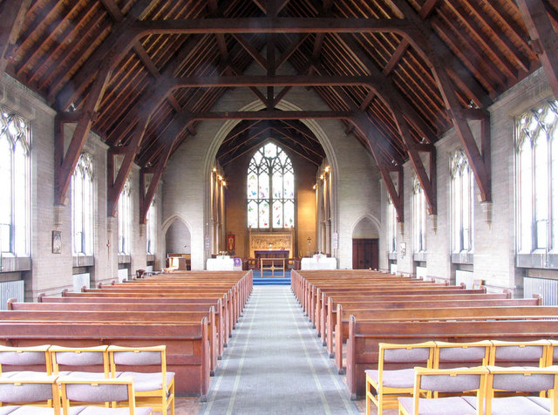
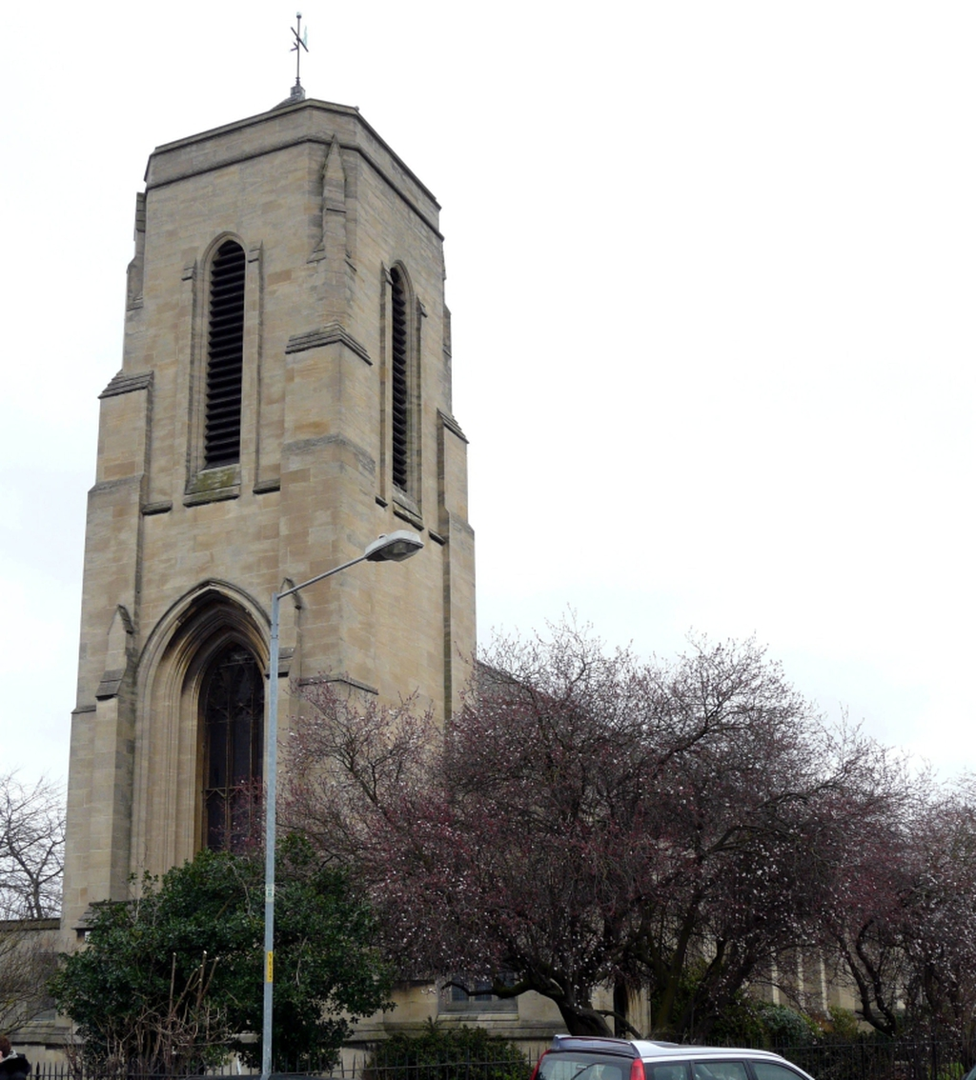
Nativity
Notes:
This year, our nativity will be performed at St Albans Church.

Slide 21
PE timetable
Year 4 PE information can be found here: Year 4 | Godwin Primary School
Please ensure that: children have jogging bottoms, plimsoles/ trainers and an additional jumper (as the weather gets colder) if they wear studs, your child needs to remove them themselves or have them covered with medical tape

Slide 22
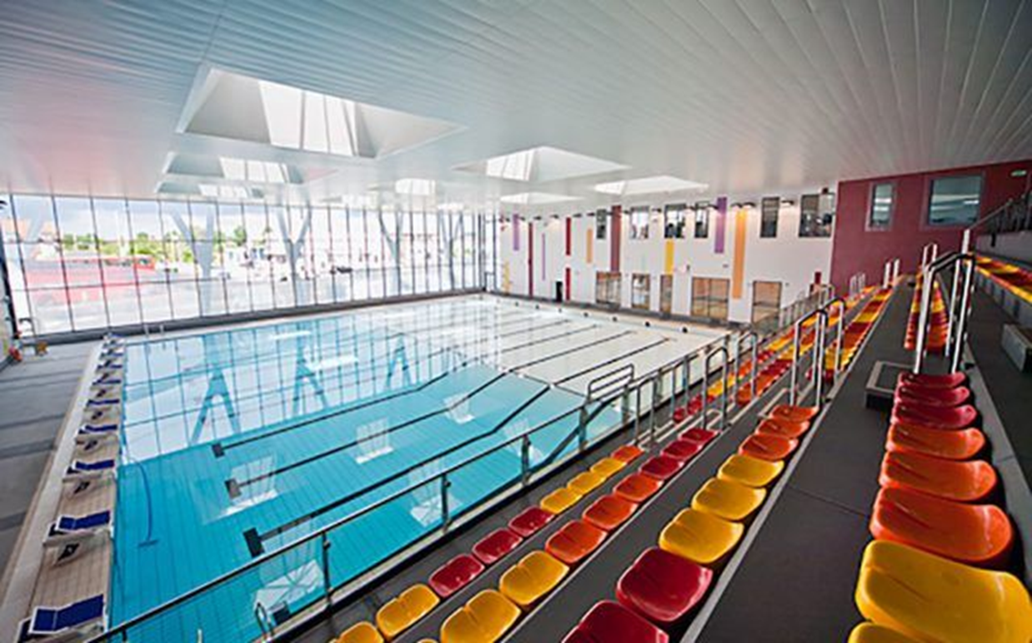
Swimming in January
Notes:
Lessons will take place at Becontree Leisure Centre. It will be on Tuesdays after Christmas. They will be assessed in the first session. An adult will be in the pool to support children who need it.

Slide 23
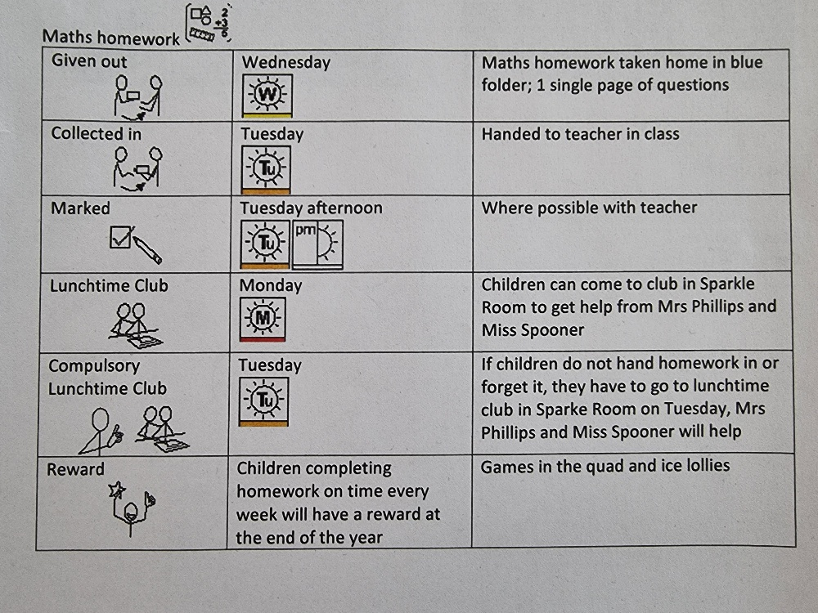
Notes:
Daily reading as well as CEW and times-tables practice
Optional writing at home

Slide 25
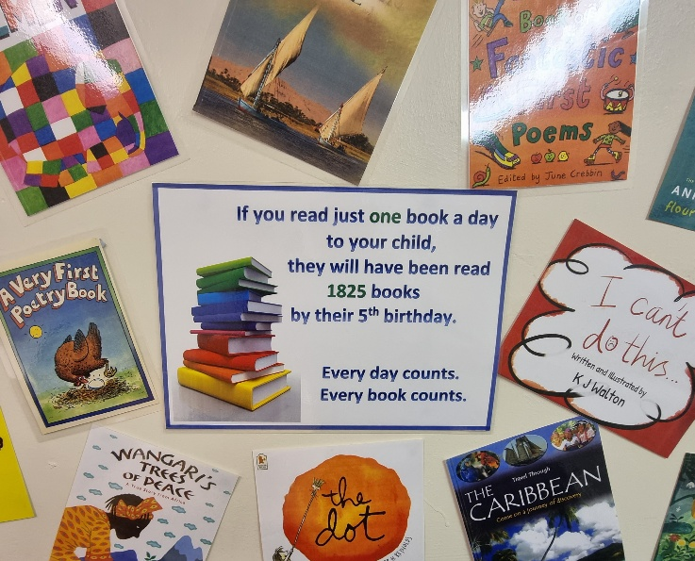

Slide 26
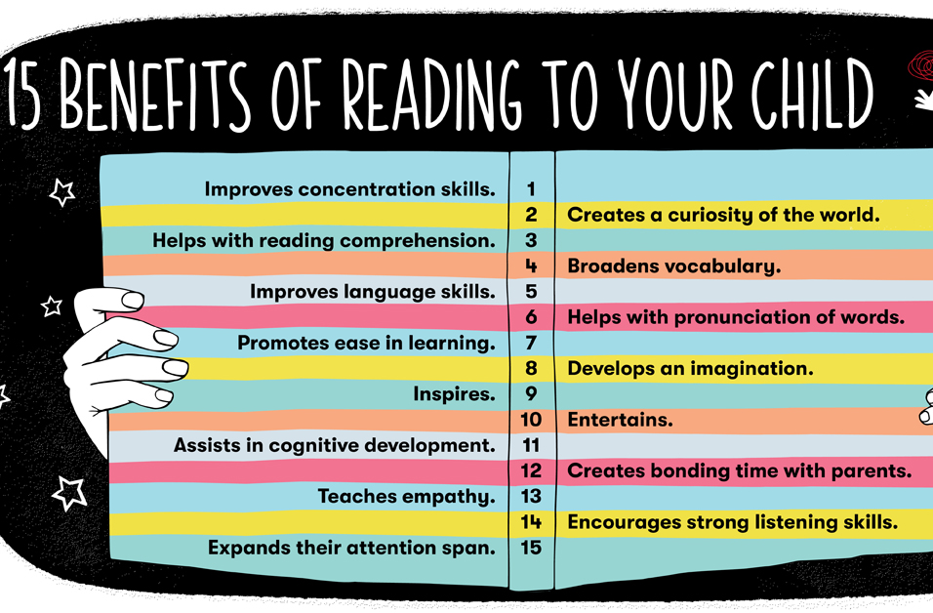

Slide 27
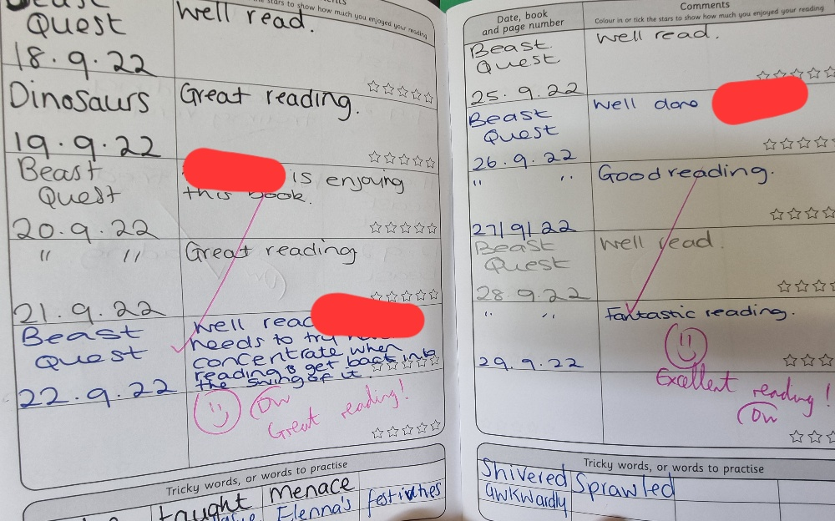
Example reading record
photo
Notes:
This what your child’s reading record could look like. Please aim for your child to read at least 5 times per week. You can sign their record each time they read.

Slide 28
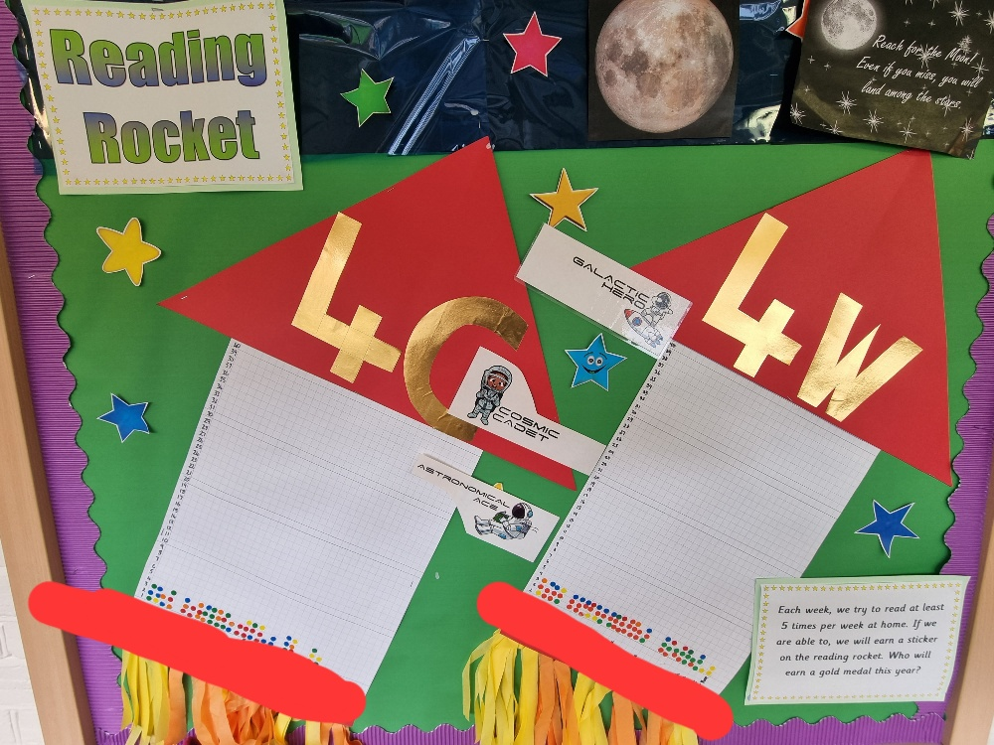
Notes:
Each week, the children earn a sticker for the 5 (or more) signatures that they have in their reading record. They can earn prizes for collecting 10, 20 and 30 stickers.

Slide 29
Question prompts
https://www.godwinprimary.co.uk/reading-at-home/
When your child reads with you, encourage them to look out for . ! ? , ( ) - in sentences and encourage them to read with expression and to think about their tone. It will help to develop their understanding.

Slide 30
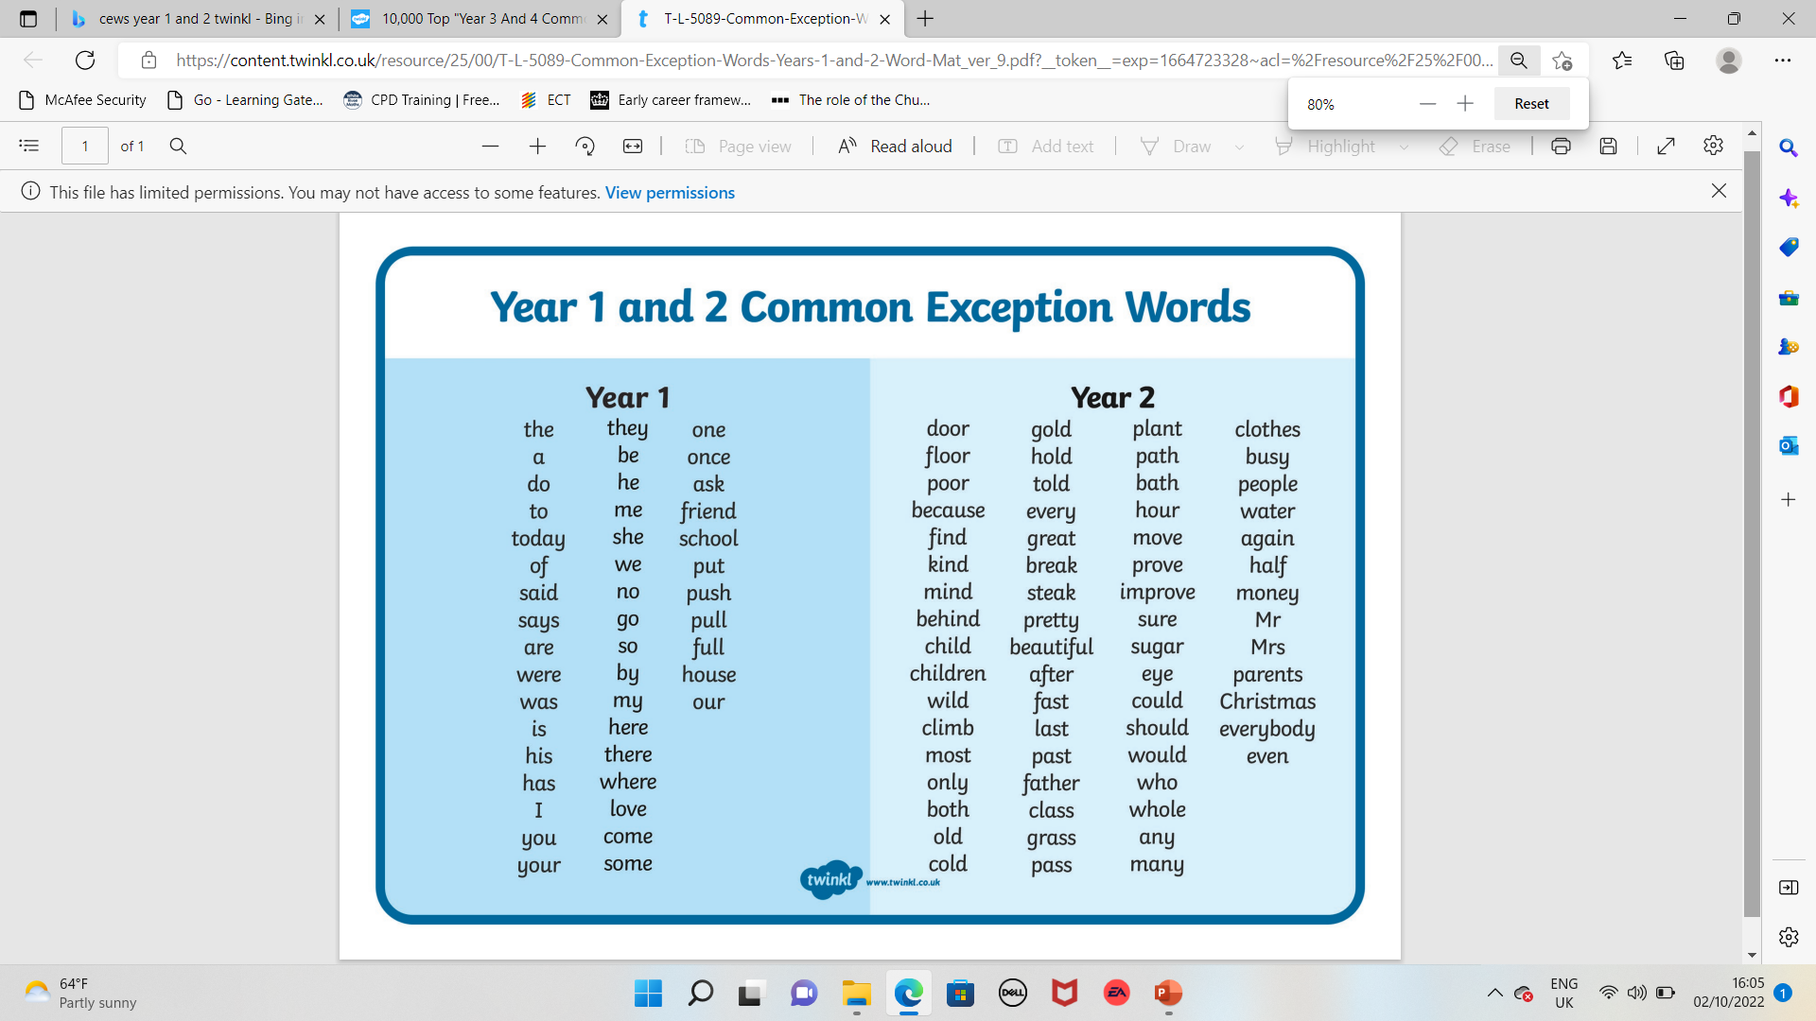
Click here to download the Year 1 and 2 list

Slide 31
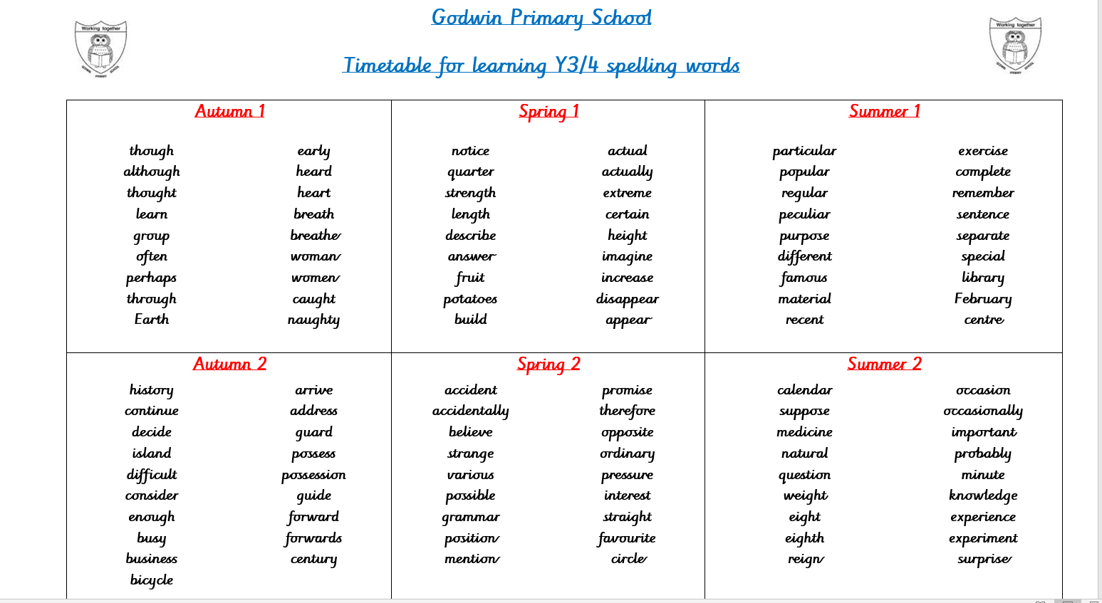
Click here to download the Year 3 and 4 list

Slide 32
So what are we doing?
Teaching and planning exciting ways of motivating your children
Making sure we keep an eye on expected standards so that we know if children are where they should be or are struggling
Extra support for children that need a little bit of help or those who may get higher – group work, Better reading partners, 1st class at Maths
Share whether we expect your child to meet the end of year standards, and what children need to do to get there, give children individual targets

Slide 33
So what can you do?
Make sure your children come to school for their Early Bird learning....on time, having had enough sleep and breakfast
Keep us informed of any problems
Support teachers with behaviour issues, asking children if they ‘stayed on Green’
Support children with homework – remind about homework club etc.
Read, read, read!
Get children to school on time everyday
Practical learning from home
Practise spellings and spelling rules
Help learning the times-tables

Slide 34
And finally a plea....
Please please label your children’s clothing!

