Slide 1

Year Five Curriculum
4/10/24

Slide 2

School Vision
Notes:
So that they can take any opportunities that they want to as adults and become whatever they want to be

Slide 3
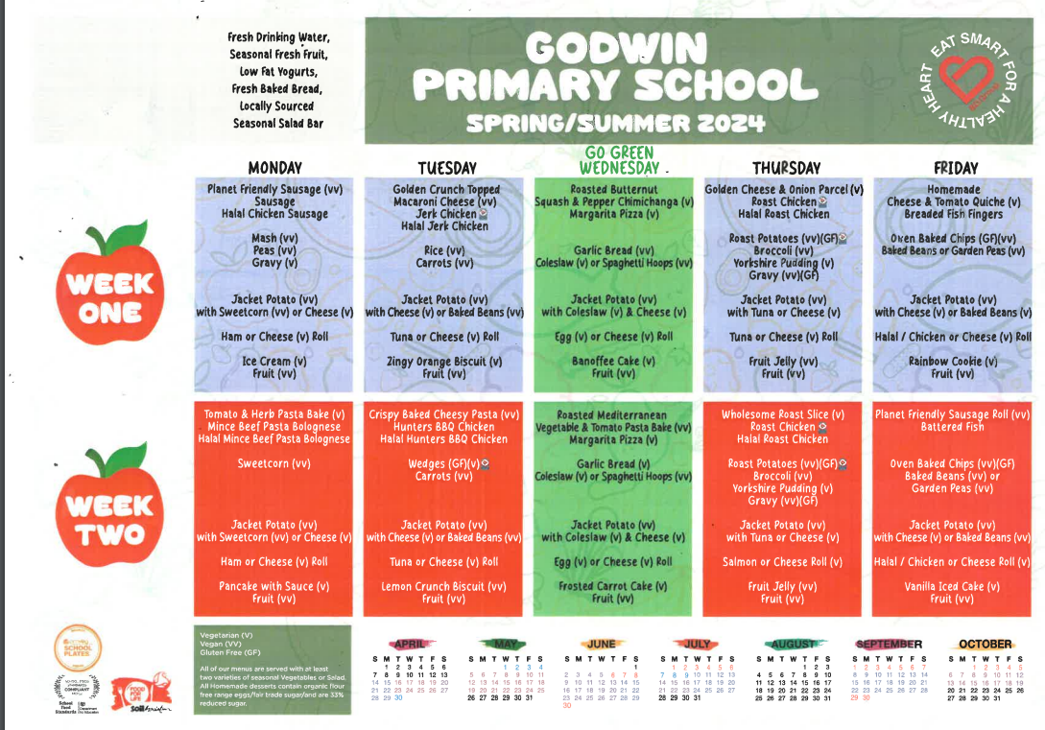
Lunch Menu https://www.godwinprimary.co.uk/school-meals/
Notes:
Throughout the PowerPoint, there are website links that will take you to referenced pages or documents. The PowerPoint can be downloaded from your child’s class page so you do not need to worry about taking notes.
You may wish to bare the menu in mind when planning evening meals.

Slide 4
The National Curriculum
The national curriculum is a set of subjects and standards used by primary and secondary schools so children learn the same things.
It covers what subjects are taught and the standards children should reach in each subject.

Slide 5
The National Curriculum
English
maths
science
design and technology
history
geography
art and design
music (fifes)
physical education (PE), including swimming
computing
ancient and modern foreign languages
relationship and health education
religious education
Plus:
PSHE & citizenship
modern foreign languages (at key stage 1)
sex education

Slide 6
Curriculum Map:
Home | Godwin Primary School

Slide 7
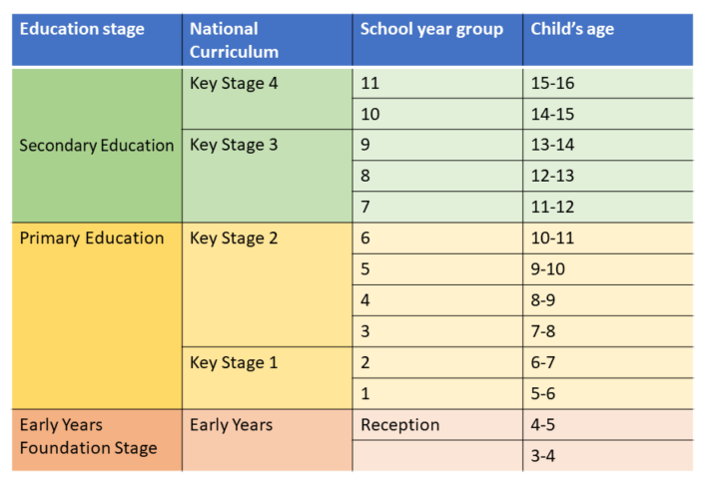

Slide 8
Whole Class Texts
Read to daily – whole class texts.
Chosen with diversity and breadth of reading experience in mind.
Texts also act as broad themes for other English work e.g. grammar and writing.
Children will also do Guided Reading with other texts which change daily.

Slide 9





Slide 10
Reading Skills
Decode words they are having difficulty with.
Work out the meaning of unfamiliar words.
Check they have understood what they have read.
Predict what will happen.
Summarise what their reading was about.
Discuss particular words chosen by the author.

Slide 11
Reading at Home
Read AT LEAST five times a week to an adult.
Reading Records due each Friday.
Personal reading books chosen and changed in school.

Slide 12
Reading at Home
Enjoy Reading!
Read to self – daily for pleasure.
Read in different places/a special place.
Read a wide range of poetry, plays, fiction, non-fiction, graphic novels, websites, different genre, textbooks, newspapers.
Have opinions about books and authors.
Read about topics in the news and discuss them.
Adults as a role model for reading.

Slide 13
Reading at Home
Useful Ideas
The Library – it’s free!
Centre for Literacy in Primary Education (CLPE) Corebooks
Waterstone’s Children’s Book Prize
Shops: Waterstone’s, WHS Smith, The Works, Asda
BBC Bitesize
First News and The Week Junior

Slide 14
Writing At School
Malamander: narrative, persuasive leaflet, report
House With Chicken Legs: persuasive speech, explanation, balanced argument
Wonder: biography, balanced argument, description, diary entry, book review
Boy at the Back of the Class: recount, poetry, persuasive letter

Slide 15
Writing At School
Also taught weekly…
Grammar
Punctuation
Handwriting
Spelling

Slide 16
Writing At Home
Y3/4 Spellings
Y5/6 Spellings
Weekly homework sheets (linked to spelling)
Writing for fun – diaries, competitions, stories, playscripts, explanation texts, blogs, websites…

Slide 17
Maths in Y5
Number: Place Value, Addition & Subtraction, Multiplication & Division, Fractions, Decimals & Percentages
Statistics
Measurement: Perimeter/Area, Converting Units, Volume
Geometry: Properties of Shapes, Position and Direction

Slide 18
Maths at Home
Times Tables Rock Stars
Checking multiplication and division facts
Telling the time
Making things – cooking, models etc.
Going shopping – money, change, special offers etc.
BBC Bitesize
Weekly Homework

Slide 19
Homework In Y5
English Sheet/Spelling
Maths book
Goes out on Wednesday
Due in on the following Tuesday
Optional Homework Club on Monday lunchtime
Compulsory Homework Club on Tuesday lunchtime

Slide 20


Keeping Children Safe Online
A range of resources can be found in the link below:
https://www.godwinprimary.co.uk/online-safety-2/
We are planning to run some online safety workshops over the coming year so please keep an eye on the newsletter

