Slide 1
Which pictures are real? Which ones are ai generated?

Slide 2
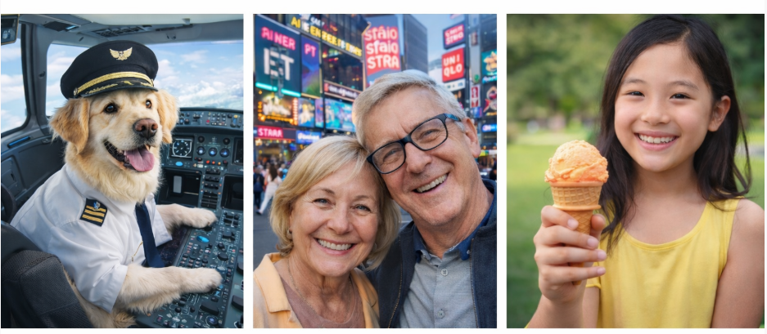
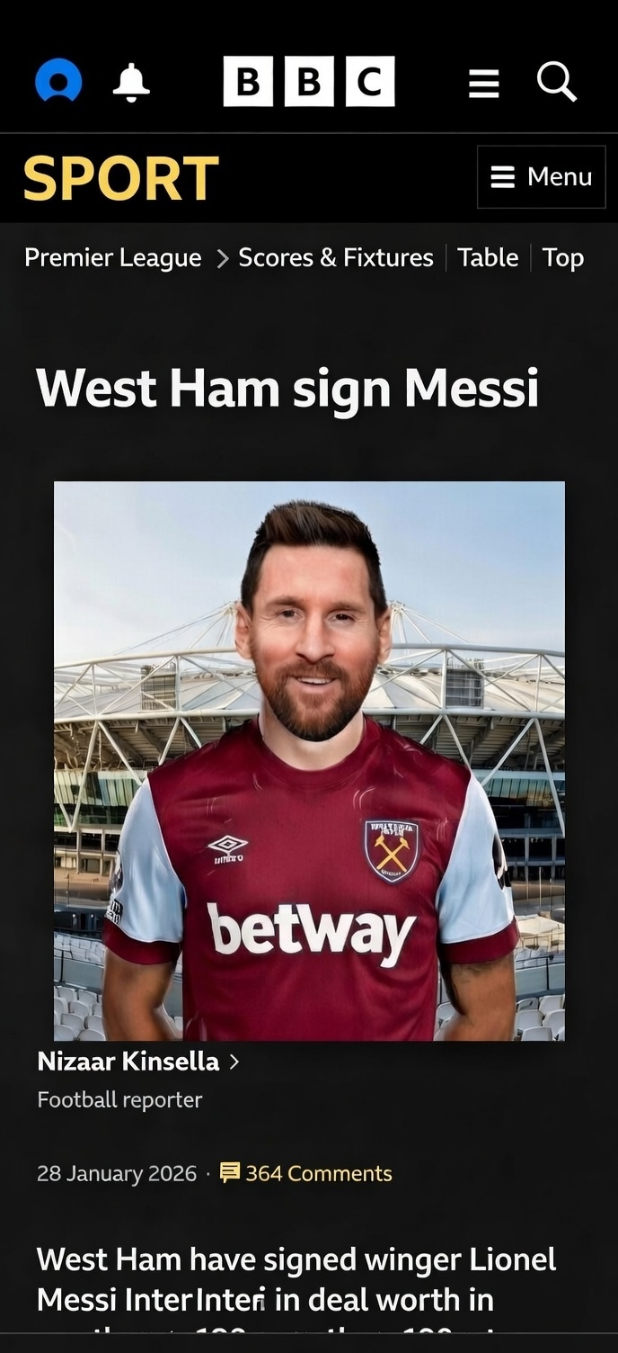
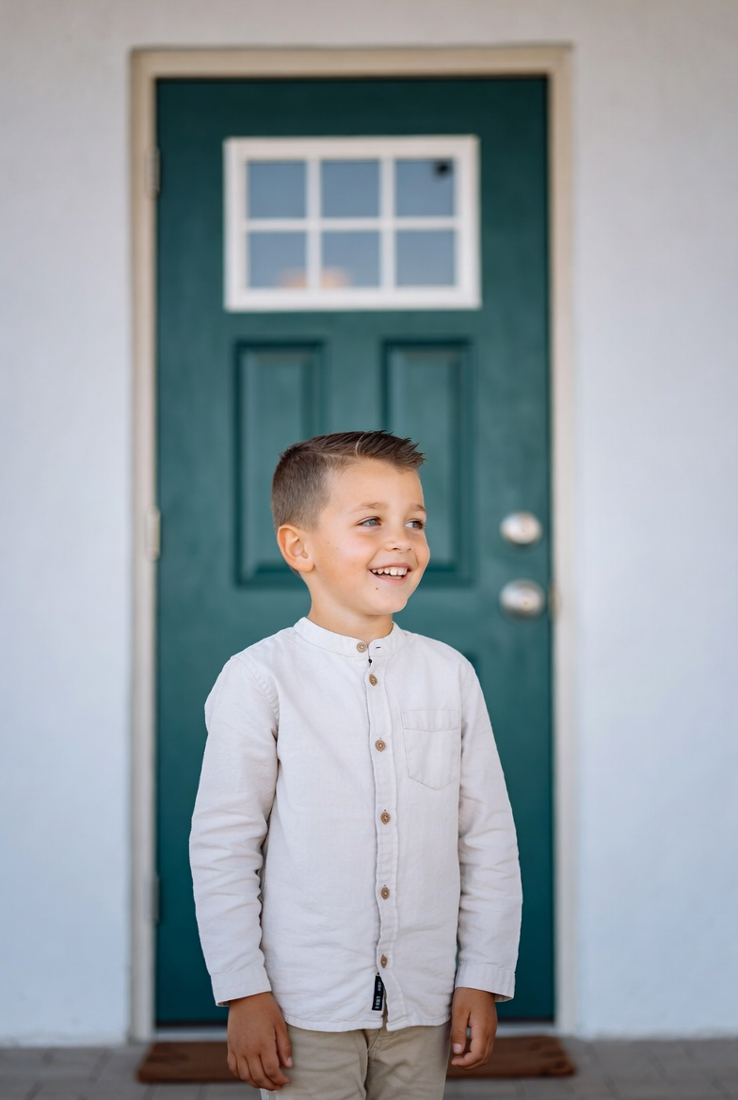


Slide 3
Are you ready for the answers?

Slide 4
They are all ai generated!
West Ham sign Messi – The story is completely made up, despite looking like a real BBC Sport page.
Dog flying a plane – Dogs cannot fly passenger planes! An obvious example of AI creating something impossible.
Couple in Times Square – Look closely at the blurry background, made-up shops and incorrect spellings on the signs.
Girl with an ice cream – Look carefully at her fingers – they are not in proportion to each other.
Boy outside the house – Look at the front door. Why does it have two door knobs?
Man on the beach – Look at the ground around him. Where is his shadow?

Slide 5
Red flags an AI picture might be fake:
Faces look a bit wrong e.g. eyes uneven, strange smiles, blurry teeth.
Hands or fingers look odd e.g. many fingers, bent the wrong way.
People look too perfect, like a game character or doll.
Backgrounds do not make sense e.g. doors floating, signs with nonsense words.
Writing in the picture looks messy, backwards or gibberish.
Famous people are doing something that seems very unlikely!
Clothes or logos look slightly wrong or misspelled.
The picture feels “too shocking” or “too good to be true”.

