Slide 1

Year 3 Parents’ meeting
October 2025
Notes:
We are not expecting a fire-drill but… If you have any questions, please wait until the end. I may answer them as we go.

Slide 2

School Vision
Notes:
So that they can take any opportunities that they want to as adults and become whatever they want to be

Slide 3
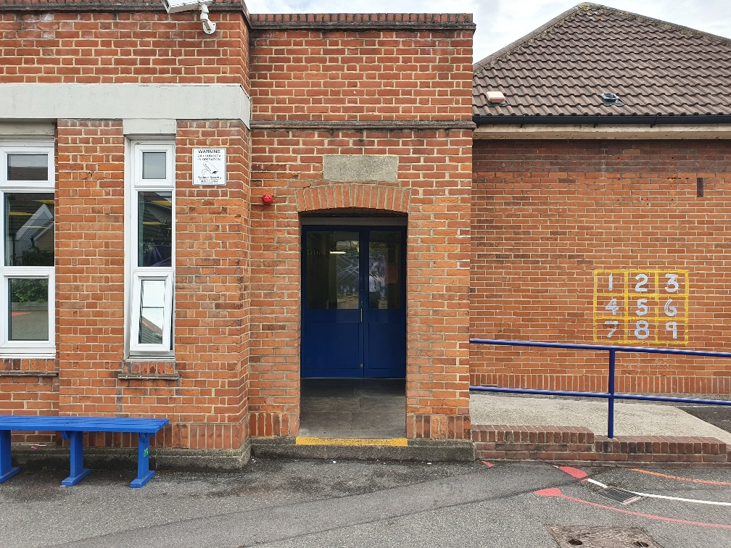
This is where the children enter the school between 8.40 and 8.55
Notes:
If you need to share any messages with your child’s class teacher, please speak to the person who is at the door. As teachers are in class, it is really difficult for them to leave their classes to come out to you.

Slide 4
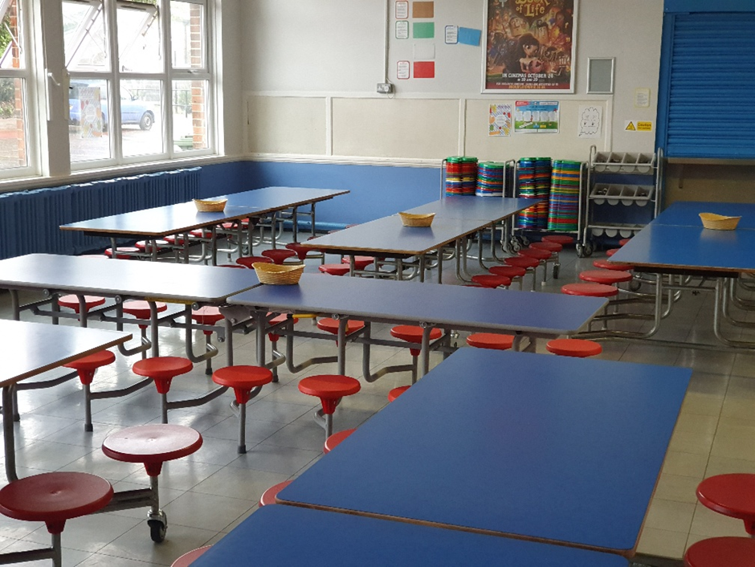
This is where the children eat lunch
Notes:
Lunchtime is at 12.15. The children in Year 3 will go straight into lunch.

Slide 5
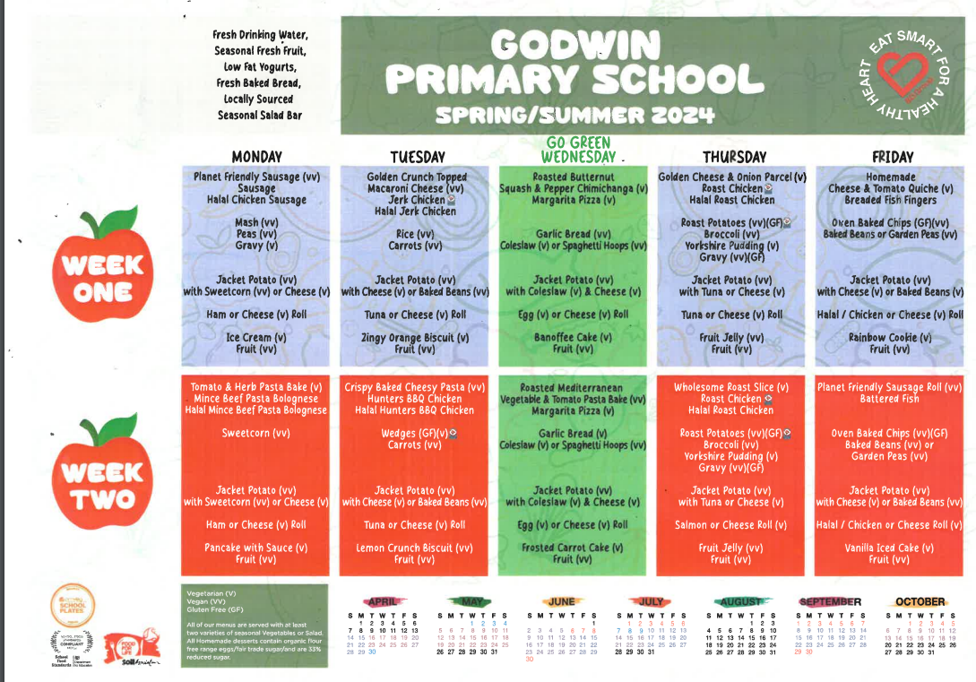
Lunch Menu https://www.godwinprimary.co.uk/school-meals/
Notes:
Throughout the PowerPoint, there are website links that will take you to referenced pages or documents. The PowerPoint can be downloaded from your child’s class page so you do not need to worry about taking notes.
You may wish to bare the menu in mind when planning evening meals.

Slide 6
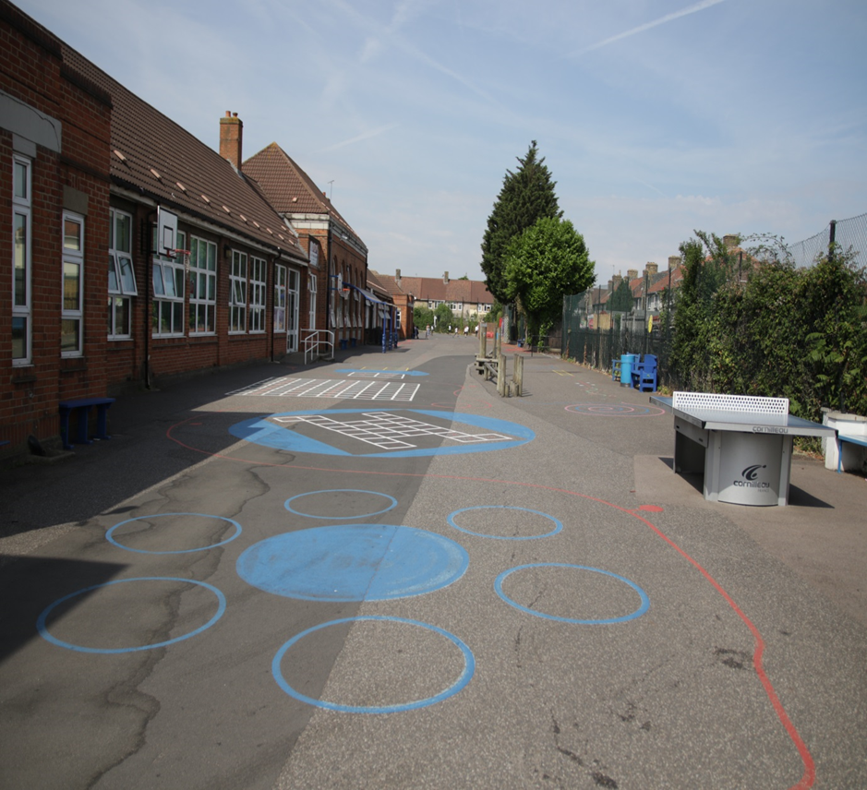


This is where the children play
Notes:
The children have a range of equipment including basketballs, table tennis equipment, hoops and skipping ropes. There are also markings in the playground for the children to use too. At morning play, they use the whole playground. At lunchtime, they stay within one half of the playground because other year groups beside Year 3 and 4 are outside too.

Slide 7
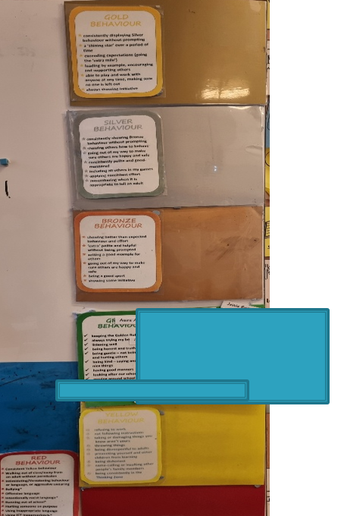
Stay
On
Green
Notes:
Stay on Green is the same as last year. Please praise your child for staying on green each day. Whenever a child finishes the day on green, bronze or gold, they earn points. Collectively, the class who earns the most amount of points within Year 3 and 4 get 30 minutes of ‘green time’ during the following week. The children help decide what this reward is. If a child can stay on green for each day during a half term, earn a badge. If they can stay on green throughout the year, they earn a badge shaped like an ‘owl’ too.

Slide 8
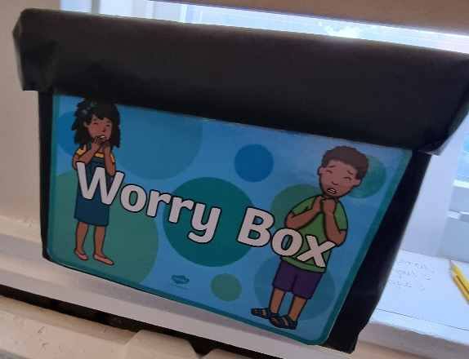
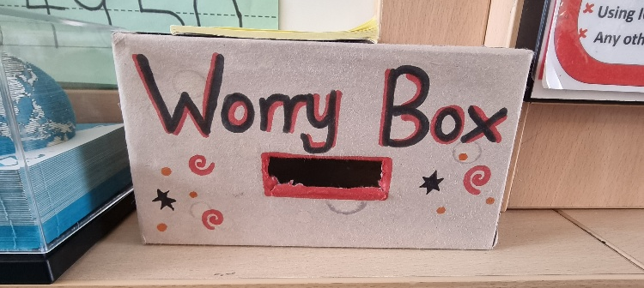
Worry Box
Notes:
A Worry Box is in each classroom. If your child is worried about something, they can speak to an adult. If they want to be more discreet, they can write their worry in the box. Adults check the class Worry Box every day.

Slide 9


Keeping Children Safe Online
A range of resources can be found in the link below:
https://www.godwinprimary.co.uk/online-safety-2/
We are planning to run some online safety parent workshops over the coming year so please keep an eye on the newsletter

Slide 10
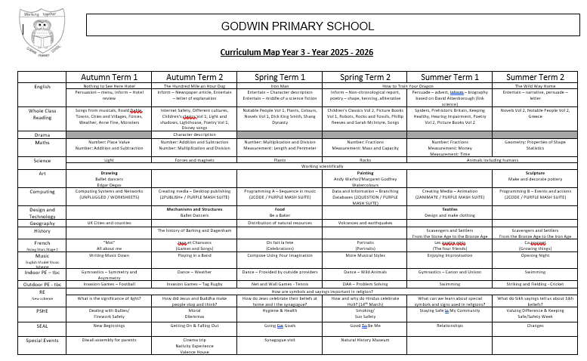
Click here to download it

Slide 11
Ongoing assessments
Children are assessed continually by adults
Assessments relating to the core subjects take place three times during the academic year

Slide 12
MTC
A formal test of multiplication skills takes place in the summer term of Year 4.
Primary-school children are expected to know all their times-tables up to 12x12.
Children will be tested using an on-screen check (on a computer or a tablet), where they will have to answer multiplication questions against the clock.
The test will last no longer than 5 minutes and is similar to other tests already used by primary schools.
Children will have 6 seconds to answer each question in a series of 25.
Guidance videos
Multiplication tables check: information video
https://youtu.be/nxjkqhaNAAI?si=FBp1npFqxj3eO3sG

Slide 13
What times tables are Year 3 learning?
We are learning the 2, 5, 10, 3, 4 and 8 times tables in Year 3.

Slide 14
Understanding times tables
https://www.youtube.com/watch?v=0UL4GFEevMcg
Notes:
It is really important that the children understand what times tables are. This video will hopefully help.

Slide 15
Download it here

Slide 16

Your child can practice via the TTR app or by visiting https://ttrockstars.com/)
Notes:
Your child’s username and password should be in the back of their reading record. If it is not, please ask your child to tell their teacher.

Slide 17
PE timetable
Year 3 PE day information is here: Year 3 | Godwin Primary School
Please ensure that: children have jogging bottoms, plimsoles/ trainers and an additional jumper (as the weather gets colder) if they wear studs, your child needs to remove them themselves or have them covered with medical tape

Slide 18
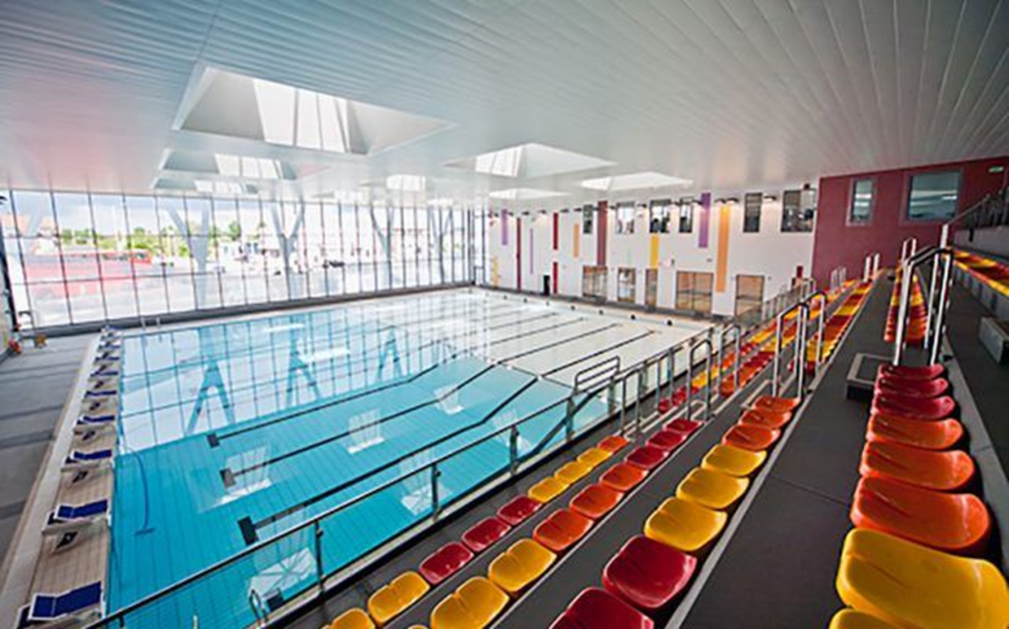
Swimming
Notes:
Year 3 go in the summer term (after Easter).

Slide 19
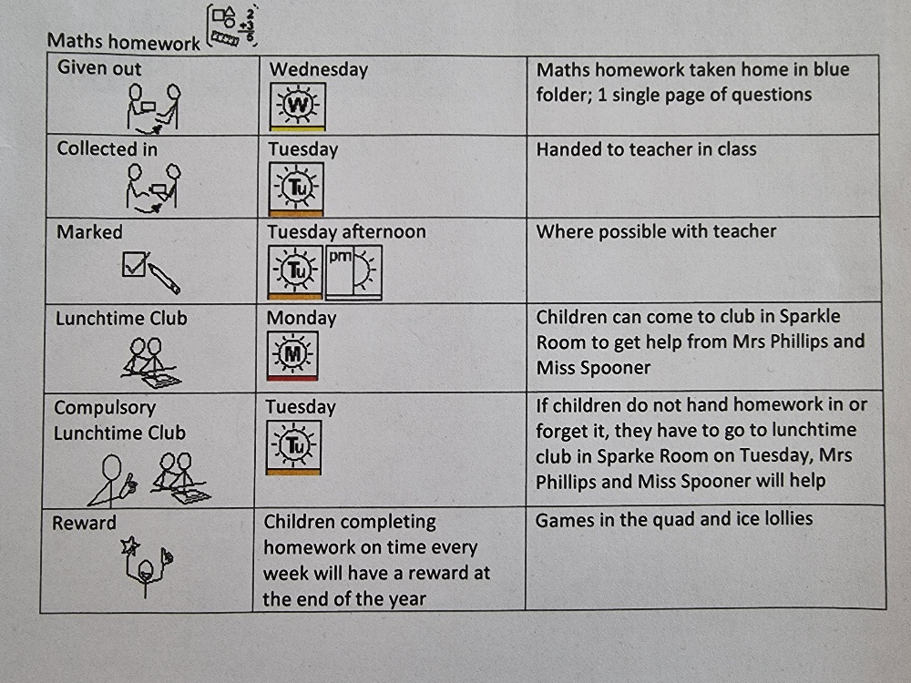
Notes:
Daily ready as well as CEW and times-tables practice
Optional writing at home

Slide 21
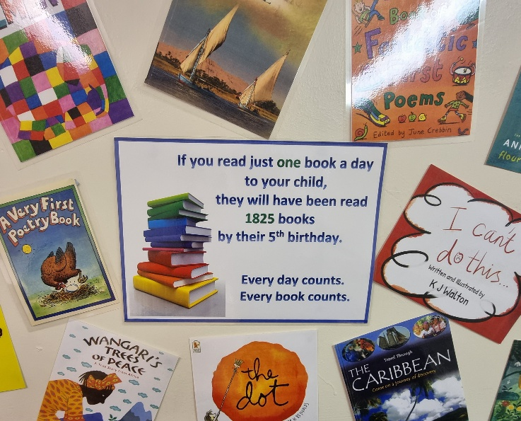

Slide 22


Slide 23
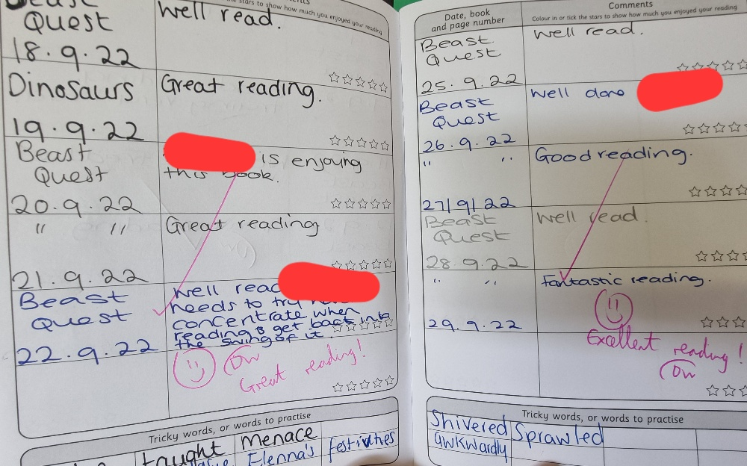
Example reading record
photo
Notes:
This what your child’s reading record could look like. Please aim for your child to read at least 5 times per week. You can sign their record each time they read.

Slide 24
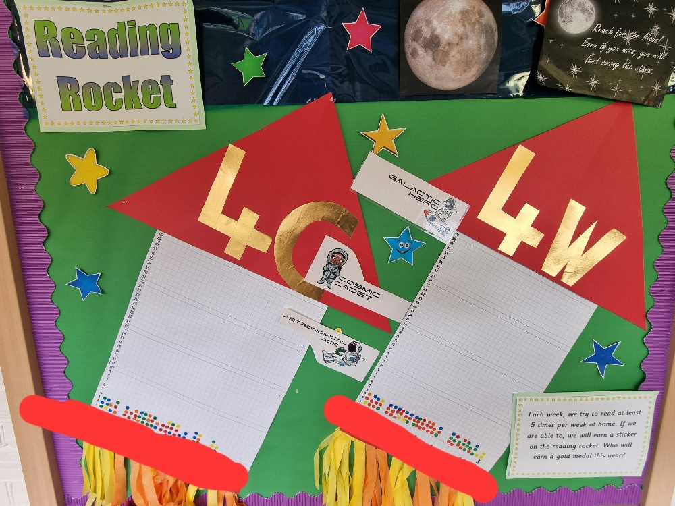
Notes:
Each week, the children earn a sticker for the 5 (or more) signatures that they have in their reading record. They can earn prizes for collecting 10, 20 and 30 stickers.

Slide 25
Question prompts
When your child reads with you, encourage them to look out for . ! ? , ( ) - in sentences and encourage them to read with expression and to think about their tone. It will help to develop their understanding.

Slide 26
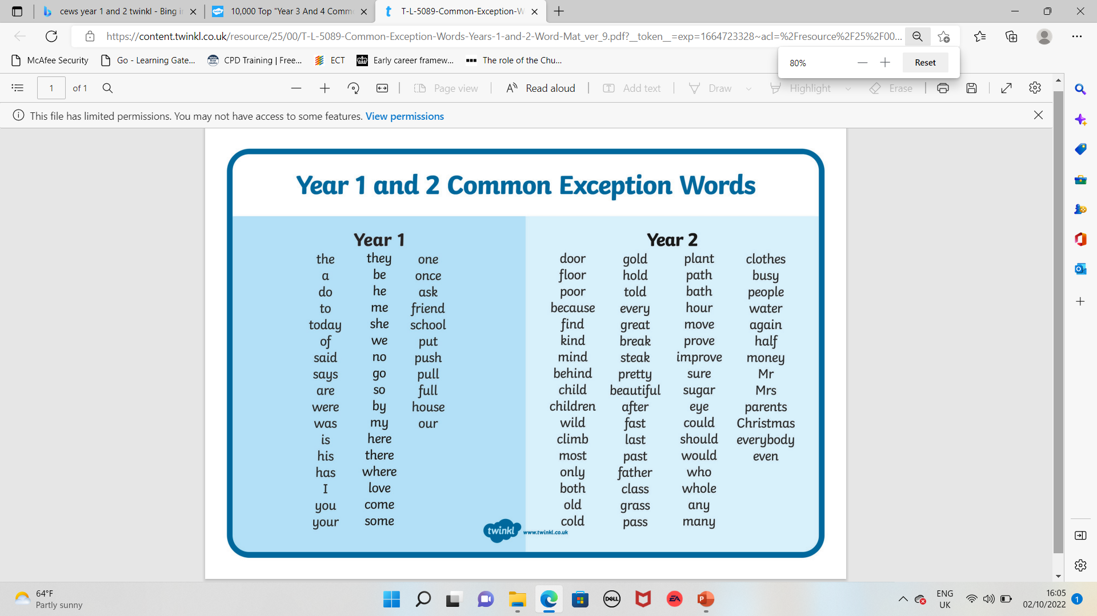
Click here to download the Year 1 and 2 list

Slide 27
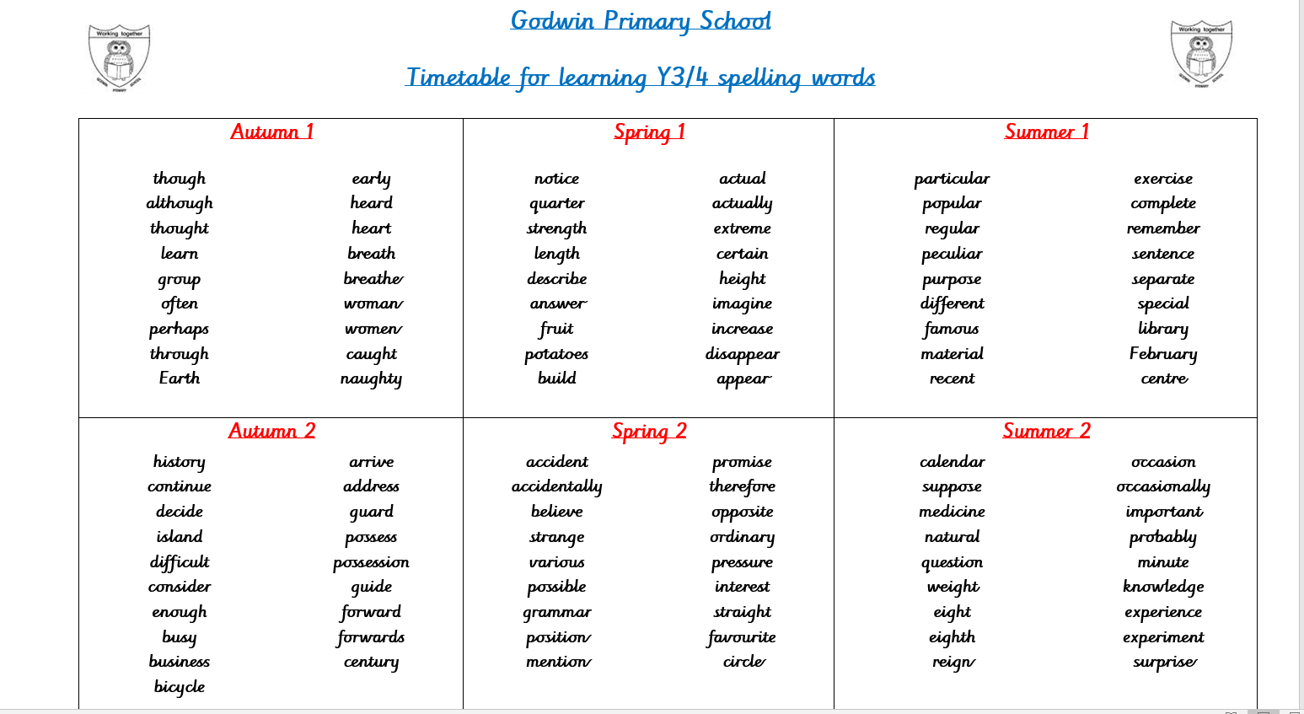
Click here to download the Year 3 and 4 list

Slide 28
So what are we doing?
Teaching and planning exciting ways of motivating your children
Making sure we keep an eye on expected standards so that we know if children are where they should be or are struggling
Extra support for children that need a little bit of help or those who may get higher – group work, Better reading partners, 1st class at Maths
Share whether we expect your child to meet the end of year standards, and what children need to do to get there, give children individual targets

Slide 29
So what can you do?
Make sure your children come to school for their Early Bird learning....on time, having had enough sleep and breakfast
Keep us informed of any problems
Support teachers with behaviour issues, asking children if they ‘stayed on Green’
Support children with homework – remind them about homework club etc.
Read, read, read!
Get children to school on time everyday
Practical learning from home
Practise spellings and spelling rules
Help learning the times-tables

Slide 30
And finally a plea....
Please please label your children’s clothing!

