Slide 1

Year Four Curriculum
3/10/25

Slide 2
Y4 Team
Teachers*:
Mr Galea
Mrs Wood
Support Staff:
Mrs Ryan (Mon-Wed)
Mrs Herd (Wed-Fri)
*parents’ consultations - 22/10/25

Slide 3
The National Curriculum
The national curriculum is a set of subjects and standards used by primary and secondary schools so children learn the same things.
It covers what subjects are taught and the standards children should reach in each subject.

Slide 4
The National Curriculum
English
maths
science
design and technology
history
geography
art and design
music
physical education (PE), including swimming
computing
relationship and health education
modern foreign languages
religious education
Plus:
PSHE & citizenship
sex education

Slide 5
Curriculum Map:
Home | Godwin Primary School

Slide 6
At Godwin Primary School we follow the National Curriculum. We plan from this, ensuring we develop a curriculum that:
…has reading at its heart - so that every child leaves us as a fluent reader, readily able to access the next stage of their learning…

Slide 7





Slide 8
Whole Class Texts
Read to daily – whole class texts as well as dedicated reading lessons.
Chosen with diversity and breadth of reading experience in mind.
Texts also act as broad themes for other English work e.g. grammar and writing.

Slide 9
Reading Skills
Decode words they are having difficulty with.
Work out the meaning of unfamiliar words.
Check they have understood what they have read.
Predict what will happen.
Summarise what their reading was about.
Discuss particular words chosen by the author.

Slide 10
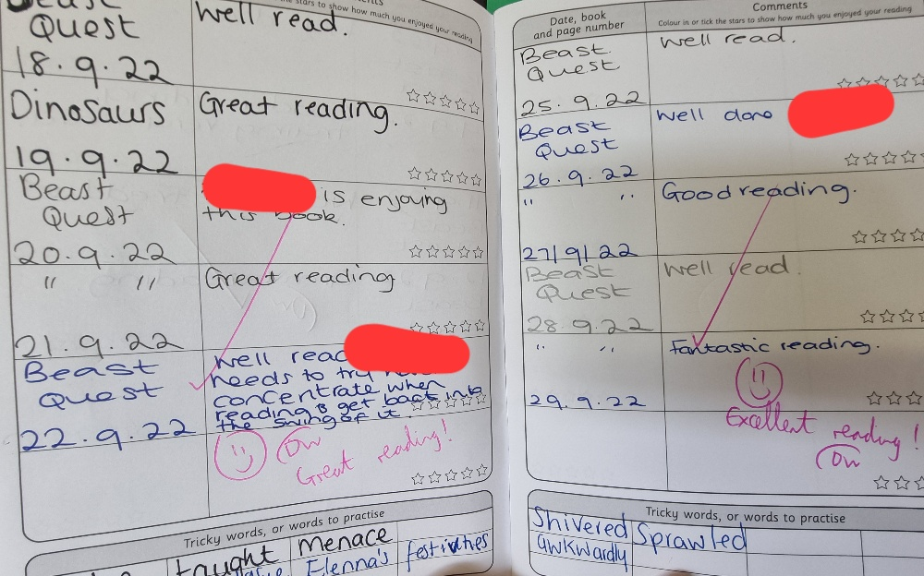
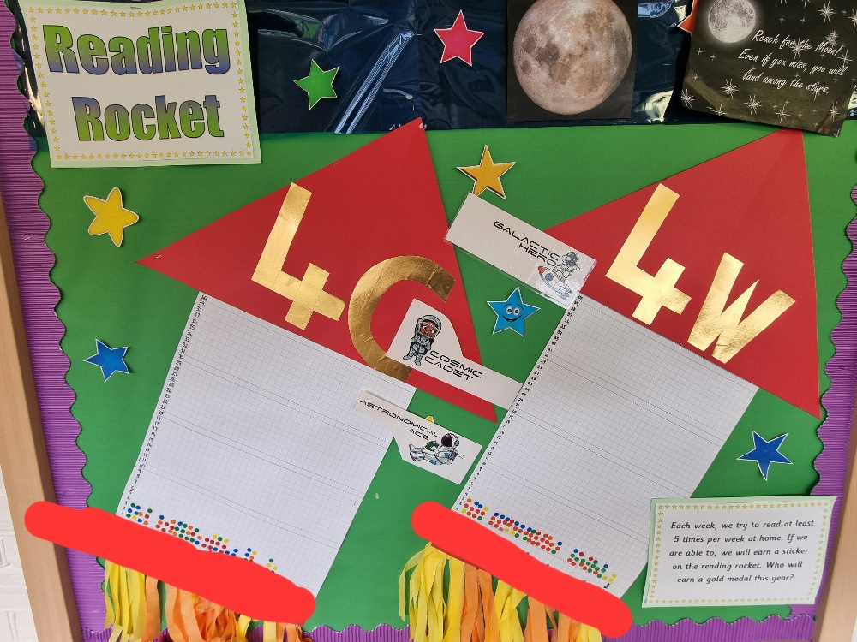
Reading at Home
Read AT LEAST five times a week to an adult.
Reading Records due each Friday – signatures needed.
Personal reading books chosen and changed in school.
Sticker on Reading Rocket.

Slide 11
Reading at Home
The Library – it’s free!
Centre for Literacy in Primary Education (CLPE) Corebooks
Waterstone’s Children’s Book Prize
Shops: Waterstone’s, WHS Smith, The Works, Asda
The internet (child-friendly sites)
First News and The Week Junior

Slide 12
Reading at Home
Enjoy Reading!
Read to self – daily for pleasure.
Read in different places/a special place.
Read a wide range of poetry, plays, fiction, non-fiction, graphic novels, websites, different genre, textbooks, newspapers.
Have opinions about books and authors.
Read about topics in the news and discuss them.
Adults as a role model for reading.

Slide 13
…develops children’s vocabulary and equips them with skills to reduce social disadvantage…

Slide 14
Writing At School
Lightning Girl: diary, persuasive leaflet
Who Let The Gods Out?: recount, poem, character description, report
Varjak Paw: story, persuasive letter, newspaper report
Harry Potter: narrative, biography, letter

Slide 15
Writing At Home
Y3/4 Spellings
Weekly homework sheets (linked to spelling)
Writing for fun – diaries, competitions, stories, playscripts, explanation texts, blogs, websites…

Slide 16
Multiplication Tables Check
Formal testing: summer term of Year 4.
Primary-school children are expected to know all their times-tables up to 12x12.
Children will be tested using an on-screen check (on a computer or a tablet), where they will have to answer multiplication questions against the clock.
The test will last no longer than 5 minutes and is similar to other tests already used by primary schools.
Children will have 6 seconds to answer each question in a series of 25.

Slide 17

Your child can practice via the TTR app or by visiting https://ttrockstars.com/)

Slide 18
Homework In Y4
Spelling
Maths
Goes out on Wednesday
Due in on the following Tuesday
Optional Homework Club on Monday lunchtime
Compulsory Homework Club on Tuesday lunchtime

Slide 19
…is based on our Godwin Values as well as our ethos of working together and nurture, to promote positive emotional and physical health…

Slide 20
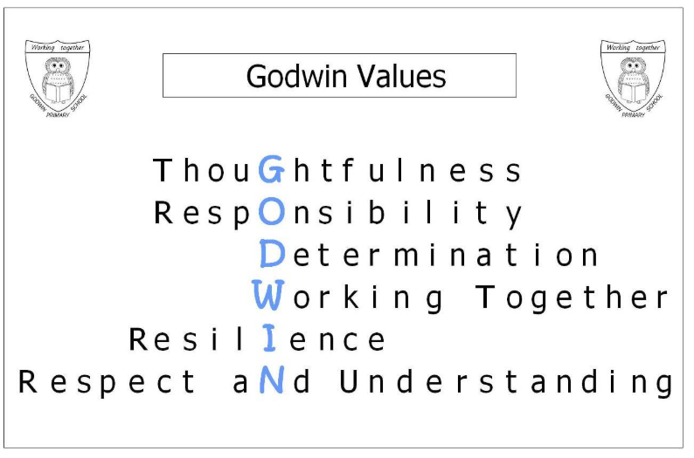

Slide 21
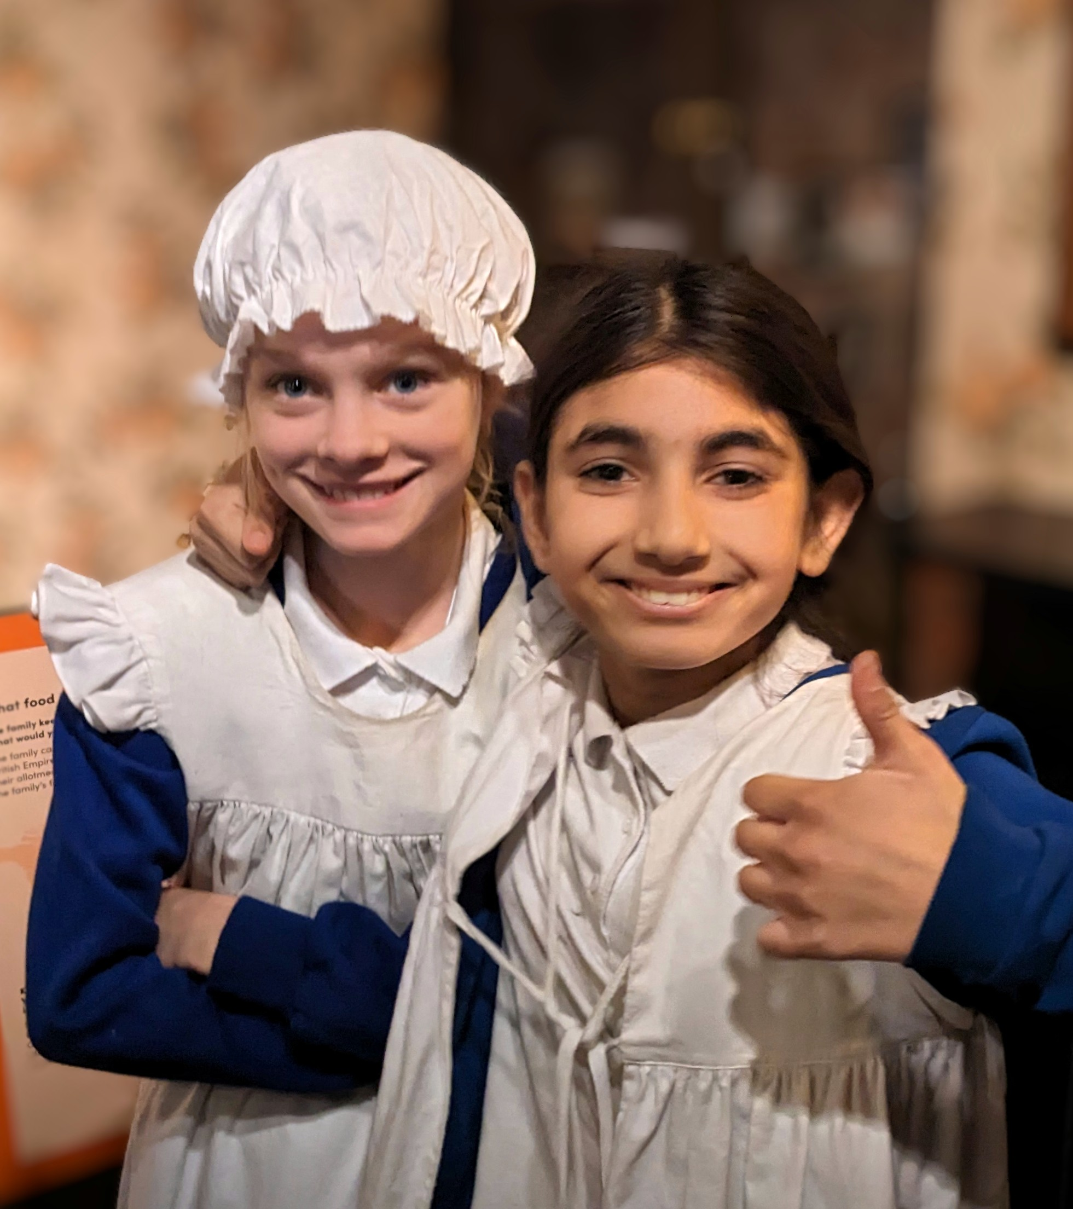

Slide 22
… provides experiences and opportunities that broaden children’s cultural capital and support the mindset that they can achieve anything, in order to encourage ambition and academic aspiration.

Slide 23
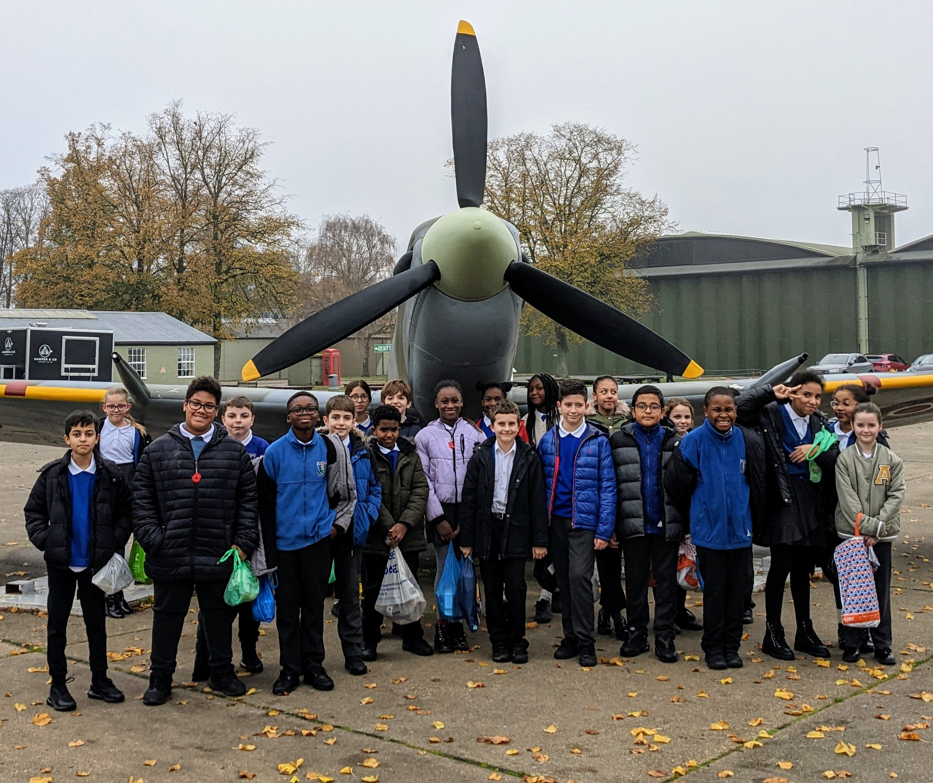
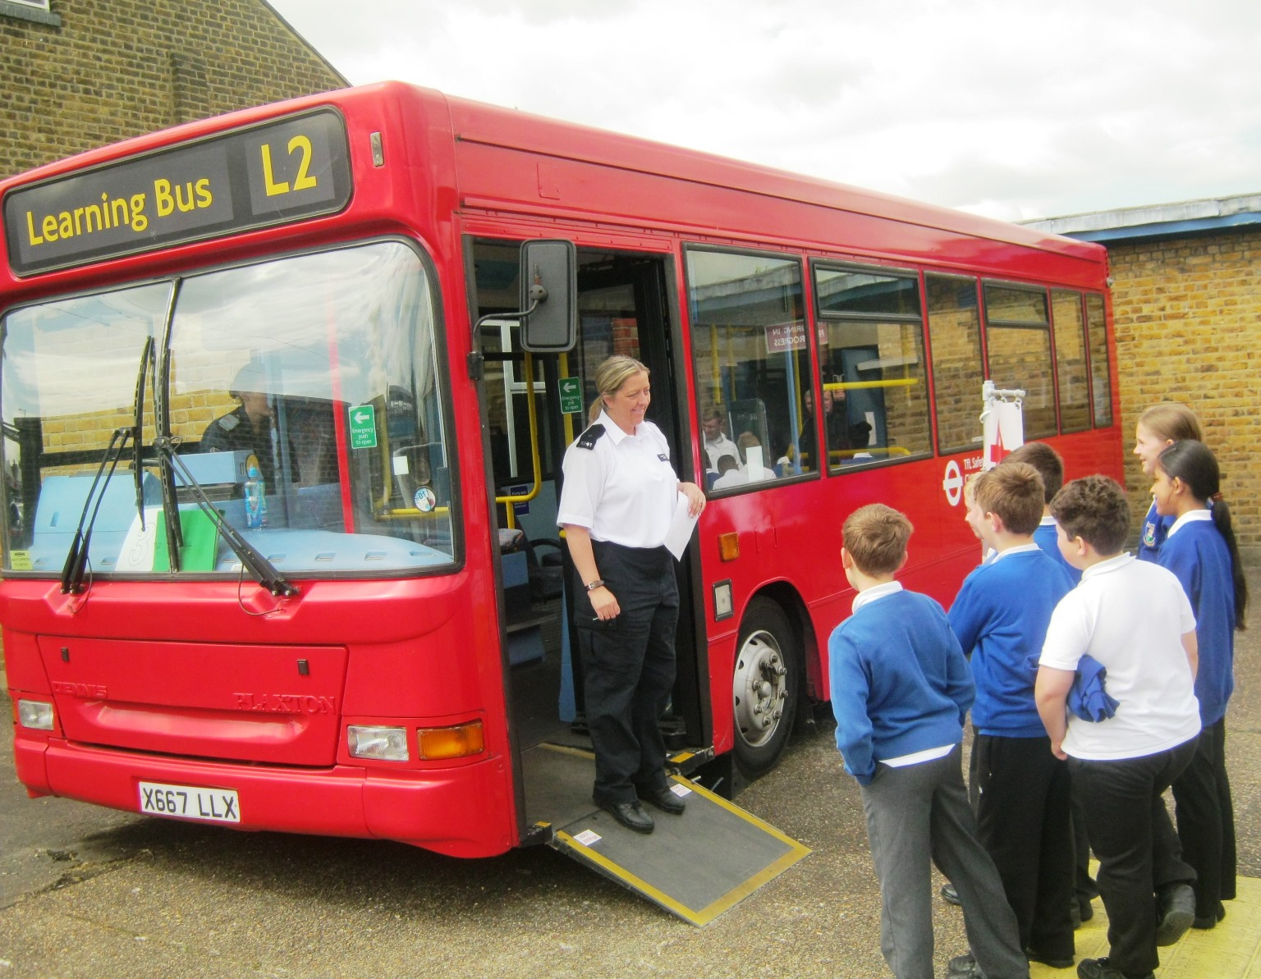
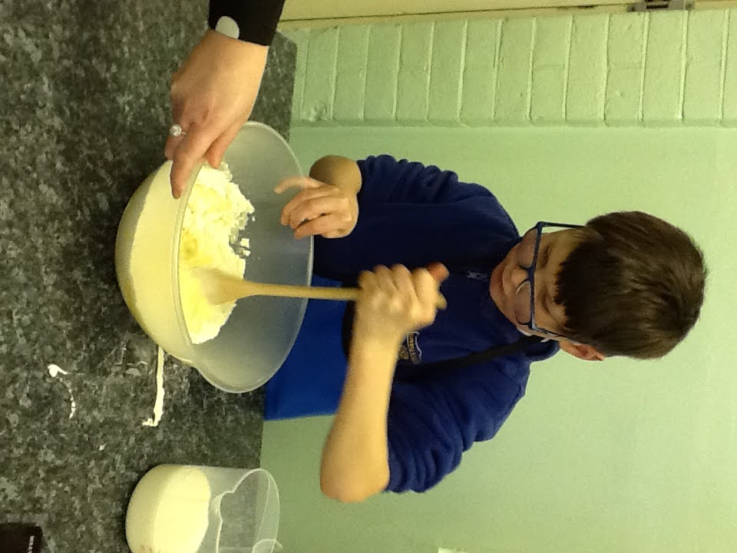
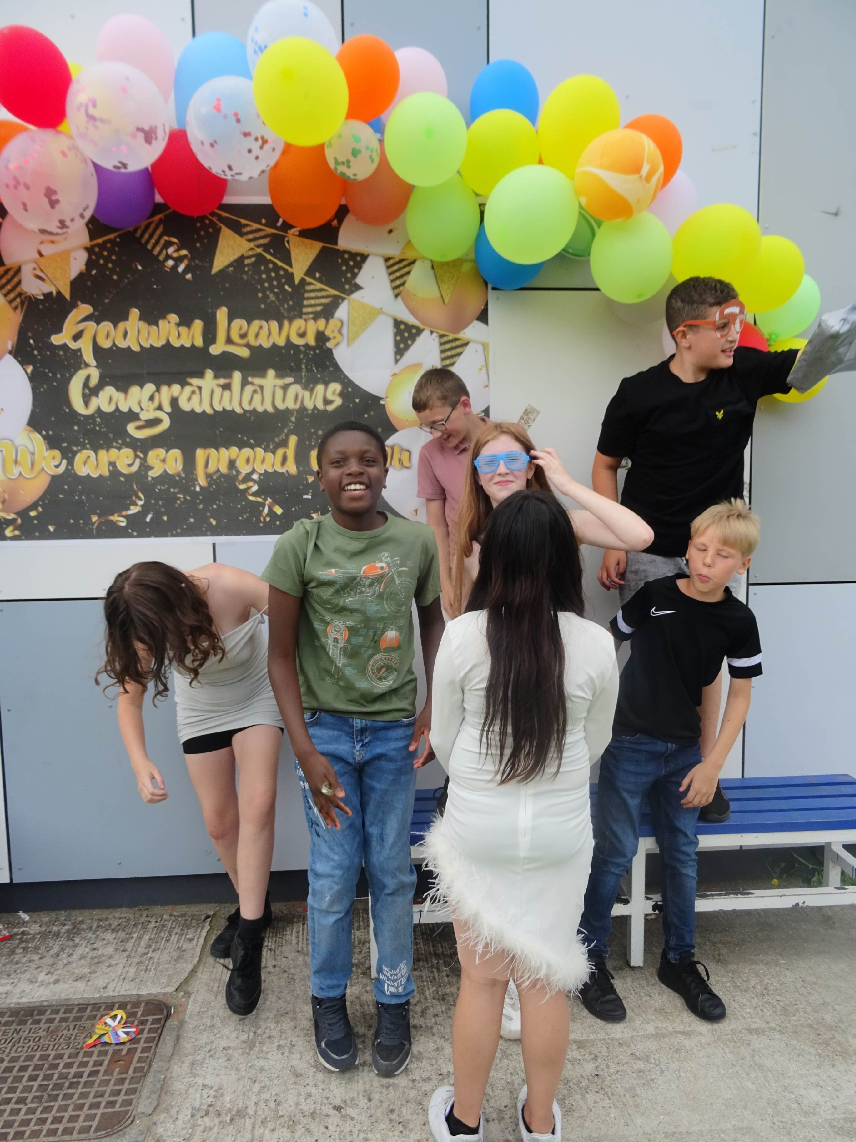
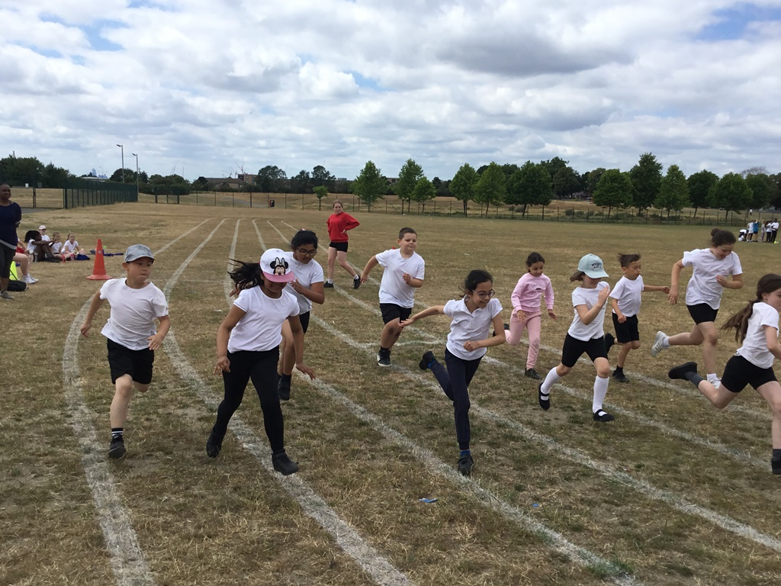
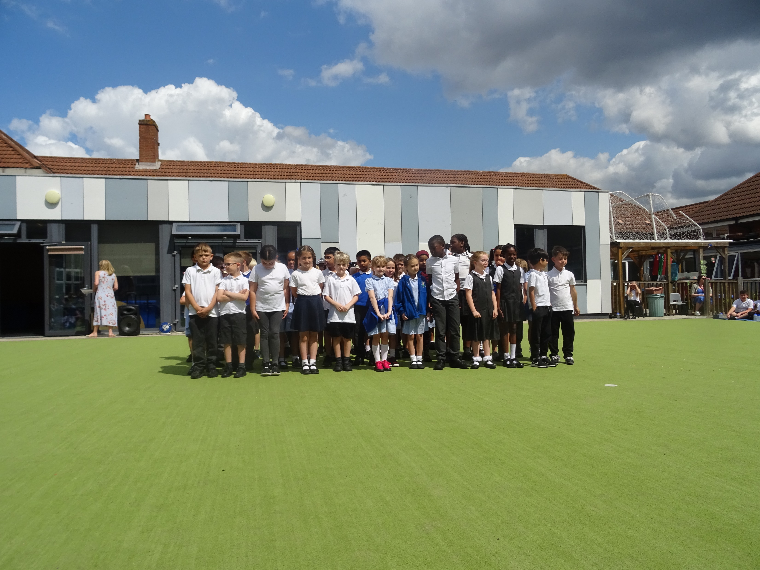
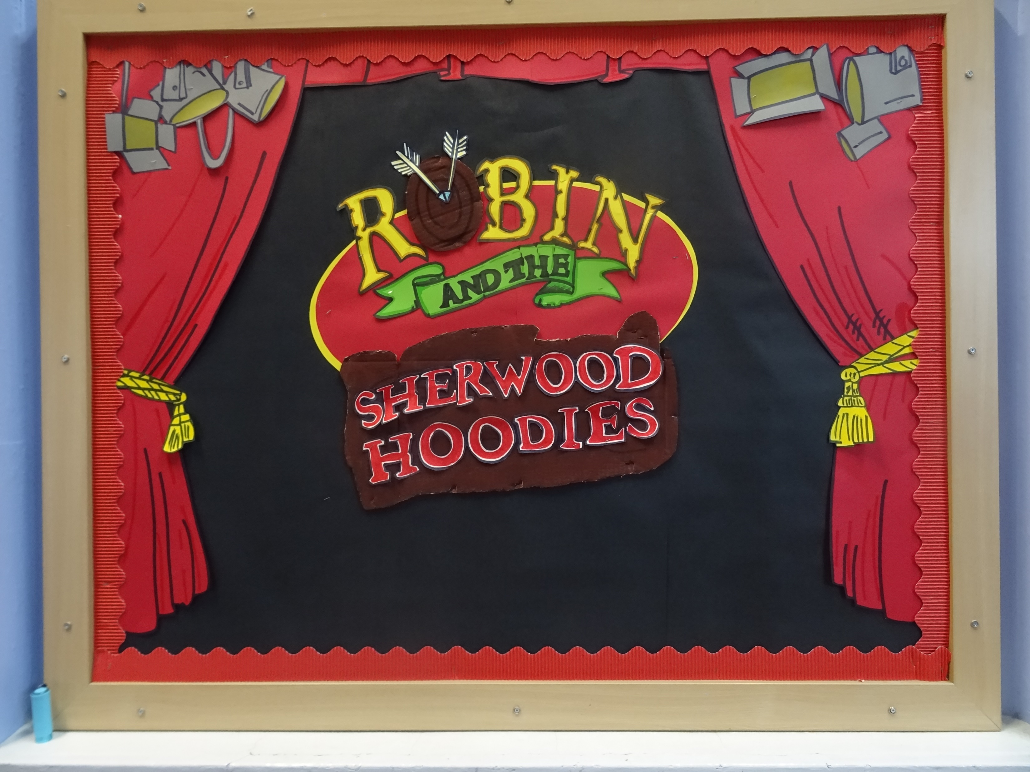
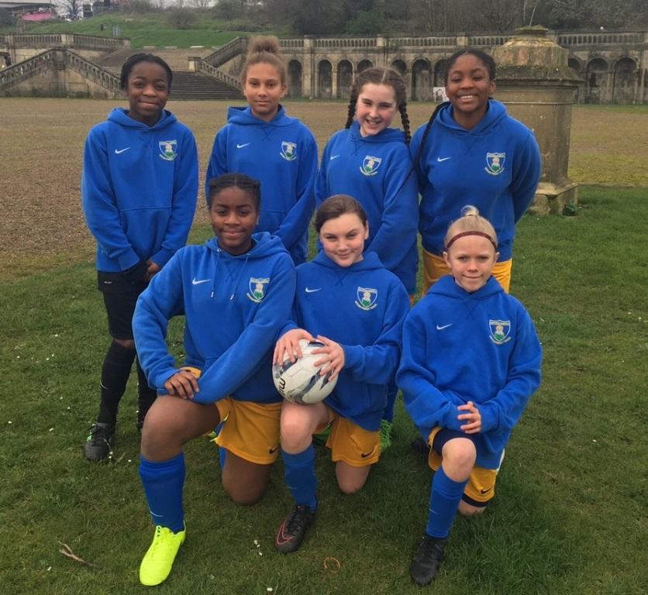
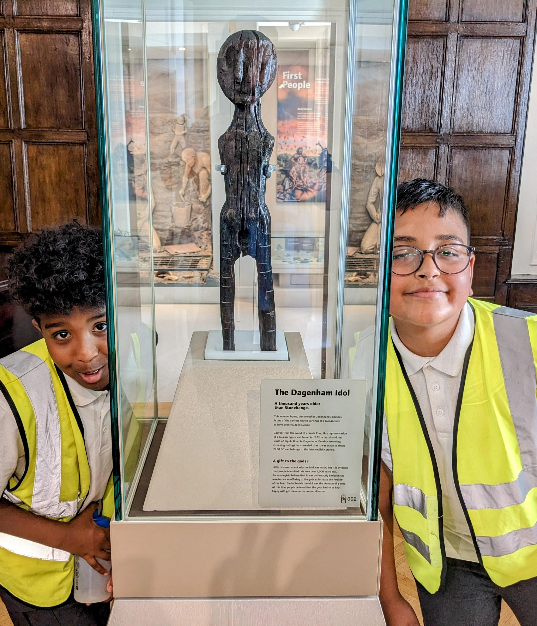
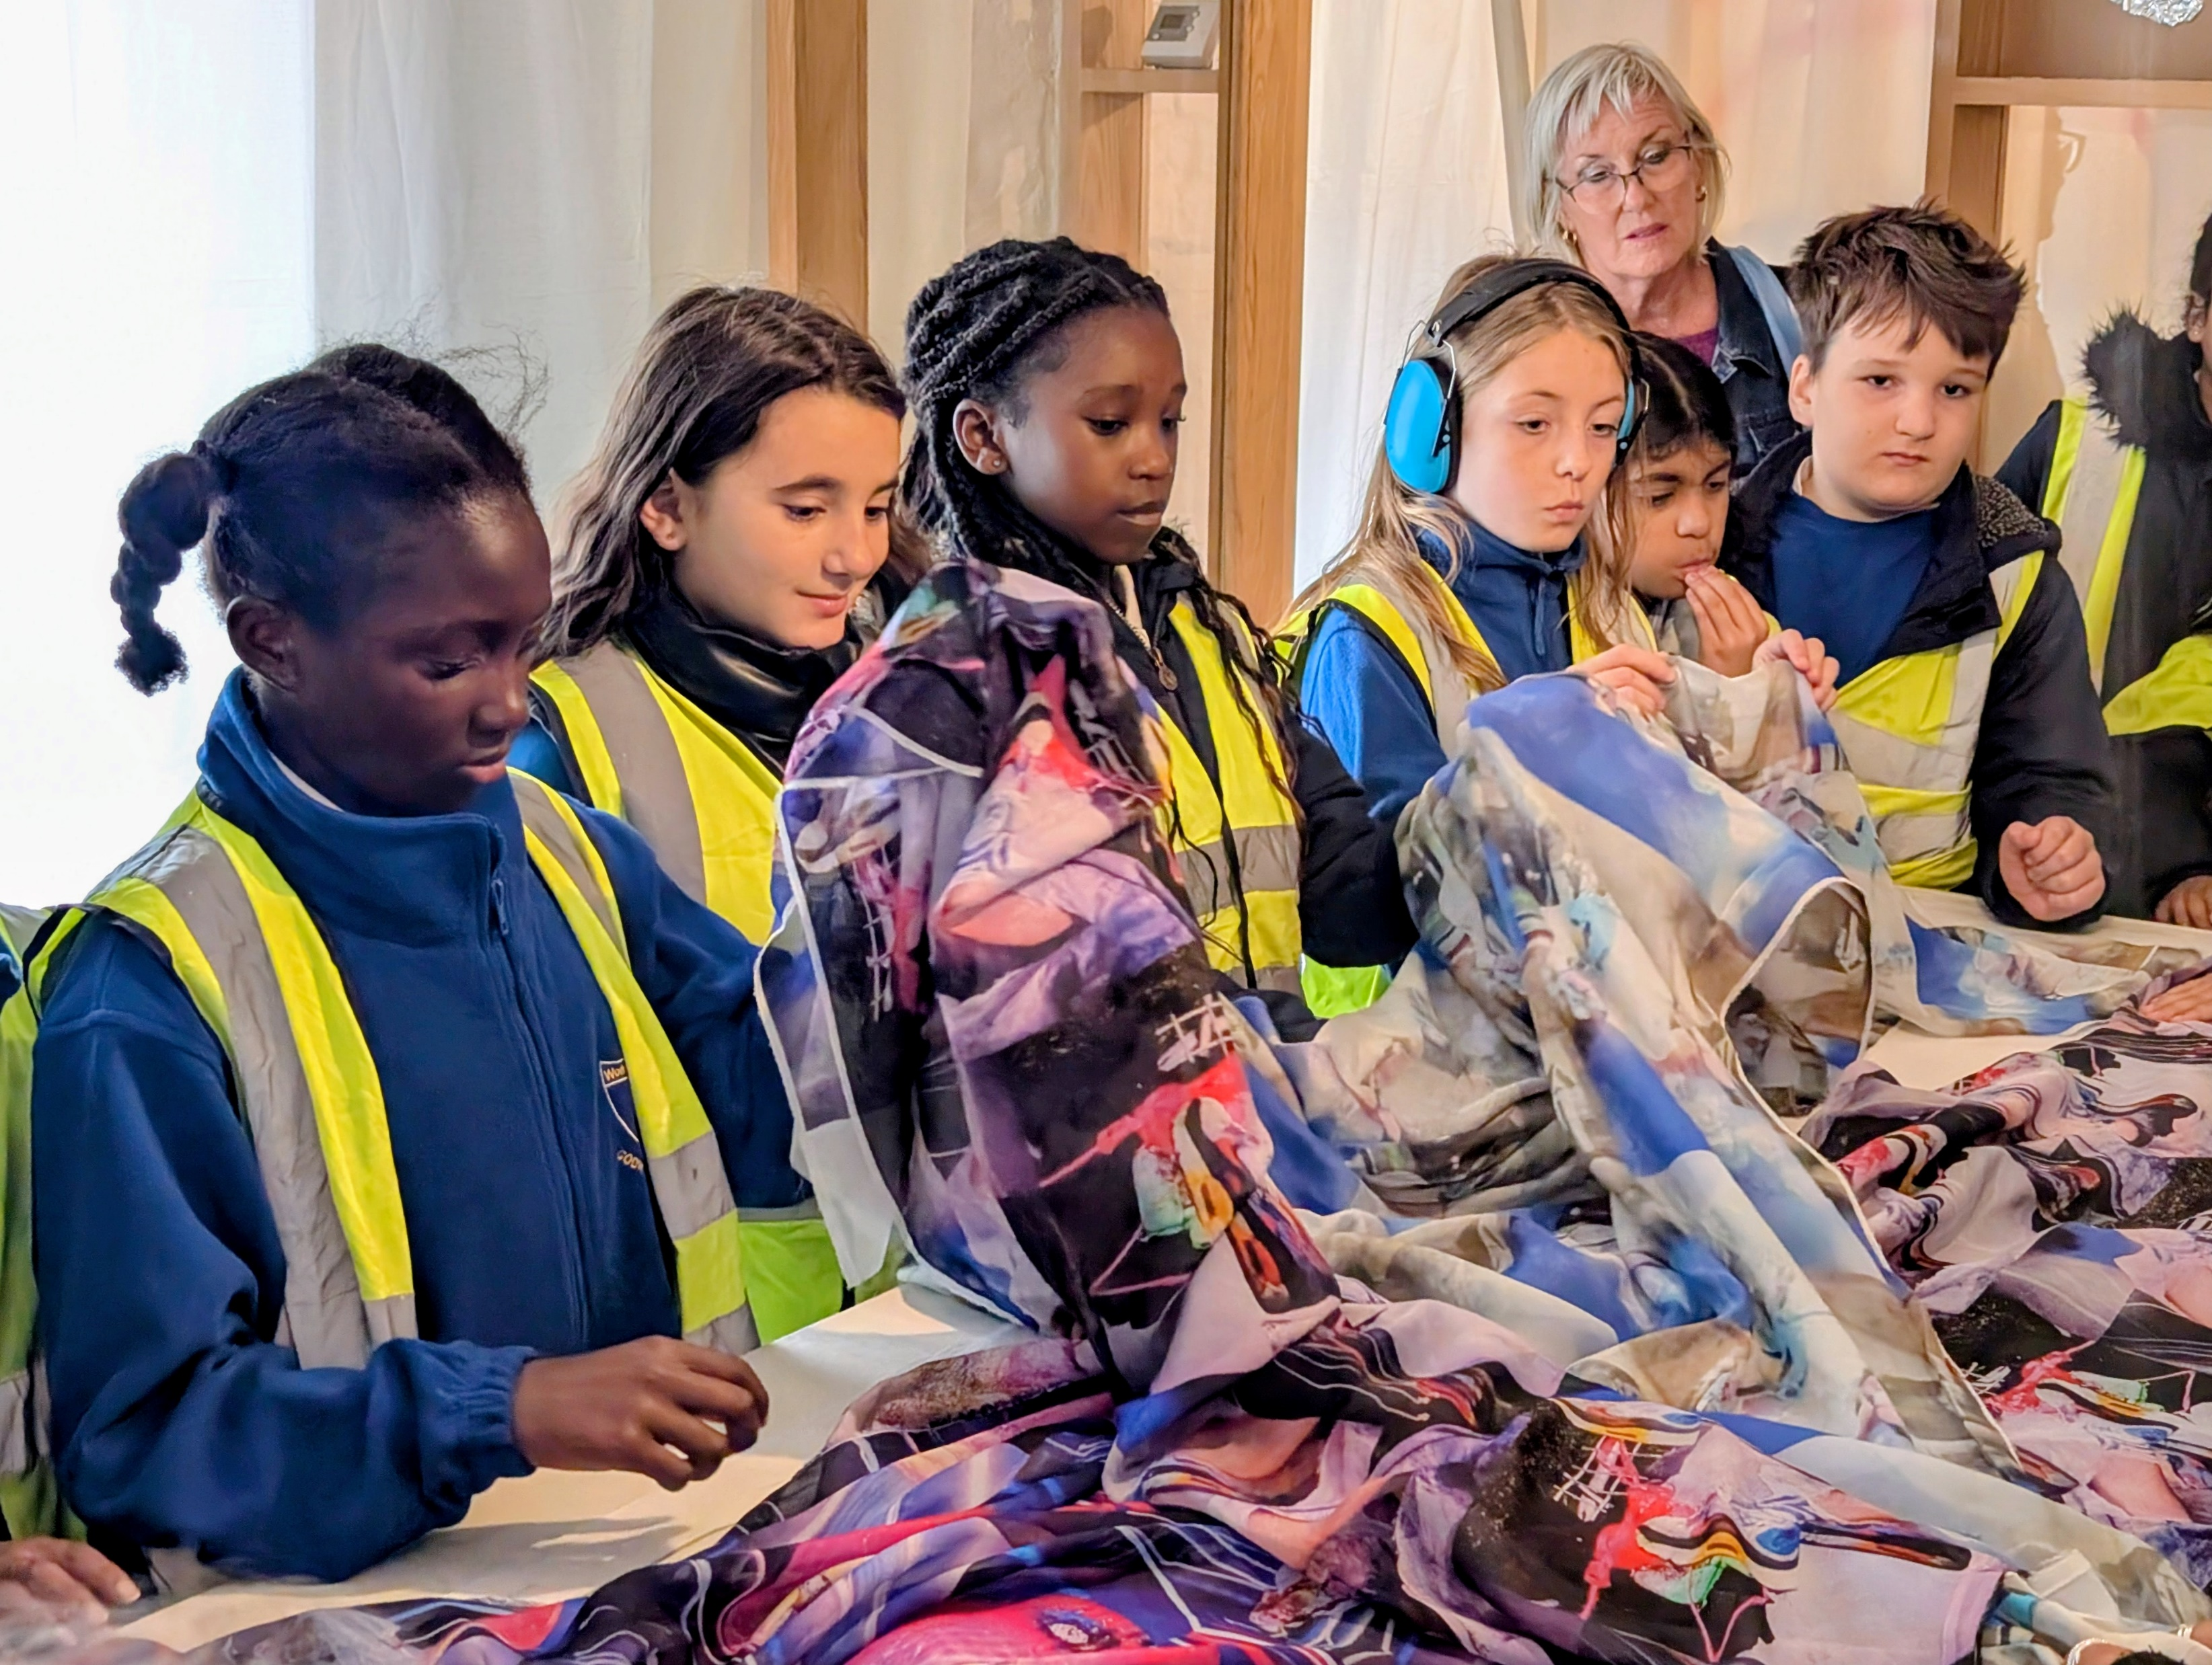

Slide 24
Trips:
Swimming – Spring term
16th October – Hindu Temple
19th November – Cinema
10th December – St Alban’s Church
TBC – Panto, City Hall, British Museum

Slide 25


