Slide 1


Reception
Parents Meeting

Slide 2
Our curriculum:
Early Years Foundation Stage (EYFS)
Children learn through 7 areas:
Communication and Language: Talking and listening Personal, Social and Emotional Development: Making friends and managing feelings Physical Development: small and large movement Literacy: Reading, writing and understanding Maths: numbers and patterns Understanding of the World: nature, culture and the past Expressive Art and Design: art, music and imagination
At the end of the year the children are assessed to see if they have met the Early Learning Goals

Slide 3
Communication and language
What children will learn
To listen carefully To follow instructions To answer and ask questions To speak confidently in sentences
What you can do to help
Chat about their day Read stories together Introduce new words Encourage full-sentence answers

Slide 4
Personal, Social and Emotional Development
What children will learn
To be more independent To recognise and talk about feelings To follow rules and routines To take turns and share To make friends and work together To make healthy choices such as food and exercise
What you can do to help​
Talk about feelings ​Set clear rules at home Play games that teach turn-taking Encourage your child to dress independently, including zipping coats Ensure they can use cutlery and eat on their own

Slide 5
Physical Development
What children will learn
To improve pencil control To use scissors safely To develop strength and coordination To enjoy physical activity
What you can do to help​
Practise cutting with scissors, drawing, and painting. Visit parks for climbing activities. Build with Duplo, Lego, or similar toys. Try practical tasks like pegging washing or washing up with a sponge.

Slide 6
Literacy
What children will learn​
Phonics sounds Reading simple words and sentences Understanding stories Writing letters, words and sentences
What you can do to help​
​Help your child recognise and write their name, then move on to other letters. Read together at least five times a week. Practise sounds and words sent home. Ask questions about stories you read to check your child understands.

Slide 7
Mathematics
What children will learn
​Children will explore numbers to 10, including 1 more/less, doubling, halving, adding, and subtracting. They’ll also learn number bonds and subtraction facts for 5 and some for 10. ​Children will compare quantities to 10, practise equal sharing, and begin recognising odd and even numbers.
What you can do to help​
Help your child recognise and order numbers 0–10. Create repeating patterns with objects. Practise accurate counting and simple addition/subtraction. Encourage fair sharing during mealtimes.

Slide 8
Understanding of the World
What children will learn
Learn about the past through topic work and stories, comparing part of our lives with how things were in the past. ​Looking at differences and similarities between different environments and countries. Celebrating festivals and religious events. ​Learning about farm animals, minibeasts and wild animals. Growing flowers and vegetables. Learning about lifecycles.
What you can do to help​
Talk about your childhood and compare it to your child’s life. Point out local features and discuss festivals you celebrate. Visit places like farms or zoos, look for minibeasts, and grow plants together.

Slide 9
Expressive Arts and Design
What children will learn
​Painting, observational drawing, junk modelling etc. Using skills such as drawing, using scissors and joining materials. ​Singing songs and rhymes. Providing role play and imaginative play opportunities. Acting out stories.
What you can do to help​
​Craft and drawing activities. Play imaginatively with your child with toys and props. Singing songs. Making music. Dancing.

Slide 10
Our topics and key texts
Topics and festivals | Key texts
All about me Autumn Harvest Diwali Guy Fawkes night Remembrance Christmas Winter People who help us Chinese New Year Easter Eid Growing Farm animals Minibeasts Summer Seaside Superheroes Wild animals | Boggity Bog The Three Billy Goats Gruff The Little Red Hen The Hungry Giant Once there were Giants Dear Santa One Snowy Night After the Storm The Rescue Party Mrs Wishy Washy Wishy Washy Day Mud Walk Meanies Meanies came to school The Toymaker The Gruffalo Lucy and Tom at the Seaside

Slide 11
How we assess whether children have achieved the Early Learning Goal
Through observation- playing with the children, watching them and listening to them in both child-led and adult-led activities.
Collecting examples of work that reflect the children’s progress.
Floor books- working with groups of children to record their learning in a class book. We will be encouraging children to reflect on what they have learnt to see if they have retained the vocabulary and teaching.

Slide 12
Our Routine
Lessons | Purpose
Read, Write Inc. (RWI) | Learning to read and write daily
Mathematics | Daily number learning, anew concept is taught each week
Discovery time | Exploring topics and literacy, often including a focus book
PE | Physical development- taught mainly in the hall once a week
Circle time | Feelings, friendships and wellbeing. Festivals and religion is also explored
Music | Singing, rhythm and movement
In order for the children to be able to achieve the Early Learning Goals they need to have a routine that will support them to feel settled and confident.

Slide 13
Other important parts of the day
Indoor learning and play
Outdoor Classroom
Assembly
Lunch and playground​
Story time

Slide 14
A typical day
Registration
Read, Write Inc
Work and play
Mathematics
Lunchtime
Discovery time
Work and play
Story time
Home time

Slide 15
Read, Write, Inc (RWI)
Every day children take part in phonics lessons to learn sounds, read words and begin writing.
Homework helps to reinforce learning.
Children are assessed after learning Set 1 sounds and grouped by ability.
For support, speak to your child’s teacher.
Terms used | Definition
Fred Talk | Segmenting the sounds in a word and then blending them to read e.g. c-a-t, cat
Fred Fingers | Segmenting a word using your fingers in order to spell it

Slide 16
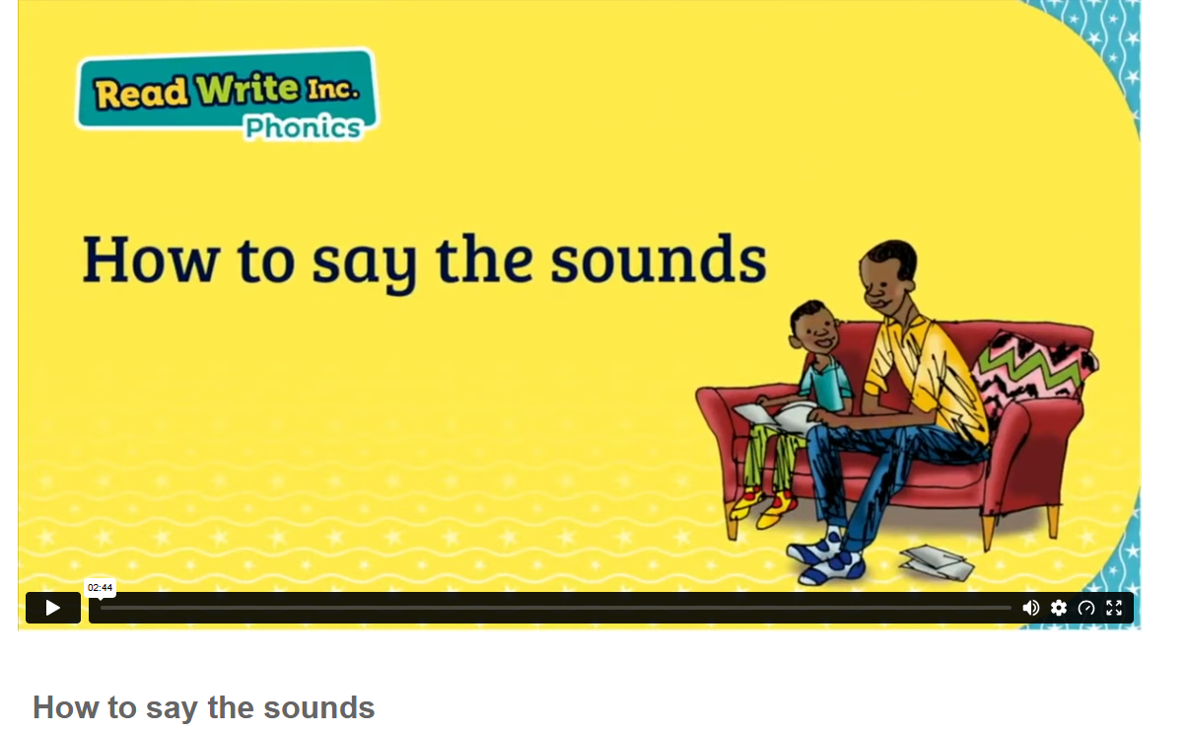
How to say the sounds
https://schools.ruthmiskin.com/training/view/CCC3DCuc/Enjxz5Ru
If you are unsure how sounds are pronounced, watch the video the Reception class page. It's also helpful for your child to watch.

Slide 17
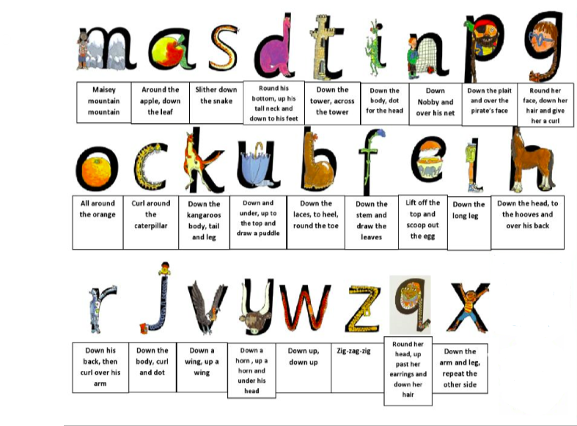
Supporting handwriting at home
We teach letter formation using a picture and rhyme.
Encourage your child to say the rhyme as they write.
Please remember that only the first letter of their name should be a capital letter (e.g., 'Thomas').

Slide 18
Reading at home with your child
Each week your child will receive a reading book to take home.
Write the name of the book in their reading record.
Read at least 5 times a week.
5 signatures on Friday = a sticker on the class reading rocket, 10 stickers on the reading record = a prize.
Reading records and reading books need to be in school every day. Please look after the book sent home.

Slide 19
What your child will need for school
What Your Child Needs
Book bag every day Wellies in school to use in the digging area Coat every day- teach them to put it on by themselves and do it up Named PE kit- black shorts/joggers, white t’shirt and trainers/plimsols Long hair tied back and earring taken out for PE

Slide 20

Attendance and punctuality- Every day matters!
Good attendance and arriving on time help children feel settled and avoid missing important learning.
Please contact school if your child is absent.
The Red Room door is open between 8:40–8:50 for arrival. Late arrivals must go to the office for registration and lunch selection.
School ends at 3:20—please be on time. Late children will wait at the front of the school. Let us know if someone else is collecting your child.

Slide 21
What to do if you have a question or concern
Check the Reception page on the website.
Speak to your child's teacher.

Slide 22

Keeping Children Safe Online
A range of resources can be found in the link below:
https://www.godwinprimary.co.uk/online-safety-2/
We are planning to run some online safety workshops over the coming year so please keep an eye on the newsletter

