Slide 1


Nursery Parents Meeting

Slide 2
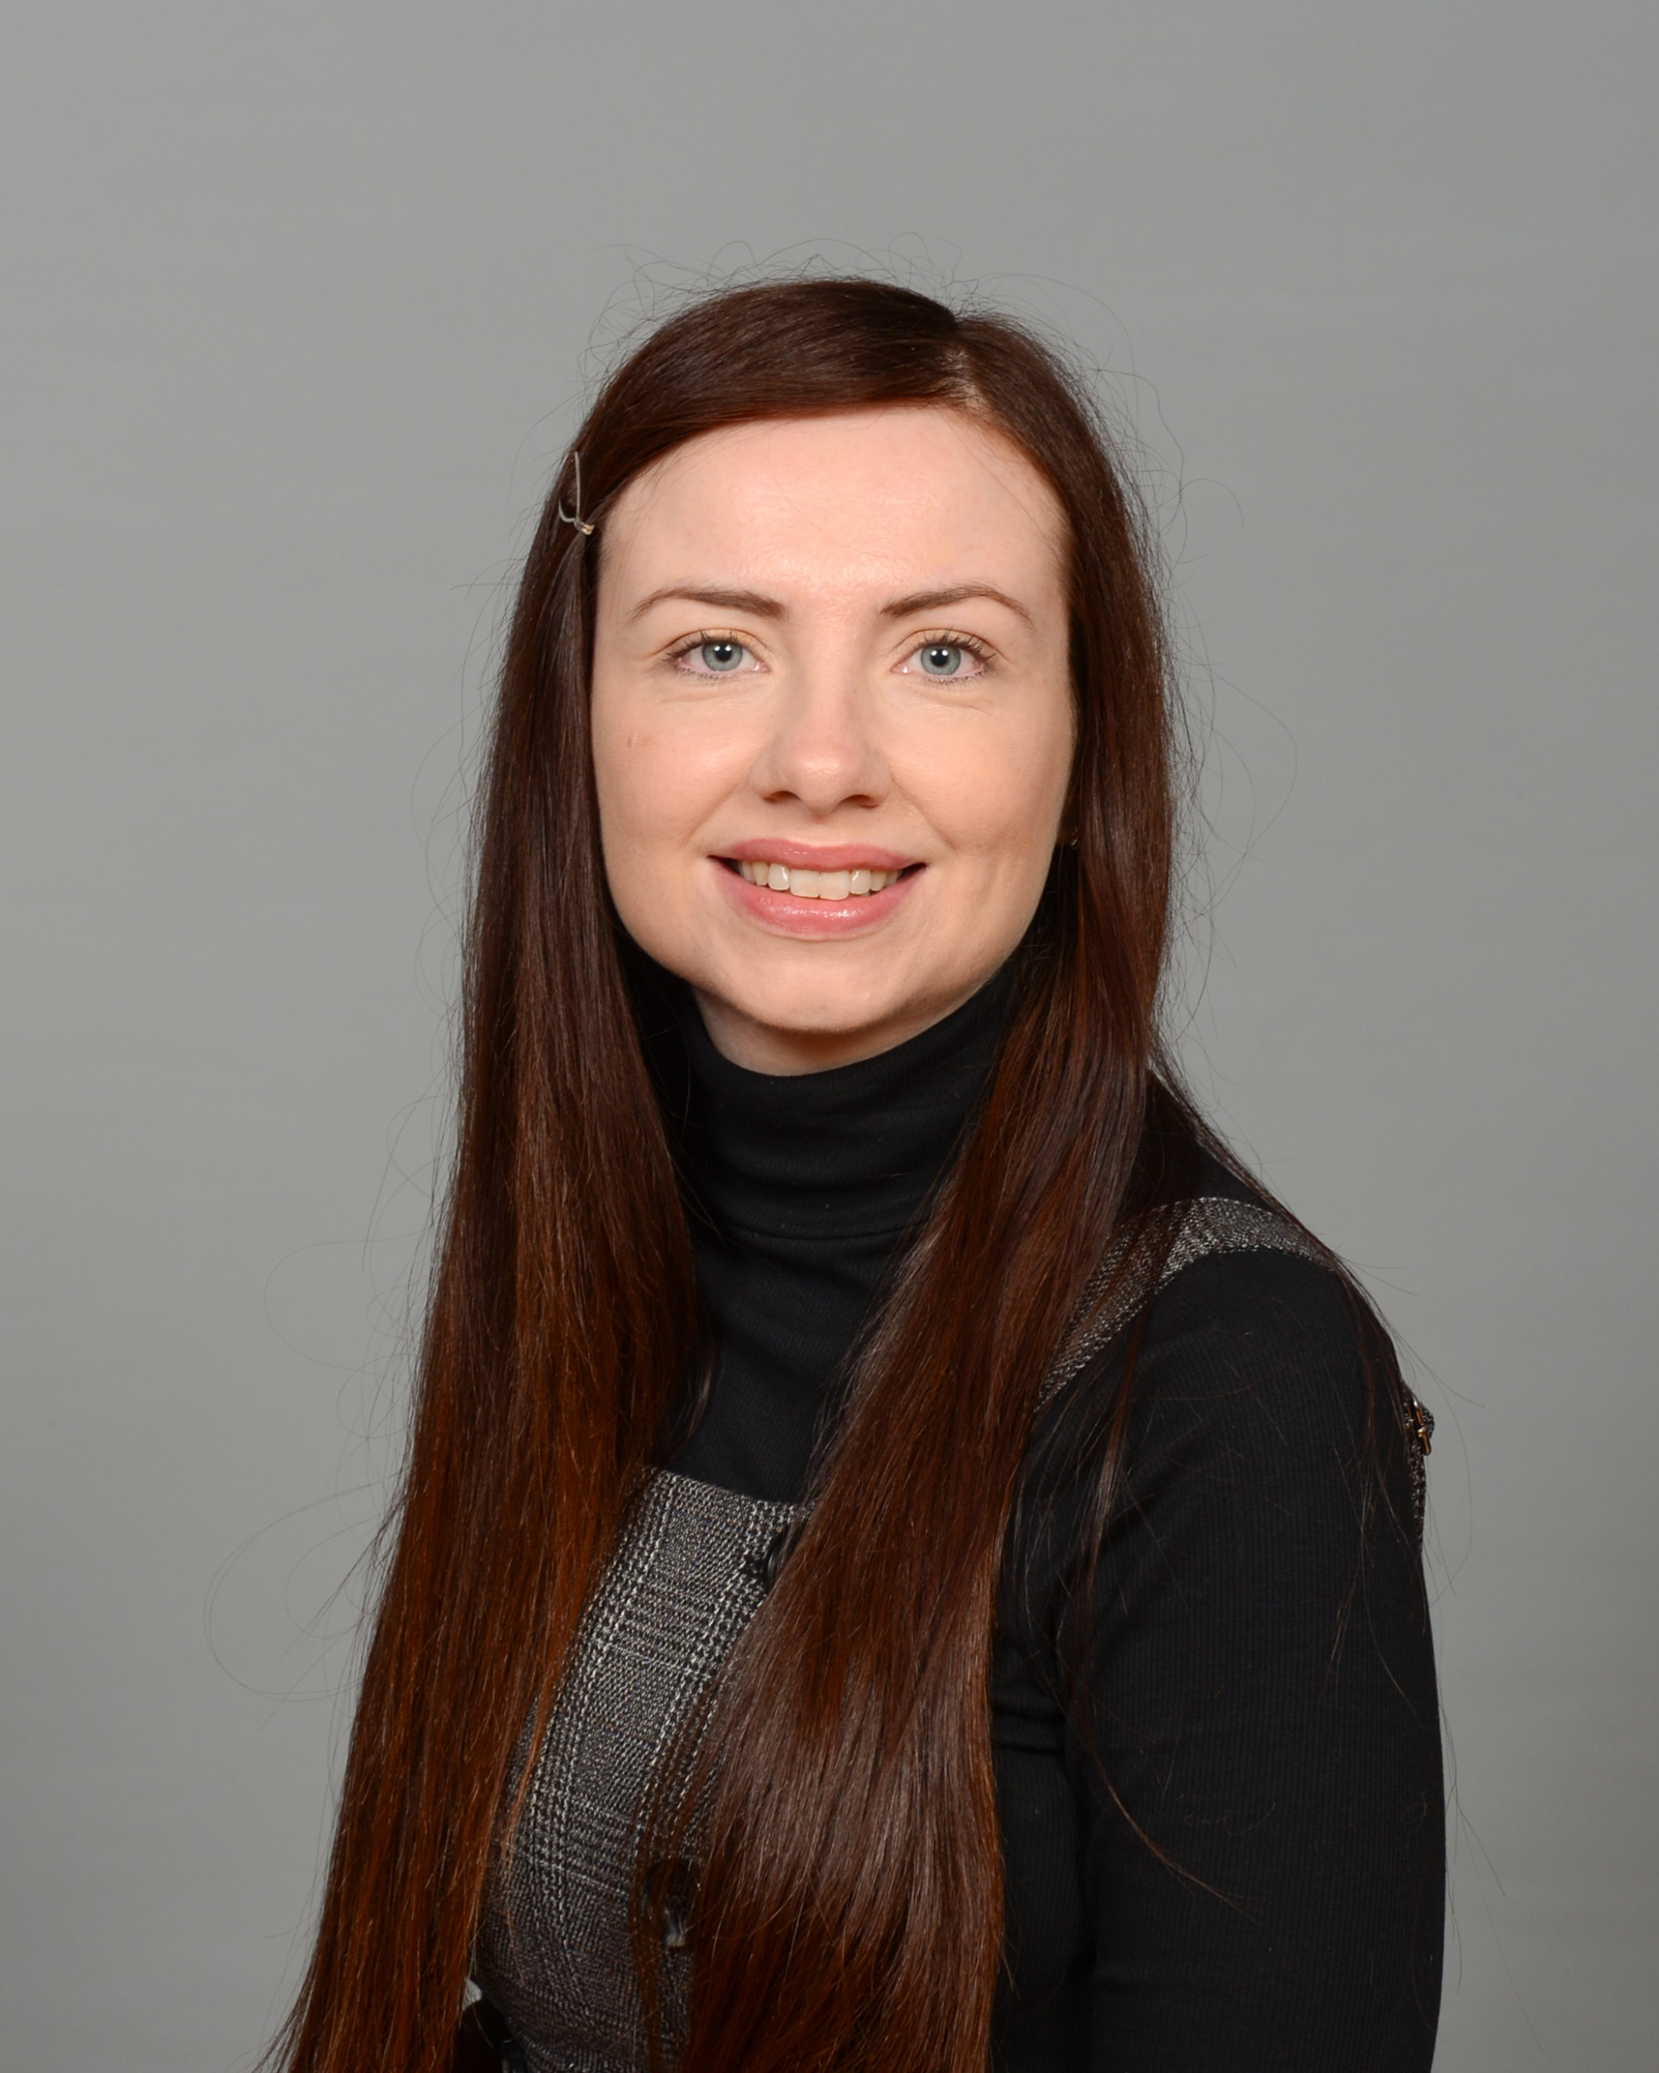
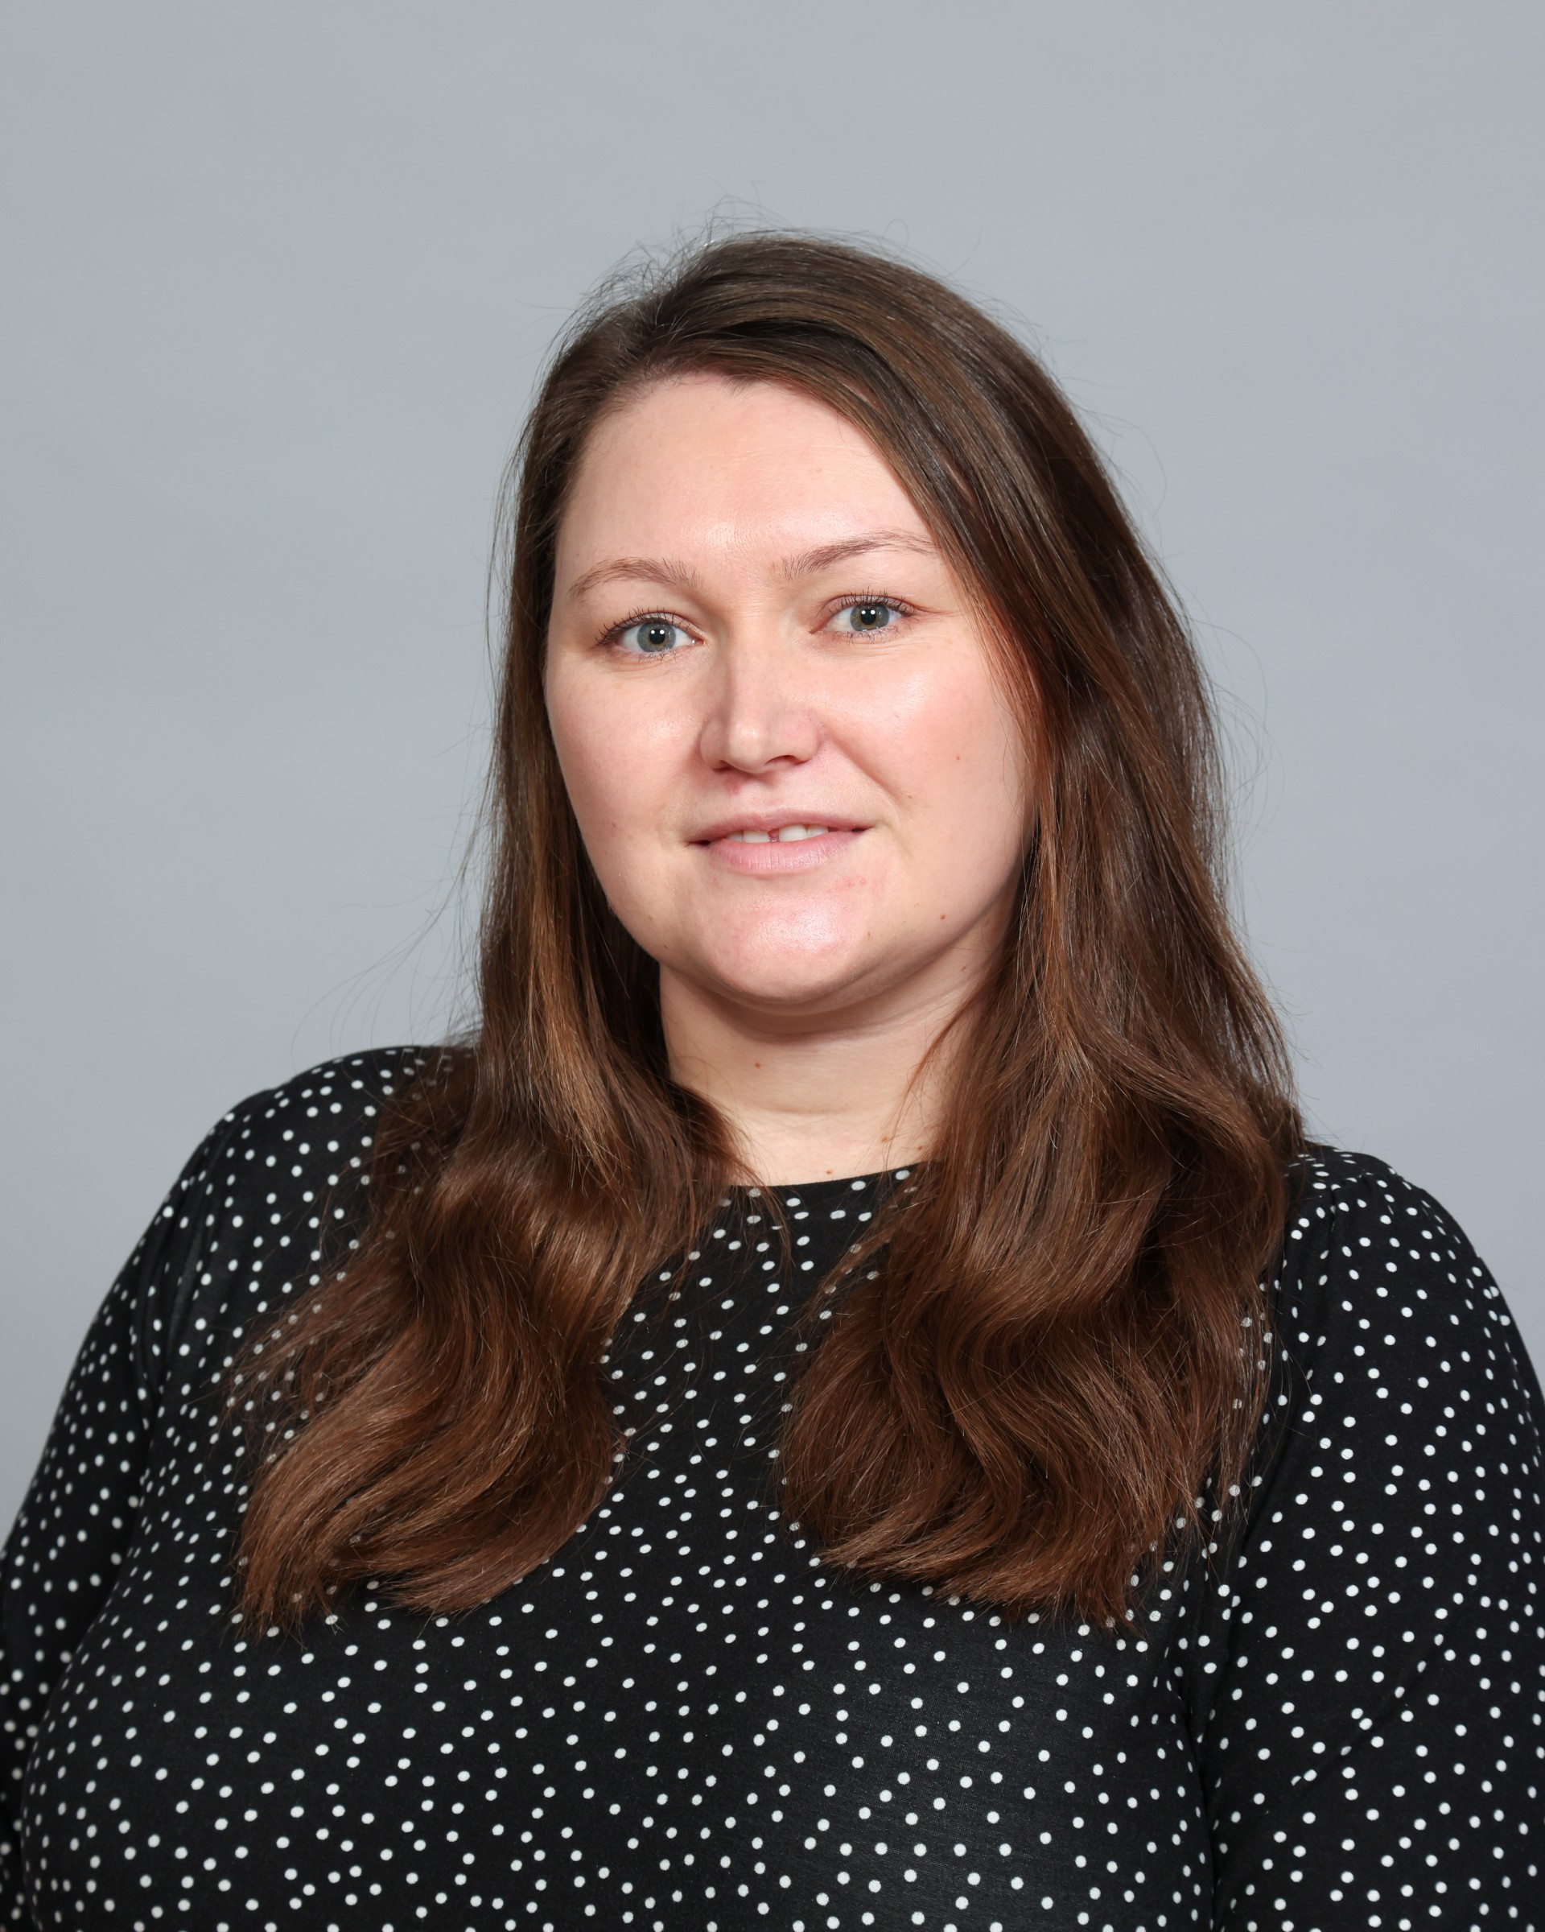
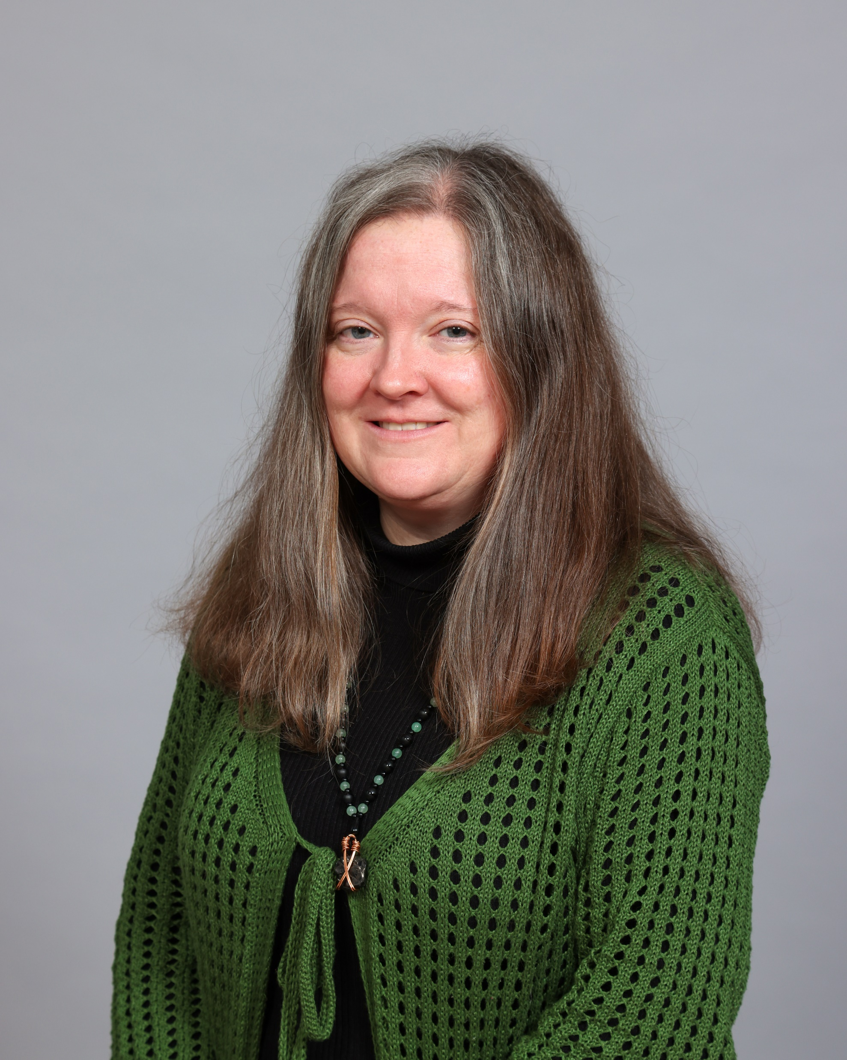
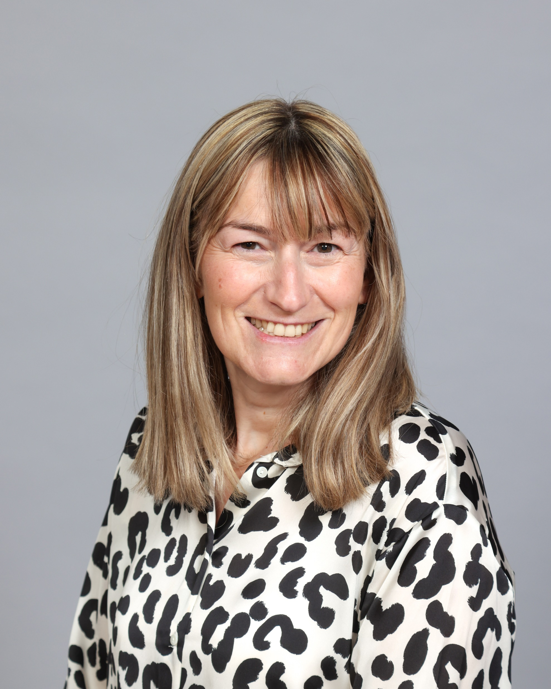
Meet the team
Miss McDonagh
Assistant Headteacher for EYFS
Mrs Corns
Nursery Teacher
Miss Graham
Nursery Nurse
Miss Burns
Teaching Assistant

Slide 3
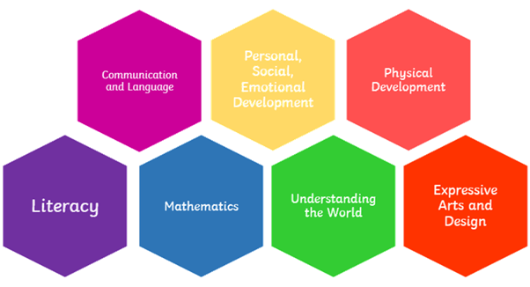
The Early Years Foundation Stage (EYFS) is a curriculum based on seven areas of learning and development.
Notes:
The Early Years Foundation Stage (EYFS) is a curriculum based on seven areas of learning and development.
These areas are split into 3 prime areas, communication and language, personal, social and emotional development and physical development - these are especially important for building foundations….
And 4 specific areas, literacy, mathematics, understanding the world and express art and design – these areas are to help strengthen and apply learning.

Slide 4
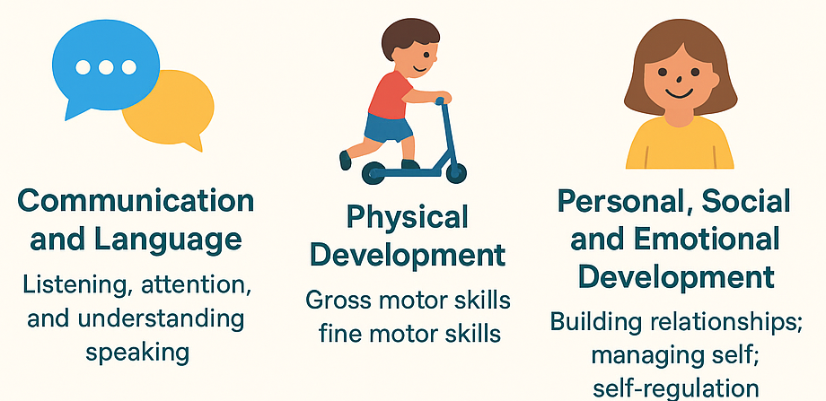
Prime Areas of Learning
Notes:
The 3 prime areas of learning are:
Communication and Language
Listening, attention, and understanding
Speaking (using talk to share ideas, ask questions, and express themselves)
Physical Development
Gross motor skills (running, climbing, balancing, moving safely)
Fine motor skills (mark-making, holding tools, using cutlery, early writing control)
Personal, Social and Emotional Development (PSED)
Building relationships with adults and peers
Managing self (independence, self-care, toileting, dressing)
Self-regulation (understanding feelings, managing emotions, taking turns)

Slide 5
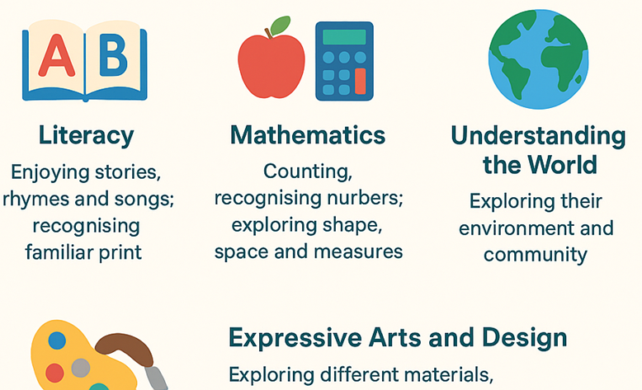
Specific Areas of Learning
Notes:
The 4 specific areas of learning are:
Literacy
Enjoying stories, rhymes, and songs
Recognising familiar print (name, signs, logos)
Beginning to hear and recognise sounds in words (phonological awareness)
Early mark-making as a foundation for writing
Mathematics
Counting, recognising numbers, and beginning to understand quantities
Exploring shape, space, and measures (patterns, sorting, comparing sizes)
Understanding the World
Exploring their immediate environment and community
Learning about people, cultures, and traditions
Exploring nature, animals, seasons, and technology
Expressive Arts and Design
Exploring different materials, media, and creative play
Role-play, storytelling, singing, dancing
Developing imagination and creative expression
Within these areas there are early learning goals which are broken down into ages and stages. We use these ages and stages to help us when it comes to planning and assessment.

Slide 6
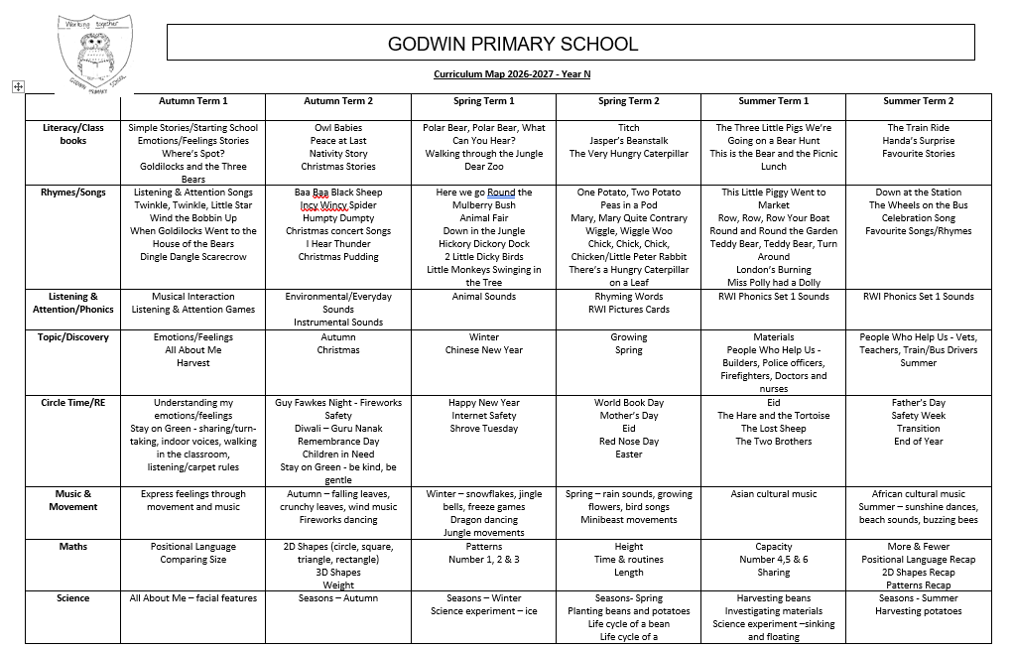
Notes:
A copy of our curriculum map can be downloaded from the school website.

Slide 7
A typical nursey session
Morning
Settling and indoor play
Welcome and registration
Listening and attention (pre-phonics)
Rhyme time
Literacy/Story
Outdoor play
Small group snack
Math/Circle time (feelings, friendships, festivals, religion)
Goodbye and home time
Afternoon
Lunchtime
Calming time
Discovery time (topic work)/Music and movement
Groups games
Story time
Goodbye and home time

Slide 8

How can you help your child at home
Read to them
Sing with them
Play with them
Talk to them
Complete fine and gross motor activities
Build independent skills - toileting, putting coats on etc.
Make learning fun and part of your everyday routine

Slide 9
What your child needs in school
A bag that can come to school and be taken home everyday such as a book bag or rucksack
A draw string bag or carrier bag that can be left at school with a set of spare clothes in – accidents happen!
Weather appropriate coat
Please label EVERYTHING!
Water bottles optional but must be clear and filled with water only
No hooped earrings, small studs only. No necklaces, bracelets or other jewelry
Appropriate footwear – no sandals or crocs
Notes:
Bring examples to show parents
- Rucksack
- Drawstring bag
- Water bottle

Slide 10



Lending Library
Lending Library starting on Friday 9th October.
Every Friday you will have the opportunity to choose a library book to share at home with your child.
  Morning Nursery: 11:35–11:50am
  Full-Time Nursery: 3:00–3:10pm
If you are unable to attend the Lending Library, a member of staff will help your child choose a book to take home.
When your child returns their library book on time each Friday, they will receive a sticker on our Reading Rocket. For every 10 stickers your child collects, they will receive a prize!

Slide 11

Lunches
Full time children go to lunch at 11.40am
They eat in the dinner hall with 2 member of staff
Packed lunches only (for now!)
Separate bag or lunchbox that is clearly labelled with your child's name
No chocolate spread (nut allergies)
Grapes must be cut in half length ways
No meat with bones
No fizzy or hot drinks
We are unable to re-heat any food
No chocolate bars (biscuit based sweet treats such as a KitKat are allowed)

Slide 12

Attendance and Punctuality
Morning Nursery session 8.50am to 11.50pm
Full time Nursery session 8.50am to 3.10 pm
Good attendance and arriving on time helps children feel settled and avoids missing important learning.
The nursery door is open between 8:50–9:00 for arrival.
Nursery finishes at 11:50 (for morning children) and 3:10 (for full time children). Late children will be taken to the office.
Please call the office if you are running late or let us know if someone else is collecting your child.

Slide 13
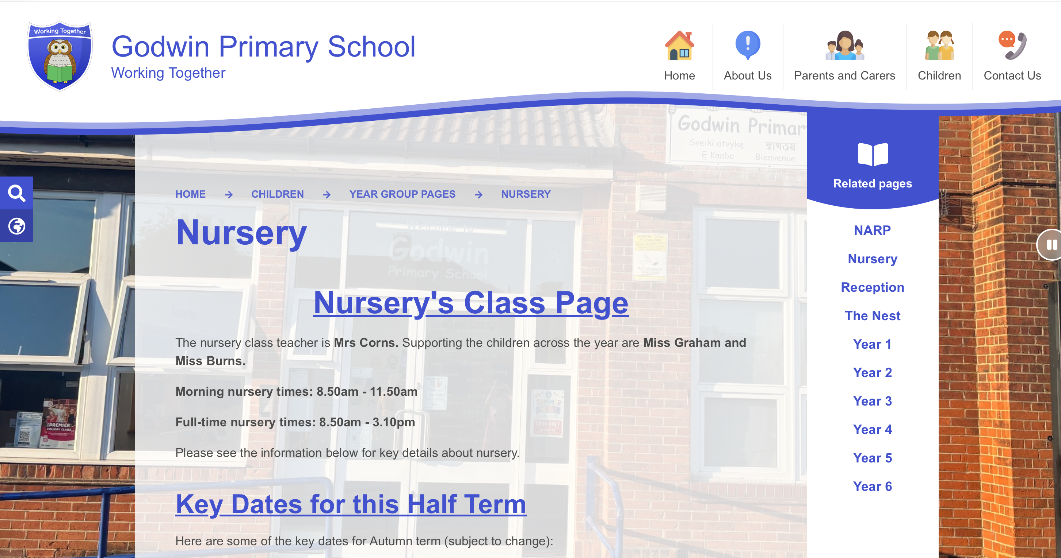
Any questions?

