Slide 1


Nursery Parents Meeting

Slide 2
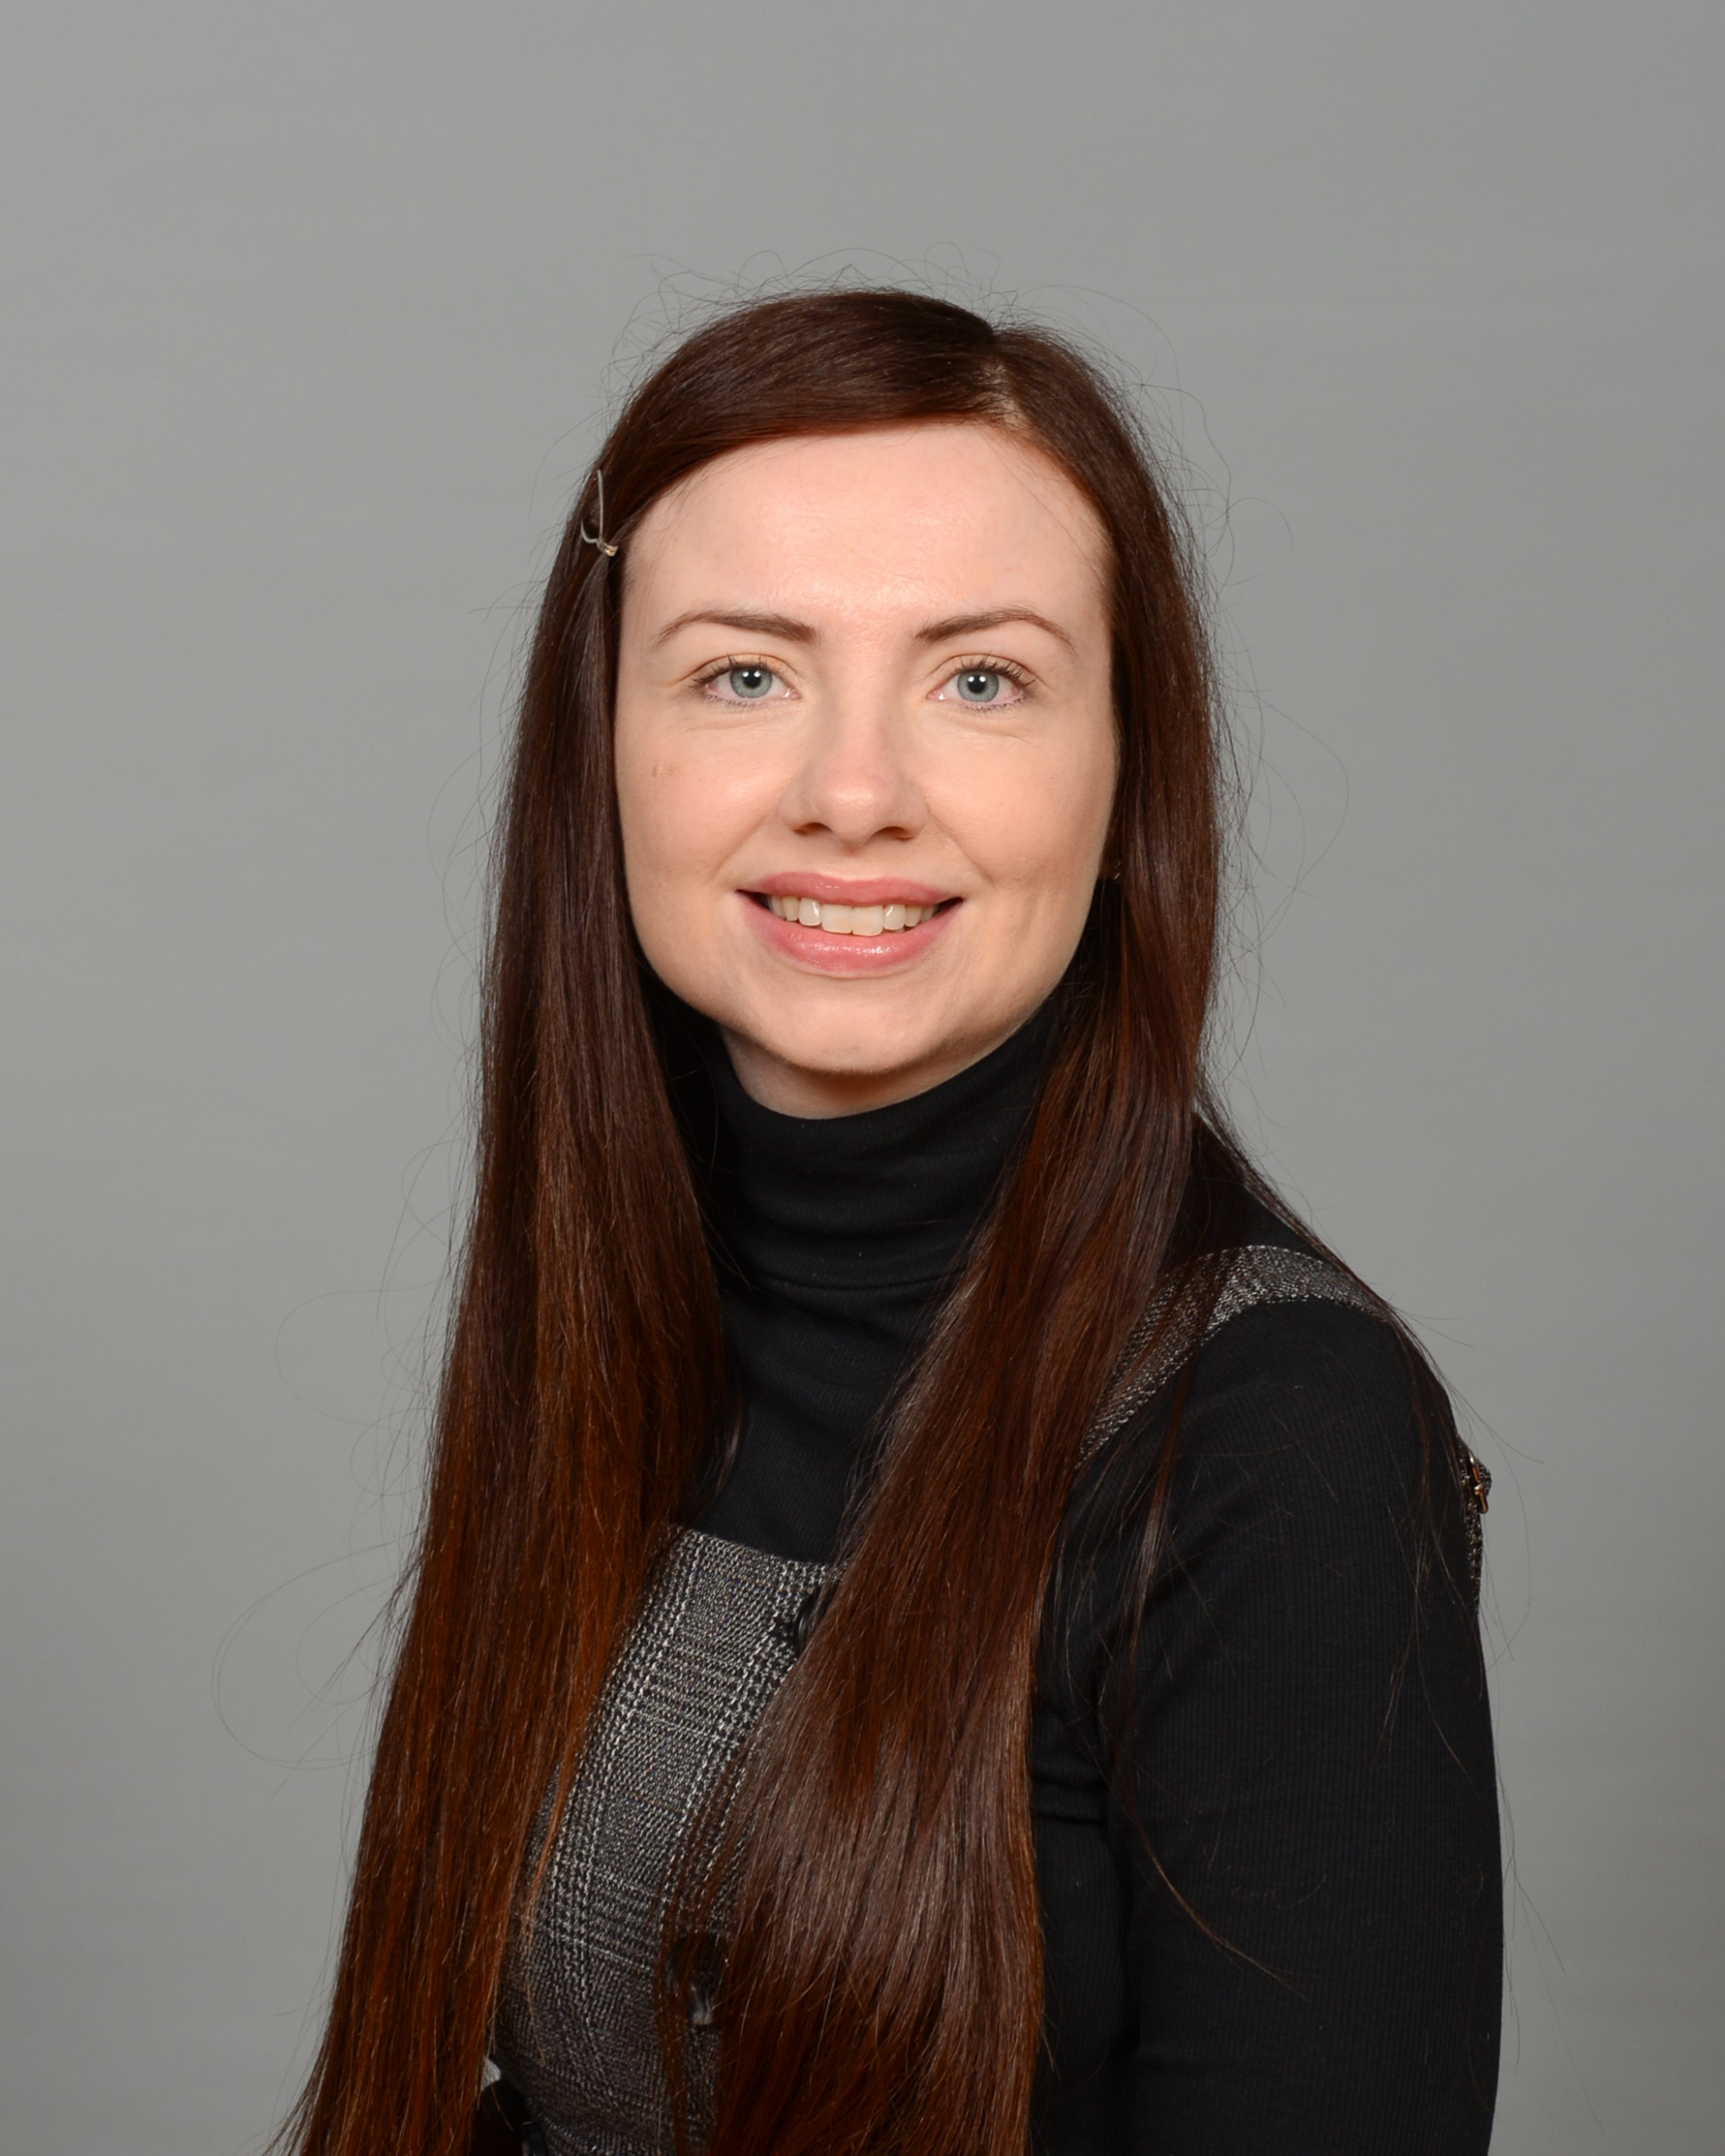



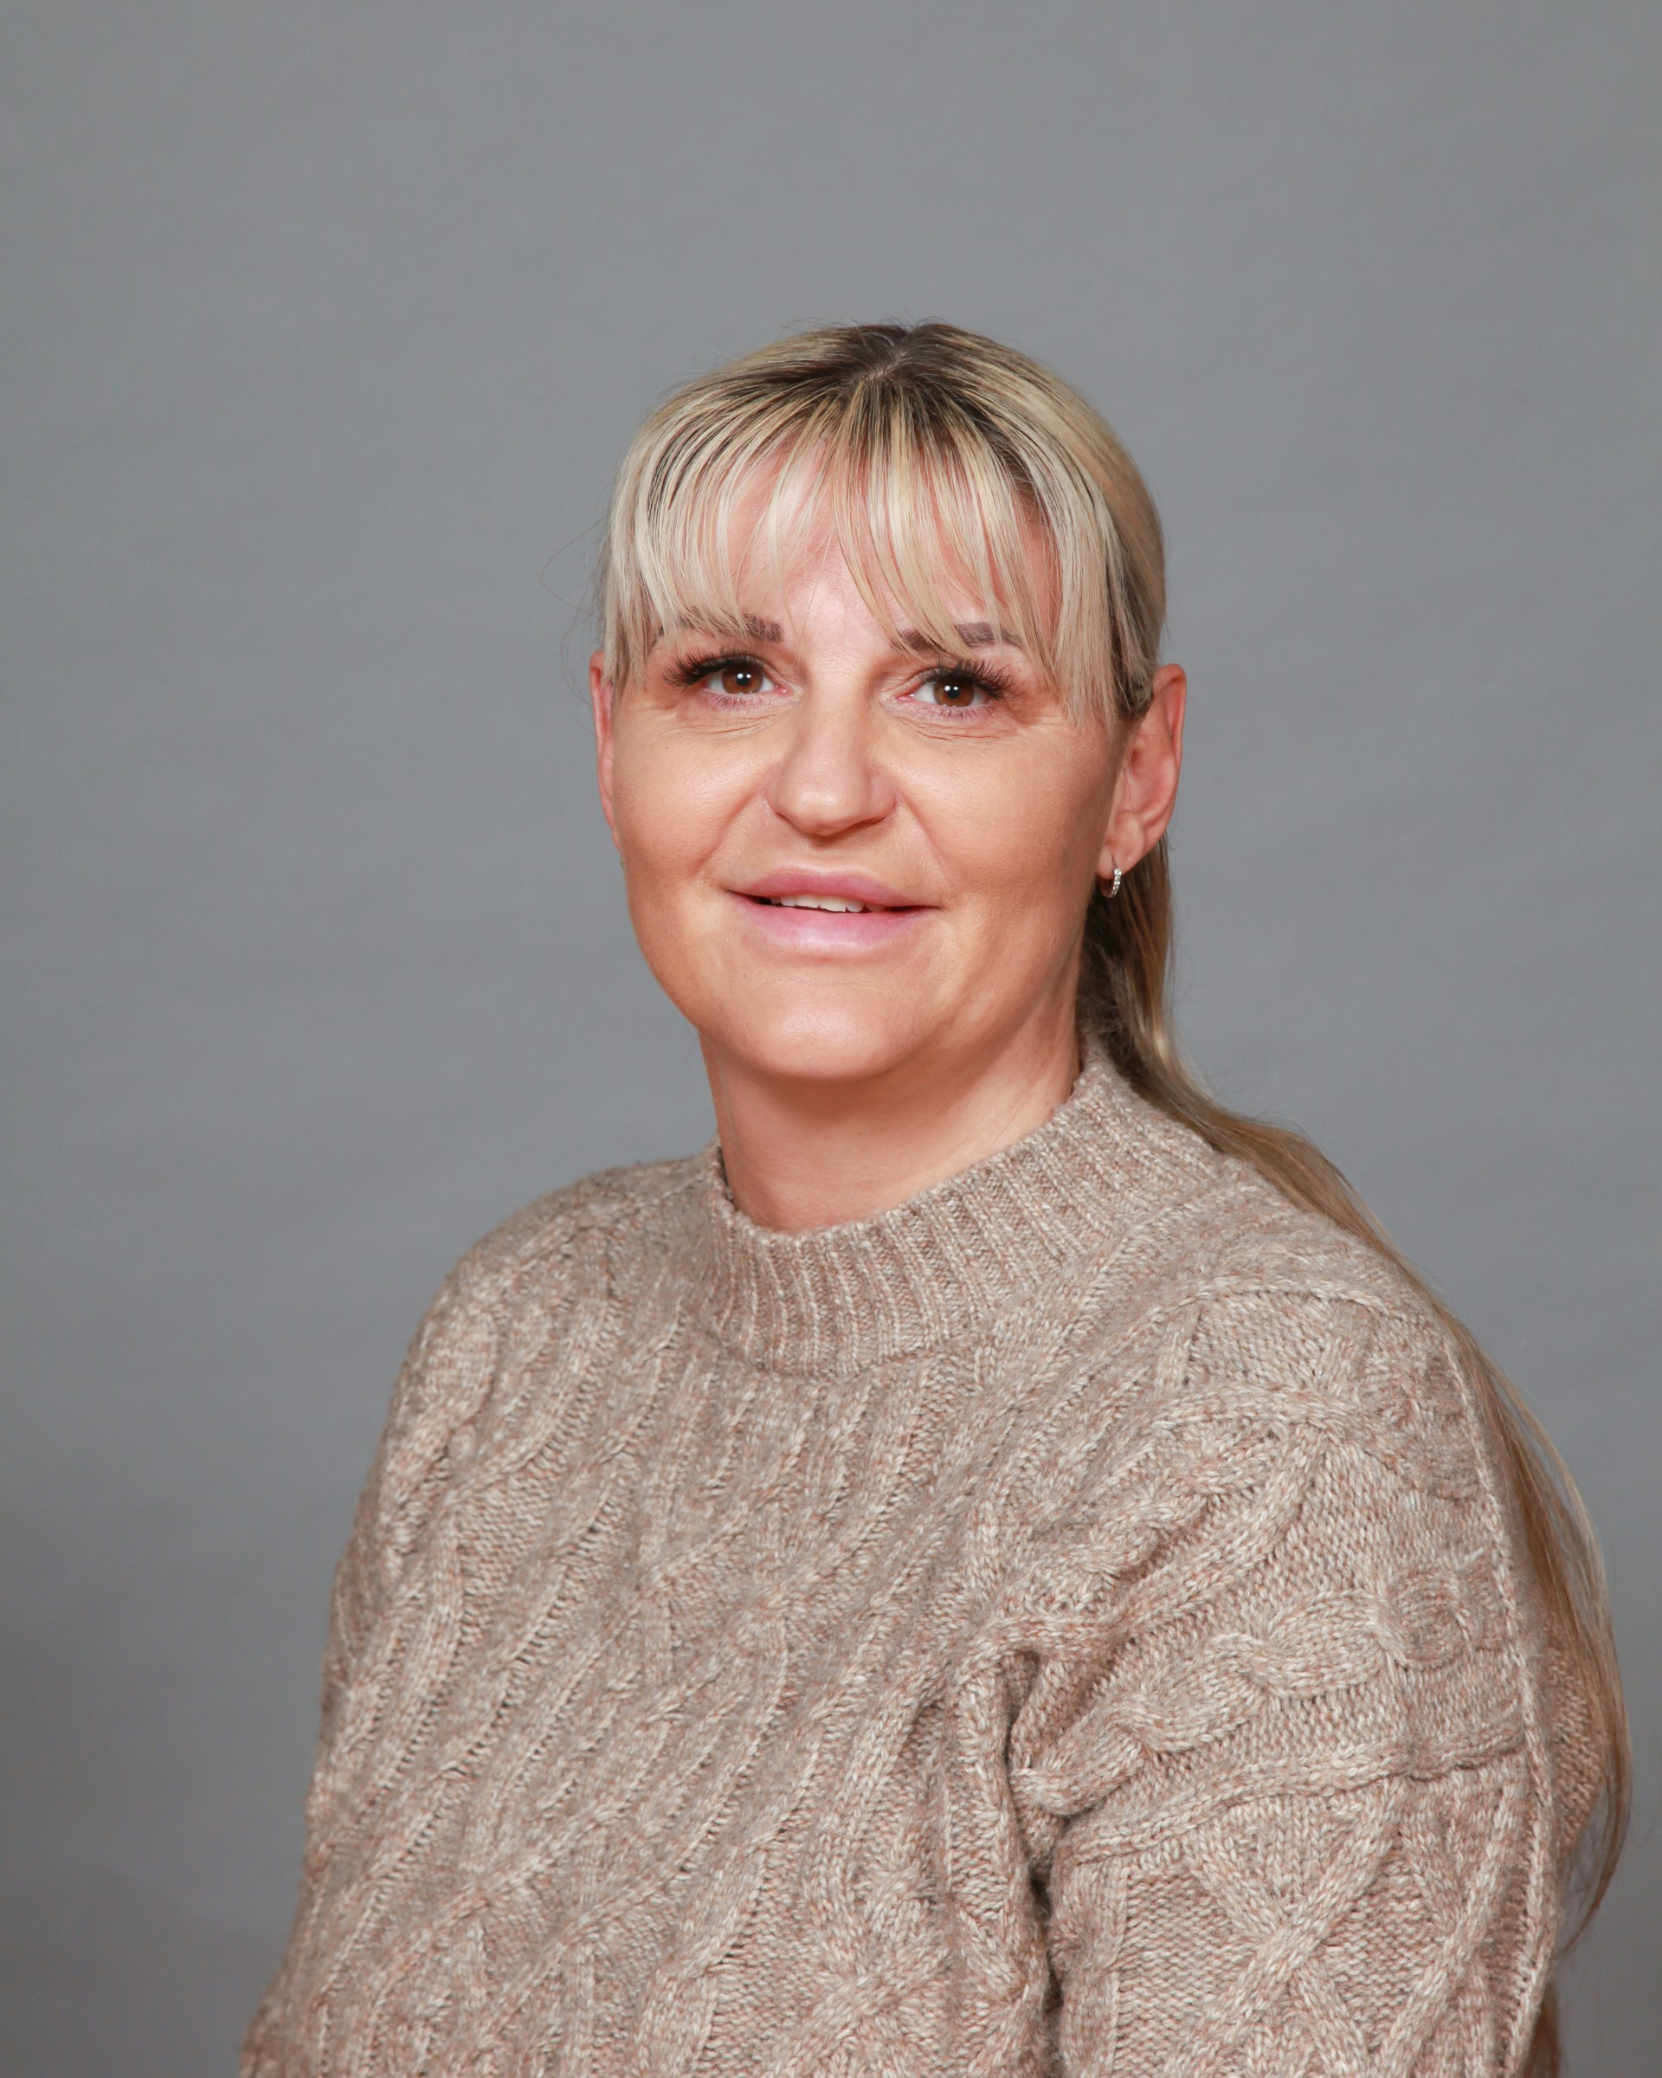
Meet the team
Miss McDonagh
Assistant Headteacher for EYFS
Mrs Corns
Nursery Teacher
Mrs Blade
Learning Support Manager
Miss Graham
Nursery Nurse
Miss Eve
Teaching Assistant

Slide 3
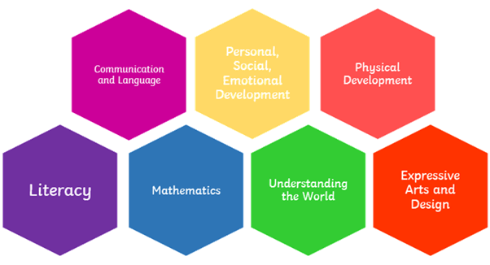
The Early Years Foundation Stage (EYFS) is a curriculum based on seven areas of learning and development.
Notes:
The Early Years Foundation Stage (EYFS) is a curriculum based on seven areas of learning and development.
These areas are split into 3 prime areas, communication and language, personal, social and emotional development and physical development - these are especially important for building foundations…. And 4 specific areas, literacy, mathematics, understanding the world and express art and design – these areas are to help strengthen and apply learning.

Slide 4
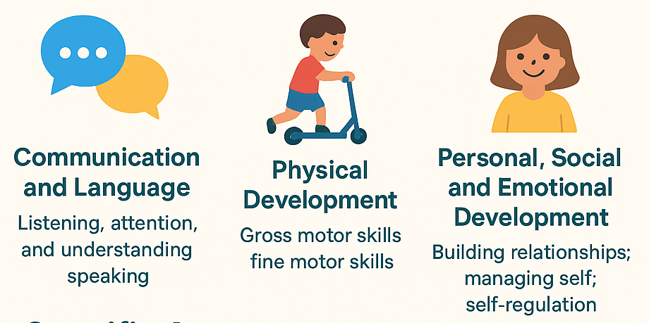
Prime Areas of Learning
Notes:
The 3 prime areas of learning are:
Communication and Language
Listening, attention, and understanding
Speaking (using talk to share ideas, ask questions, and express themselves)
Physical Development
Gross motor skills (running, climbing, balancing, moving safely)
Fine motor skills (mark-making, holding tools, using cutlery, early writing control)
Personal, Social and Emotional Development (PSED)
Building relationships with adults and peers
Managing self (independence, self-care, toileting, dressing)
Self-regulation (understanding feelings, managing emotions, taking turns)

Slide 5
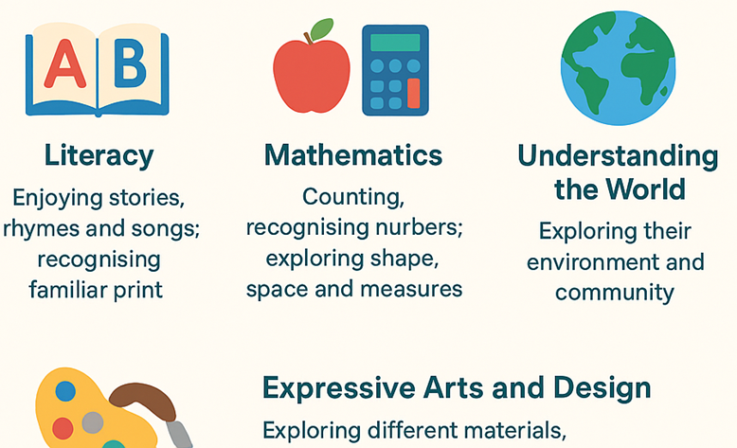
Specific Areas of Learning
Notes:
The 4 specific areas of learning are:
Literacy
Enjoying stories, rhymes, and songs
Recognising familiar print (name, signs, logos)
Beginning to hear and recognise sounds in words (phonological awareness)
Early mark-making as a foundation for writing
Mathematics
Counting, recognising numbers, and beginning to understand quantities
Exploring shape, space, and measures (patterns, sorting, comparing sizes)
Understanding the World
Exploring their immediate environment and community
Learning about people, cultures, and traditions
Exploring nature, animals, seasons, and technology
Expressive Arts and Design
Exploring different materials, media, and creative play
Role-play, storytelling, singing, dancing
Developing imagination and creative expression
Within these areas there are early learning goals which are broken down into ages and stages. We use these ages and stages to help us when it comes to planning and assessment.

Slide 6
Curriculum Map
 | Autumn Term | Spring Term | Summer Term
Topics | All About Me Autumn/Harvest Diwali Bonfire Night Christmas | Winter Hot and Cold (countries including animals and their habitats) Chinese New Year Growing and living things (life cycles) Spring/Easter | Eid People Who Help Us Materials Summer Transition from N to R
Literacy Key Texts | Where’s Spot? Goldilocks and the Three Bears Owl Babies Peace at Last Christmas Stories | Polar Bear Polar Bear Walking Through the Jungle Dear Zoo Titch Jasper’s Beanstalk The Enormous Turnip | The Very Hungry Caterpillar This is the Bear and the Picnic Lunch Where’s My Teddy? The Train Ride Handa’s Surprise The Three Little Pigs
Mathematical Focuses | Positional language Comparing size 2D shapes (circle, square) Recognising different types of patterns Repeating patterns | 2D shapes (triangle, rectangle) Numbers 1, 2 and 3 Capacity – full and empty Height – tall and short Time – routines | Weight – heavy and light Length – long and short Numbers 4,5 and 6 More and Less 3D shapes

Slide 7
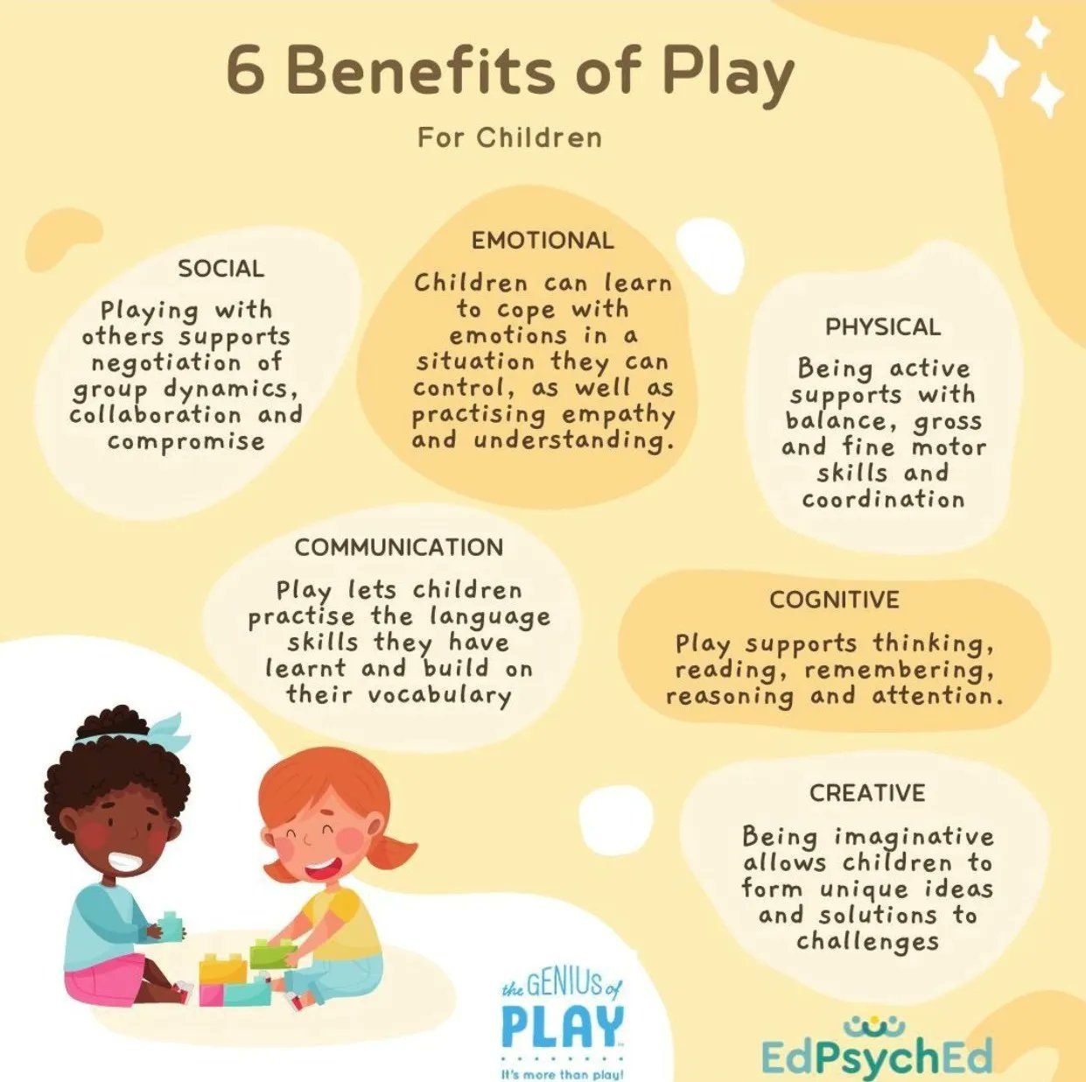
A typical nursery session
Indoor play and settling
Welcome and registration
Listening and attention
Rhyme time
English/Story time
Outdoor play
Small group snack
Maths/Circle time
Goodbye and home time

Slide 8


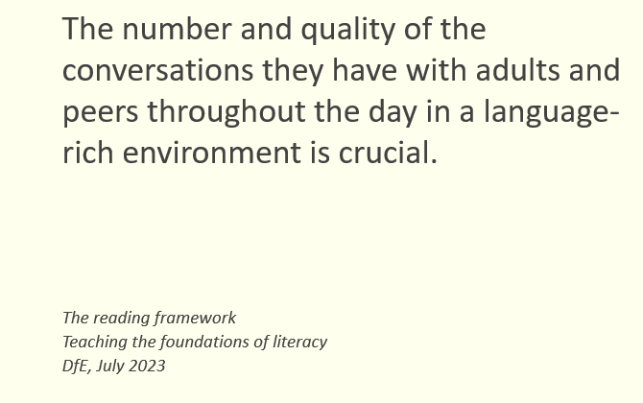
How can you help your child at home
Read to them
Sing with them
Play with them
Talk to them
Complete fine motor activities
Build independent skills
Make learning fun and part of your everyday routine

Slide 9

Reminders
Nursery session is from 12.25 – 3.25
Attendance and punctuality – siblings in KS2
Colder weather
Label clothing
School bag
Spare clothes (including wellies)

Slide 10
Any questions?

