Slide 1

Year Five Curriculum
2/10/26

Slide 2
Y5 Team
Teachers*:
Mr Moran
Miss Shepherd
Support Staff:
Mrs Ryan (Mon-Wed)
Mrs Herd (Wed-Fri)
*parents’ consultations - 19/10/26

Slide 3
The National Curriculum
The national curriculum is a set of subjects and standards used by primary and secondary schools so children learn the same things.
It covers what subjects are taught and the standards children should reach in each subject.

Slide 4
The National Curriculum
English
maths
science
design and technology
history
geography
art and design
music (fifes)
physical education (PE), including swimming
computing
ancient and modern foreign languages
relationship and health education
modern foreign languages
religious education
Plus:
PSHE & citizenship
sex education

Slide 5
Curriculum Map:
Home | Godwin Primary School

Slide 6





Slide 7
Whole Class Texts
Read to daily – whole class texts as well as dedicated reading lessons.
Chosen with diversity and breadth of reading experience in mind.
Texts also act as broad themes for other English work e.g. grammar and writing.

Slide 8
Reading Skills
Decode words they are having difficulty with.
Work out the meaning of unfamiliar words.
Check they have understood what they have read.
Predict what will happen.
Summarise what their reading was about.
Discuss particular words chosen by the author.

Slide 9
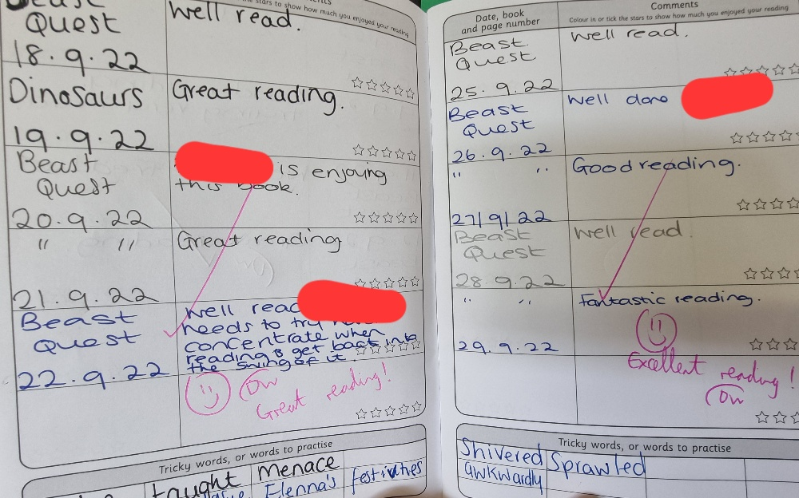
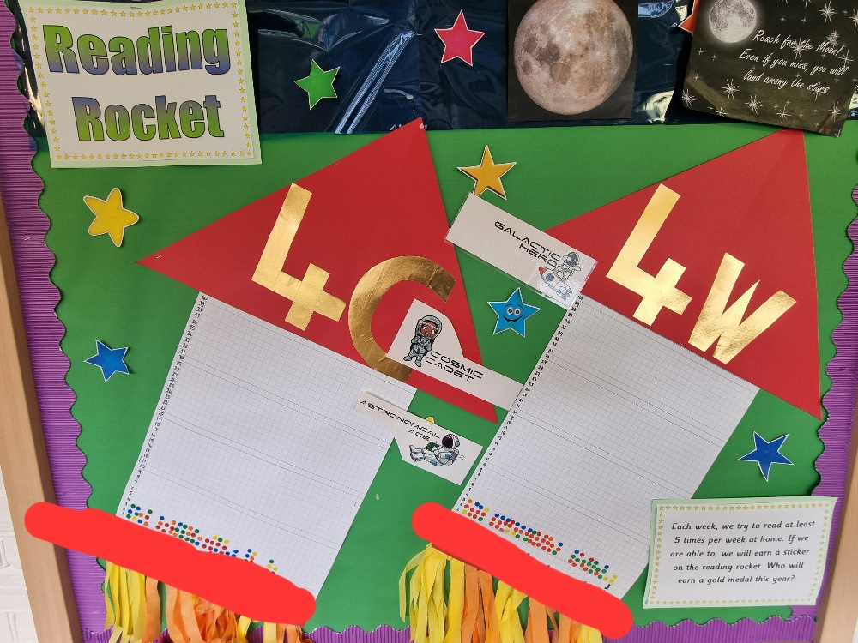
Reading at Home
Read AT LEAST five times a week to an adult.
Reading Records due each Friday – signatures needed.
Personal reading books chosen and changed in school.
Sticker on Reading Rocket.

Slide 10
Reading at Home
The Library – it’s free!
Centre for Literacy in Primary Education (CLPE) Corebooks
Waterstone’s Children’s Book Prize
The internet (child-friendly sites)
First News and The Week Junior

Slide 11
Reading at Home
Enjoy Reading!
Read to self – daily for pleasure.
Read in different places/a special place.
Read a wide range of poetry, plays, fiction, non-fiction, graphic novels, websites, different genre, textbooks, newspapers.
Have opinions about books and authors.
Read about topics in the news and discuss them.
Adults as a role model for reading.

Slide 12
Writing At School
Malamander: narrative, persuasive leaflet, report
House With Chicken Legs: persuasive speech, explanation, balanced argument
Wonder: biography, balanced argument, description, diary entry, book review
Boy at the Back of the Class: recount, poetry, persuasive letter

Slide 13
Writing At Home
Y3/4 Spellings
Y5/6 Spellings
Weekly homework sheets (linked to spelling)
Writing for fun – diaries, competitions, stories, playscripts, explanation texts, blogs, websites…

Slide 14
Maths in Y5
Number: Place Value, Addition & Subtraction, Multiplication & Division, Fractions, Decimals & Percentages
Statistics
Measurement: Perimeter/Area, Converting Units, Volume
Geometry: Properties of Shapes, Position and Direction

Slide 15
Maths at Home
Times Tables Rock Stars
Checking multiplication and division facts
Telling the time
Making things – cooking, models etc.
Going shopping – money, change, special offers etc.
BBC Bitesize
Weekly Homework

Slide 16
Homework In Y5
Spelling
Maths book
Goes out on Wednesday
Due in on the following Tuesday
Optional Homework Club on Monday lunchtime
Compulsory Homework Club on Tuesday lunchtime

Slide 17
Key Dates:
Swimming – every Friday to Christmas
19th October – Parents’ Consultations
12th November – Individual Photos
24th November – Cinema
16th December – St Alban’s Church
TBC – Barking Mosque, Greenwich Observatory, Billingsgate Roman House and Baths

