Slide 1

Year 1 Parents’ meeting

Slide 2

Our vision for Godwin is:
Excellence in all we do

Slide 3


Slide 4
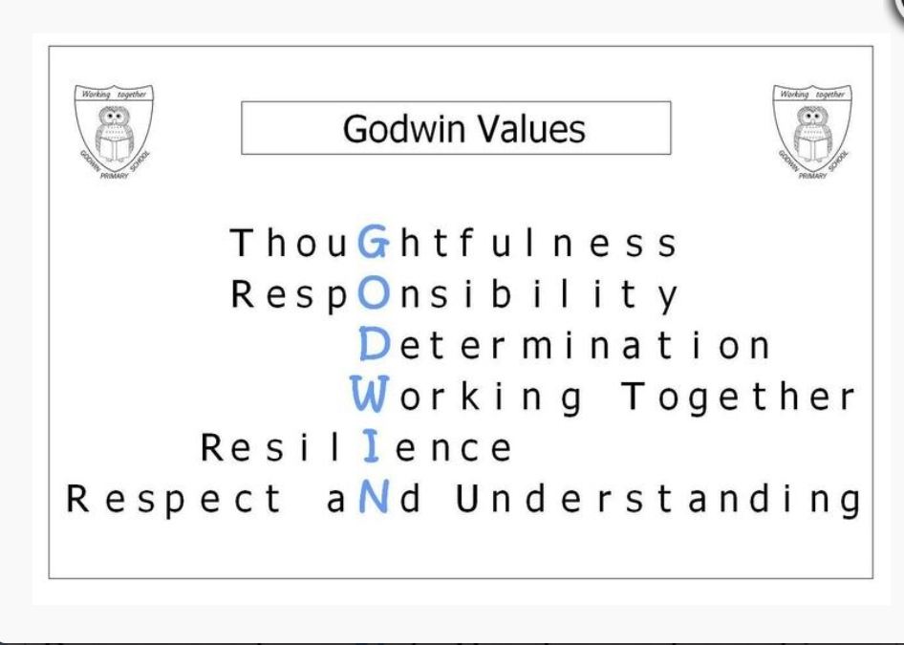

Slide 5
The Year 1 Curriculum Map
 | Autumn Term 1 | Autumn Term 2 | Spring Term 1 | Spring Term 2 | Summer Term 1 | Summer Term 2
English | Read, Write, Inc In phases | Read, Write, Inc In phases | Read, Write, Inc In phases | Read, Write, Inc In phases | Read, Write, Inc In phases | Catch up
Class books | Elmer Amazing Grace | Pumpkin Soup Goldilocks and the Three Bears The Jolly Christmas Postman | The Three Little Pigs Mr Wolf’s Pancakes The Great Fire of London | Little Red Riding Hood The Journey | Jack and the Beanstalk Man on the Moon | Emily Brown books
Drama | All about me
Maths | Number: Place Value (within 10); Number: Addition and Subtraction (within 10) | Number: Addition and Subtraction (within 10) | Number: Place Value (Within 20) Number: Addition and Subtraction (within 20) | Number: Place Value (Within 50) Measurement: Length and Height Measurement: Weight and Volume | Number: Multiplication and Division Number: Fractions Geometry: Position and Direction | Number: Place Value (within 100) Measurement: Money Measurement: Time Geometry: Shape
Science | Animals including humans (include healthy eating, linking to food tech). |  | Everyday Materials | Plants |  | Seasonal Changes (have to be aware of throughout year)
 | Working scientifically

Slide 6
 | Autumn Term 1 | Autumn Term 2 | Spring Term 1 | Spring Term 2 | Summer Term 1 | Summer Term 2
Art | Sculpture Andy Goldsworthy art from nature |  | Painting Great Fire of London paintings (hot colours) | Drawing Observational – National flowers
Computing | Computing Systems and Networks – Technology Around Us (UNPLUGGED) | Creating Media – Digital Painting (2PAINT / PURPLE MASH SUITE) | Creating Media – Digital Writing (2PUBLISH / PURPLE MASH SUITE) | Programming A – Moving a robot (BEEBOTS) | Data and Information – Grouping Data (MAINLY UNPLUGGED / SORTING ACTIVITY) | Programming B – Introduction to Animation (2CODE / PURPLE MASH SUITE)
DT |  | Food Technology Bring on breakfast |  |  | Mechanisms Design and make a weather vane/weather station | Textiles Fabric Faces
Geography |  | Local area, London and England |  | The UK - Scotland, Ireland, Wales | Weather in the UK
History |  | My History significant historical events and places in their own locality | The Great Fire of London |  |  | First aeroplane flight
Music | My Musical Heartbeat | Dance, Sing and Play! Christmas Carols | Exploring Sounds | Learning to Listen | Having Fun with Improvisation | Let’s Perform Together
Indoor PE | Gymnastics – Body Parts | Dance – Growing | Gymnastics – Wide, Narrow, Curled | Dance – Heroes | Dance – The Zoo | Games for understanding
Outdoor PE | Jumping | Running | Rackets, Bats and Balls | Hands 1 | Feet 1 | Team Building
PSHE | Understanding emotions and self regulation | My Special People, My Special Places | Healthy Eating and looking after teeth | Keeping safe and medicines | What Is Bullying? | SRE – Growing & Caring for Ourselves/ Safety Week
SEAL | New Beginnings | Going For Goals | Getting On & Falling Out | Good To Be Me | Relationships | Changes
RE | What does it mean to belong?
 | What does it mean to belong to Christianity? | How do Christians celebrate Christmas? | What does it mean to belong to Sikhism? | What does it mean to belong to Islam? | How do Hindu people belong? | What can be special about living with family and friends?

Slide 7
What will your
Year 1 child be learning in
English and mathematics?

Slide 8
English – Word reading
Apply phonic knowledge using all 40+ phonemes to read words
Read the common exception words
Read aloud accurately books that are consistent with their developing phonic knowledge

Slide 9
English – Comprehension
Develop pleasure and motivation
Link what they read or hear read to their own experiences
Be familiar with key stories, fairy stories and traditional tales, retelling them and joining in with predictable phrases
Discuss word meanings, linking new meanings to those already known

Slide 10
English – Writing
Write simple sentences
Spell common exception words correctly
Apply phonics knowledge to spell words
Form lower-case letters correctly
Form capital letters
Form digits 0-9
English – Handwriting

Slide 11
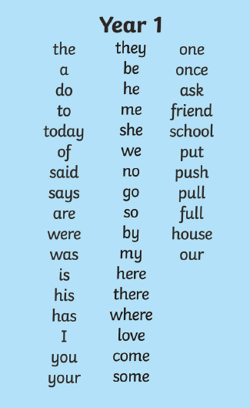
Year 1
Common exception words

Slide 12
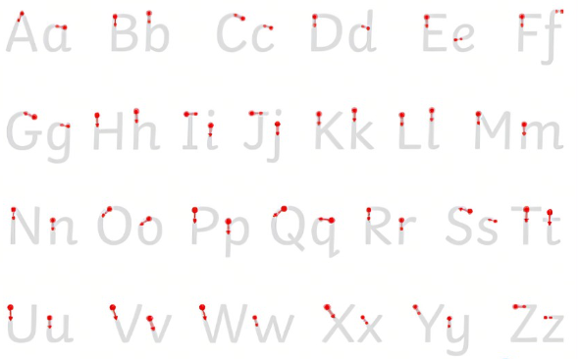
Year 1
Letter formation

Slide 13
Mathematics – Number and place value
Count to and across 100
Read and write numbers from 1 to 20 in numerals and words.
Know number bonds and related subtraction facts for numbers within 20
Add and subtract one-digit and two-digit numbers to 20, including zero
Mathematics – Addition and subtraction

Slide 14
Mathematics – Multiplication and division
Count in multiples of twos, fives and tens
Mathematics – Fractions
Half and quarters (of shapes, amounts and numbers)

Slide 15
Mathematics – Measurement
Compare, describe and solve practical problems and begin to record
  Length and height
  Weight
  Capacity and volume
Know the value of different coins and notes
Sequence events
Tell the time to the hour and half past the hour and draw the hands on a clock face to show these times.
Recognise and name common 2-D and 3-D shapes
Mathematics – Properties of shape

Slide 16
How your
Year 1 child will be assessed

Slide 17
End of year Phonics Check
Year 1 phonics screening check
The check will take place in June when your child will read 40 words out loud to a teacher. You’ll find out how your child did, and their teacher will assess whether he or she needs extra help with reading.
Your child will do it again in Year 2 if they need to.

Slide 18
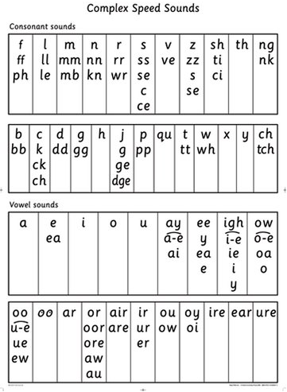
What do they need to know?

Slide 19
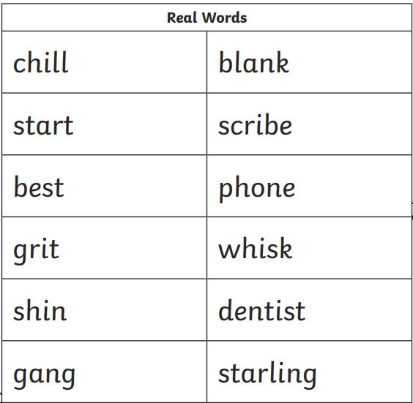
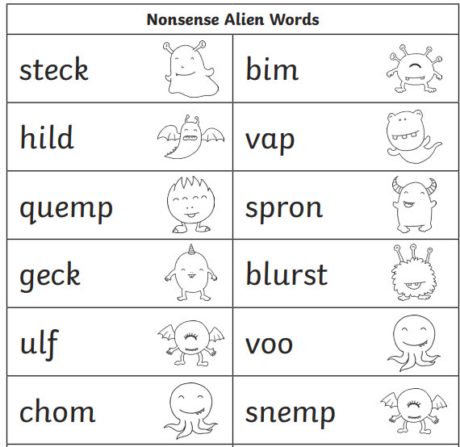
Real words and alien words

Slide 20
Teacher assessments
Teachers will use the work that children do every day, to assess your child.
At the end of Year 1, you will be told whether we believe your child to be:
  Working at greater depth within the expected standard
  Working at the expected standard
  Working towards the expected standard
  Working at pre key stage standard

Slide 21
How we can work together to support your child

Slide 22
Attendance and punctuality
Our target for attendance is 96%
Below 90% is considered persistent absence
90% attendance = 19 days missed in a year, which is almost 4 weeks of lessons (on average 1/2 day every week)
100% attendance is celebrated each term as well as for 100% attendance for the whole year

Slide 23
So what are we doing?
Teaching and planning exciting ways of motivating your children
Making sure we keep an eye on expected standards so that we know if children are where they should be or are struggling
Giving opportunities for daily phonics
Extra support for children that need a little bit of help
Sharing whether we expect your child to meet the end of year standards, and what children need to do to get there, give children individual targets
Changing home reading books weekly to enable your child to read at home at least 5 times a week

Slide 24
So what can you do?
Make sure your children come to school....on time, having had enough sleep and breakfast
Keep us informed of any problems
Support teachers with behaviour issues, asking children if they stayed on ‘Green’
Read, read, read!
  Share stories
  Listen to them read at least 5 times a week to gain a sticker for the reading rocket.
Practise reading and spelling the common exception words
Help develop maths using 1 minute maths
Put time aside to have conversations with your child
Join the library
Make sure your child has regular attendance

Slide 25
What you should do if you have a concern or question
Notes:
teacher, then phase leader who will deal with the issue or arrange contact from
somebody who can help

Slide 26
School website
School website
https://www.godwinprimary.co.uk/
Class pages
https://www.godwinprimary.co.uk/class-pages/

Slide 27


Keeping Children Safe Online
A range of resources can be found in the link below:
https://www.godwinprimary.co.uk/online-safety-2/

Slide 28
And finally a plea....
Please, please name your children’s clothing!

