Slide 1

Year 2 Parents’ meeting

Slide 2

Our vision for Godwin is:
Excellence in all we do

Slide 3


Slide 4
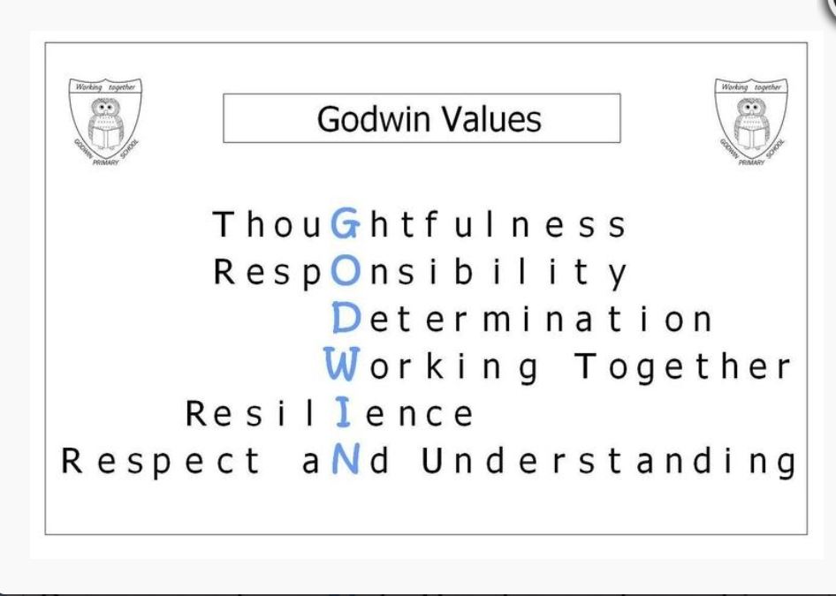

Slide 5
The Year 2 Curriculum Map
 | Autumn Term 1 | Autumn Term 2 | Spring Term 1 | Spring Term 2 | Summer Term 1 | Summer Term 2
English core textx | Once Upon a Wildwood | Molly McDrew an adventure around the World The Owl was afraid of the dark | Fantastic Mr Fox | Fantastic Mr Fox | Flat Stanley | The Adventures of the Breakfast Club
Drama |  | Nativity
Maths | Number: Place Value Number: Addition and Subtraction | Number: Addition and Subtraction Geometry: Properties of shape | Measurement: Money Number: Multiplication and Division | Measurement: Length and Height Measurement: Mass, Capacity and Temperature | Number: Fractions Measurement: Time | Statistics Geometry: Position and Direction
Science | Living things and habitats |  | Animals including humans |  | Everyday materials | Plants
 | Working scientifically

Slide 6
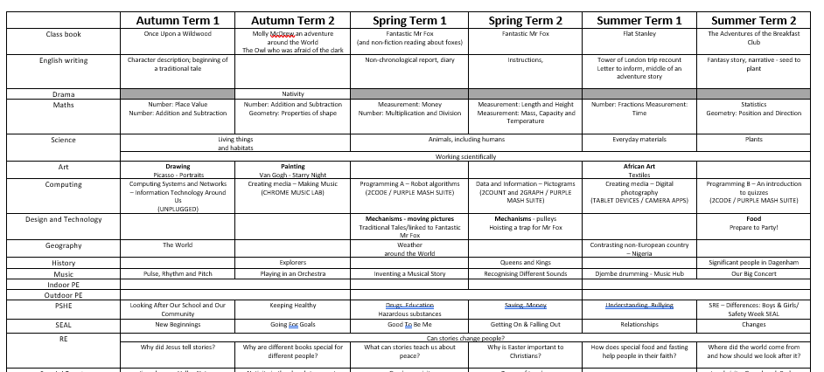

Slide 7
What will your
Year 2 child be learning in
English and mathematics?

Slide 8
English – Word reading
Apply phonic knowledge using all 40+ phonemes to read words
Read the Year 1 and Year 2 common exception words
Read most words quickly and accurately, without overt sounding and blending
Read aloud books closely matched to their improving phonic knowledge, sounding out unfamiliar words accurately, automatically and without undue hesitation

Slide 9
English – Comprehension
Develop pleasure and motivation
Sequence and retell stories
Explore non-fiction books and how they are structured
Check their reading makes sense and correcting inaccurate reading
Make inferences
Answer and ask questions about what they have read
Predict what might happen on the basis of what has been read so far

Slide 10
English – Spelling
Spell common exception words correctly
Apply phonics knowledge to spell words
Add suffixes to spell longer words including –ment, –ness, –ful, –less, –ly
Form lower-case letters, capital letters and digits correctly
Start using some of the diagonal and horizontal strokes needed to join letters
English – Handwriting

Slide 11
English – Writing
Write for different purposes e.g. fictional narrative, poetry, writing about real events
Use both punctuation correctly, including full stops, capital letters, exclamation marks, question marks, commas for lists and apostrophes for contracted forms and the possessive
Write sentences with different forms: statement, question, exclamation, command
Include expanded noun phrases to describe and specify [for example, the blue butterfly]
Use the present and past tenses correctly and consistently

Slide 12
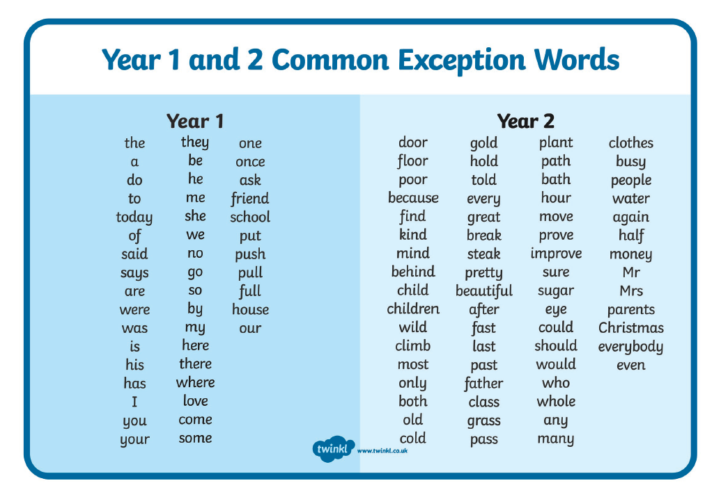

Slide 13
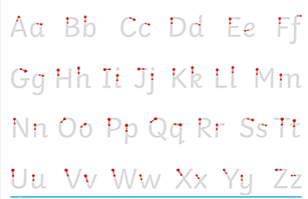
Year 2
Letter formation

Slide 14
Mathematics – Number and place value
Count in steps of 2, 3, 5 and 10
Recognise place value of digits in 2-digit numbers
Read and write, compare and order numbers to at least 100
Recall and use bonds and related subtraction facts for numbers within 20
Add and subtract two-digit numbers
Mathematics – Addition and subtraction

Slide 15
Mathematics – Multiplication and division
Recall and use multiplication and division facts for twos, fives and tens
Use the multiplication (×), division (÷) and equals (=) signs
Mathematics – Fractions
Half, quarters and thirds (of shapes, amounts and numbers)
Write simple fractions for example, 2 1 of 6 = 3 and recognise the equivalence of 4 2 and 2 1

Slide 16
Mathematics – Measurement
Choose and use appropriate standard units of measure e.g.
  Length and height (cm, m)
  Weight (g, kg)
  Capacity and volume (ml, l)
Solve addition and subtraction problems involving money
Compare and sequence intervals of time
Tell the time to 5 minutes, including quarter past, quart to, half past the hour and on the hour

Slide 17
Mathematics – Properties of shape
Identify and describe properties of 2D and 3D shapes
Symmetry in 2-D
Mathematics – Position and direction
Use mathematical vocabulary to describe position, direction and movement, including:
  movement in a straight line
  rotation as a turn and in terms of right angles for quarter, half and three-quarter turns (clockwise and anticlockwise).

Slide 18
How your
Year 2 child will be assessed

Slide 19
Teacher assessments
Teachers will use the termly quizzes, and the work that children do every day, to assess your child.
At the end of Year 2, you will be told whether we believe your child to be:
  Working at greater depth within the expected standard
  Working at the expected standard
  Working towards the expected standard
  Working at pre key stage standard

Slide 20
How we can work together to support your child

Slide 21
Attendance and punctuality
Our target for attendance is 96%
Below 90% is considered persistent absence
90% attendance = 19 days missed in a year, which is almost 4 weeks of lessons (on average 1/2 day every week)
100% attendance is celebrated each term as well as for 100% attendance for the whole year

Slide 22
So what are we doing?
Teaching and planning exciting ways of motivating your children
Making sure we keep an eye on expected standards so that we know if children are where they should be or are struggling
Giving opportunities for daily phonics
Extra support for children that need a little bit of help
Sharing whether we expect your child to meet the end of year standards, and what children need to do to get there, give children individual targets
Changing home reading books weekly to enable your child to read at home at least 5 times a week

Slide 23
So what can you do?
Make sure your children come to school....on time, having had enough sleep and breakfast
Keep us informed of any problems
Weekly homework
Support teachers with behaviour issues, asking children if they stayed on ‘Green’
Read, read, read!
  At least 5 times a week.
  share stories
Practise reading and spelling the common exception words
Help develop maths using TT Rockstars (login in your child’s reading record book)
Put time aside to have conversations with your child
Join the library
Make sure your child has regular attendance

Slide 24
What you should do if you have a concern or question

Slide 25
School website
School website
https://www.godwinprimary.co.uk/
Class pages
https://www.godwinprimary.co.uk/class-pages/
https://www.ttrockstars.com/login
TT Rockstars

Slide 26


Keeping Children Safe Online
A range of resources can be found in the link below:
https://www.godwinprimary.co.uk/online-safety-2/
We are planning to run some online safety workshops over the coming year so please keep an eye on the newsletter

Slide 27
And finally a plea....
Please, please label your children’s clothing!

