Slide 1


Reception
Parents Meeting

Slide 2
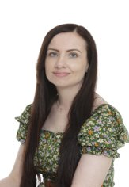


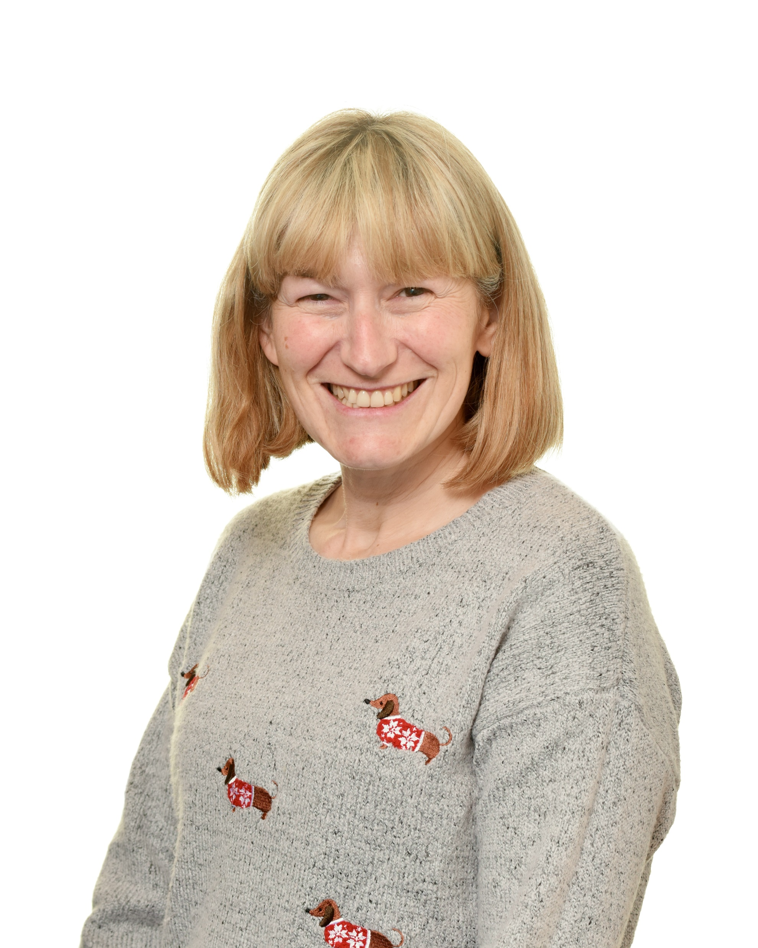
Meet the team

Slide 3
Early Years Foundation Stage (EYFS):
The areas of our curriculum
The Early Years Foundation Stage (EYFS) is a curriculum for children from birth to 5 years.
Reception is the end of the curriculum where we assess the children against the Early Learning Goals.
There are 3 prime areas: Communication and Language, Personal, Social and Emotional Development and Physical Development.
There are 4 specific areas: Mathematics, Literacy, Understanding of the World and Expressive Arts and Design.

Slide 4
Communication and language
Speaking | Listening, Attention and Understanding
Encourage full-sentence responses, conversations, and questions. Introduce new vocabulary and support your child in using it. | Children are encouraged to listen carefully through stories and conversations, and to follow listening rules to stay focused during lessons.
What you can do to help
Encourage your child to speak in full sentences. Read stories together and ask questions to check understanding. Discuss school topics to build vocabulary and reinforce learning.

Slide 5
Personal, social and emotional development
Self- Regulation | Managing self | Building Relationships
Talking about our feeling. Learn to think about the feelings of others before acting. | We talk about 'Stay on Green' and classroom rules. Children are encouraged to dress independently for PE and to keep trying when tasks are challenging. | Playing turn taking games. Talking about being kind. Playing cooperatively with others.
What you can do to help​
​Set clear rules at home. Play games that teach turn-taking and perseverance. Encourage your child to dress independently, including zipping coats. Ensure they can use cutlery and eat on their own.

Slide 6
Physical development
Fine motor | Gross motor
​Fine motor skill activities such as construction, threading, using tweezers. Scissor activities. Mark making and writing. | ​PE lessons. Access to physical activities in the Outdoor Classroom.
What you can do to help​
Practise cutting with scissors, drawing, and painting. Visit parks for climbing activities. Build with Duplo, Lego, or similar toys. Try practical tasks like pegging washing or washing up with a sponge.

Slide 7
Literacy
Comprehension | Word Reading | Writing​
Children will answer questions, retell stories, discuss events, and make predictions to build comprehension. | ​Teaching children sounds leading on to blending words and reading sentences. | ​Children will learn to form letters, use known sounds to spell words, and progress to writing full sentences.
What you can do to help​
​Help your child recognise and write their name, then move on to other letters. Read together at least five times a week. Practise sounds and words sent home. Ask questions during story time to check understanding.

Slide 8
Mathematics
Number | Numerical Patterns
​Children will explore numbers to 10, including 1 more/less, doubling, halving, adding, and subtracting. They’ll also learn number bonds and subtraction facts for 5 and some for 10. | ​Children will compare quantities to 10, practise equal sharing, and begin recognising odd and even numbers.
What you can do to help​
Help your child recognise and order numbers 0–10. Create repeating patterns with objects. Practise accurate counting and simple addition/subtraction. Encourage fair sharing during mealtimes.

Slide 9
Understanding of the world
Past and Present | People, Culture and Communities | The Natural World
Learn about the past through topic work and stories, comparing part of our lives with how things were in the past. | ​Looking at differences and similarities between different environments and countries. Celebrating festivals and religious events. | ​Learning about farm animals, minibeasts and wild animals. Growing flowers and vegetables. Learning about lifecycles.
What you can do to help​
Talk about your childhood and compare it to your child’s life. Point out local features and discuss festivals you celebrate. Visit places like farms or zoos, look for minibeasts, and grow plants together.

Slide 10
Expressive arts and design
Creating with Materials | Being imaginative and Expressive
​Painting, observational drawing, junk modelling etc. Using skills such as drawing, using scissors and joining materials. | ​Singing songs and rhymes. Providing role play and imaginative play opportunities. Acting out stories.
What you can do to help​
​Craft and drawing activities. Play imaginatively with your child with toys and props. Singing songs. Making music. Dancing.

Slide 11
Our topics and key texts
Topics and festivals | Key texts
All about me Autumn Harvest Diwali Guy Fawkes night Remembrance Christmas Winter People who help us Chinese New Year Easter Eid Growing Farm animals Minibeasts Summer Seaside Superheroes Wild animals | Boggity Bog The Three Billy Goats Gruff The Little Red Hen The Hungry Giant Once there were Giants Dear Santa One Snowy Night After the Storm The Rescue Party Mrs Wishy Washy Wishy Washy Day Mud Walk Meanies Meanies came to school The Toymaker The Gruffalo Lucy and Tom at the Seaside

Slide 12
How we assess whether children have achieved the Early Learning Goal
Through observation- playing with the children, watching them and listening to them in both child-led and adult-led activities.
Collecting examples of work that reflect the children’s progress.
Floor books- working with groups of children to record their learning in a class book. We will be encouraging children to reflect on what they have learnt to see if they have retained the vocabulary and teaching.

Slide 13
Our Routine
Lessons
Read, Write Inc. (RWI) Our phonics lessons that take place every morning
Mathematics- a new concept is taught each week, lessons are daily
Discovery time- Literacy/topic lessons taught 4 days a week which often include a focus book
PE- Taught in the hall once a week
Circle time- Exploring emotions, rules and festivals taught once a week
Music- involving singing, movement and instruments taught once a week
In order for the children to be able to achieve the Early Learning Goals they need to have a routine that will support them to feel settled and confident.

Slide 14
Other important aspects of our routine​
Indoor work and play- Children engage in planned activities across the curriculum in both the classroom and Red Room. Activities include a mix of independent and adult-led tasks.
Outdoor Classroom- this is our garden where planned activities covering the areas of the curriculum are available for children to take part in.​
Assembly- Soon they will be joining assembly on the screen and then joining Key Stage 1 in the hall when they are ready​.
Lunch and playground​.
Story time- stories are a very important part of learning​.

Slide 15
A typical day
Registration
Read, Write Inc
Work and play
Mathematics
Lunchtime
Discovery time
Work and play
Story time
Home time

Slide 16
Read, Write, Inc (RWI)
Children learn to read and write through daily phonics sessions (up to 1 hour), including new sounds, writing practice, and word reading.
Weekly homework supports learning at home—please ensure it's completed.
Children are assessed after learning Set 1 sounds and grouped by ability.
For support, speak to your child’s teacher.
Terms used | Definition
Fred Talk | Segmenting the sounds in a word and then blending them to read e.g. c-a-t, cat
Fred Fingers | Segmenting a word using your fingers in order to spell it

Slide 17

How to say the sounds - youtube
If you are unsure how sounds are pronounced, watch the video on YouTube or the Reception class page. It's also helpful for your child to watch.

Slide 18
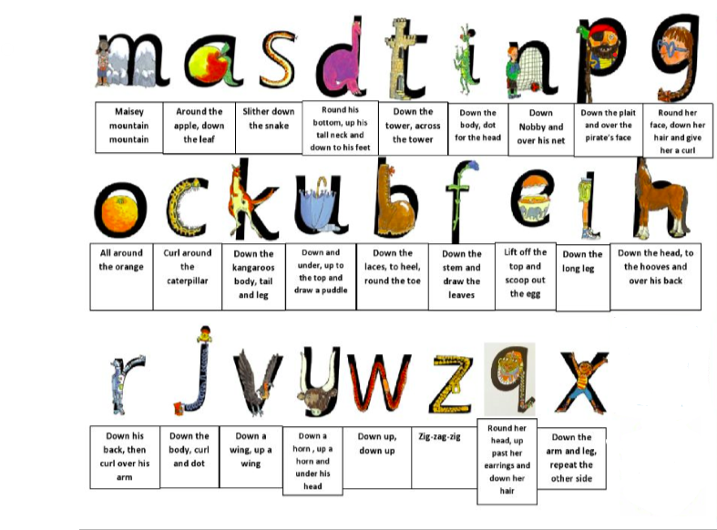
Supporting handwriting at home
Each sound is paired with a picture and a rhyme to guide correct letter formation. Encourage children to say the rhyme as they write the letter.
At this stage, only the first letter of their name should be capitalized (e.g., 'Thomas').

Slide 19
Reading at home with your child
Each week your child will receive a reading book with no words to take home.
Please write the name of the book in their reading record.
Our aim is for children to read 5 times a week.
If your child has 5 signatures in their reading record on Friday they will receive a sticker to put on the class reading rocket, if they get 10 stickers they will get a prize.
Please make sure your child has their reading record and their reading book in school every day and please look after the book sent home.

Slide 20
What your child will need for school
Please remember
Book bag- Please ensure your child brings their book bag daily, as books may be changed on any day.
Wellington boots- Children need wellies for the digging area and they are useful for rainy days—please ensure they have a pair in school.
Coat- Please ensure your child brings a coat and can put it on and zip it up independently.
PE kit- Your child needs a named PE kit: black shorts/joggers, white t-shirt, and plimsolls or trainers. Please remove earrings and tie up long hair on PE days.

Slide 21

Attendance and punctuality
Attendance
Daily attendance is essential to avoid gaps in learning. Attendance below 90% is classed as persistent absence.
If your child is absent, please call the school to explain-otherwise, it will be marked as unauthorized.
Punctuality
Children should arrive via the Red Room door between 8:40–8:50. Late arrivals must go to the office for registration and lunch selection.
School ends at 3:20—please be on time. Late children will wait at the front of the school. Let us know if someone else is collecting your child.

Slide 22
What to do if you have a question or concern
Check the school website, more specifically the Reception page, if it's a simple question the answer may be there.
Speak to your child's teacher, they work with your child every day and will have the most knowledge about your child.
If you need further support speak to the Assistant Headteacher for the EYFS.

Slide 23

Keeping Children Safe Online
A range of resources can be found in the link below:
https://www.godwinprimary.co.uk/online-safety-2/
We are planning to run some online safety workshops over the coming year so please keep an eye on the newsletter

