Slide 1

Year Five Curriculum
2/10/25

Slide 2
Y5 Team
Teachers*:
Mr Moran
Miss Shepherd
Support Staff:
Miss Small
Mrs Mumtaz, Mr Sarumi, Mr Nangrejo
(*parents’ consultations - 22/10/25)

Slide 3
The National Curriculum
The national curriculum is a set of subjects and standards used by primary and secondary schools so children learn the same things.
It covers what subjects are taught and the standards children should reach in each subject.

Slide 4
The National Curriculum
English
maths
science
design and technology
history
geography
art and design
music (fifes)
physical education (PE), including swimming
computing
ancient and modern foreign languages
relationship and health education
modern foreign languages
religious education
Plus:
PSHE & citizenship
sex education

Slide 5
Curriculum Map:
Home | Godwin Primary School

Slide 6
At Godwin Primary School we follow the National Curriculum. We plan from this ensuring we plan for a curriculum that:
…has reading at its heart - so that every child leaves us as a fluent reader, readily able to access the next stage of their learning;
…develops children’s vocabulary and equips them with skills to reduce social disadvantage;
…is based on our Godwin values as well as our ethos of working together and nurture, to promote positive emotional and physical health;
…provides experiences and opportunities that broaden children’s cultural capital and support the mindset that they can achieve anything, in order to encourage ambition and academic aspiration.

Slide 7
…has reading at its heart - so that every child leaves us as a fluent reader, readily able to access the next stage of their learning…

Slide 8





Slide 9
Whole Class Texts
Read to daily – whole class texts as well as dedicated reading lessons.
Chosen with diversity and breadth of reading experience in mind.
Texts also act as broad themes for other English work e.g. grammar and writing.

Slide 10
Reading Skills
Decode words they are having difficulty with.
Work out the meaning of unfamiliar words.
Check they have understood what they have read.
Predict what will happen.
Summarise what their reading was about.
Discuss particular words chosen by the author.

Slide 11
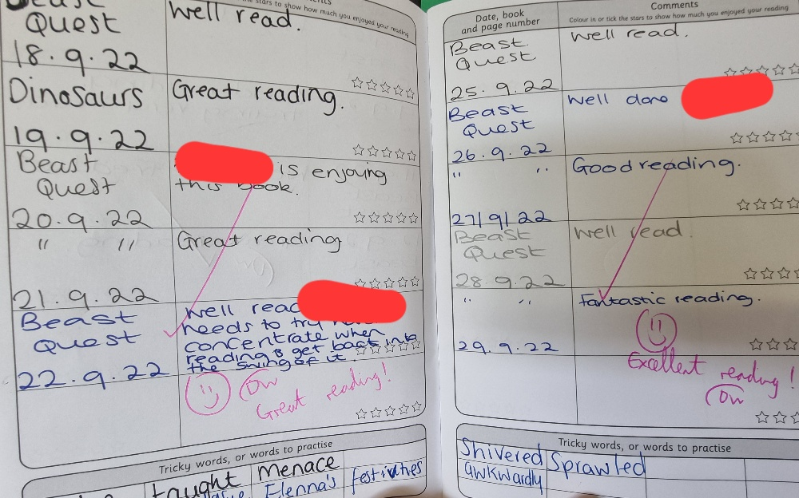
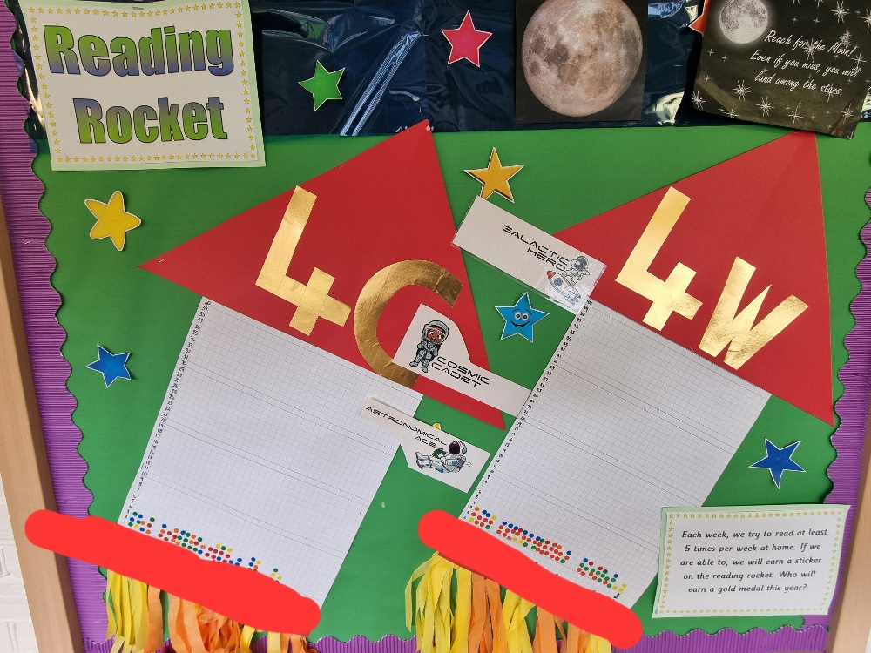
Reading at Home
Read AT LEAST five times a week to an adult.
Reading Records due each Friday – signatures needed.
Personal reading books chosen and changed in school.
Sticker on Reading Rocket.

Slide 12
Reading at Home
The Library – it’s free!
Centre for Literacy in Primary Education (CLPE) Corebooks
Waterstone’s Children’s Book Prize
Shops: Waterstone’s, WHS Smith, The Works, Asda
The internet (child-friendly sites)
First News and The Week Junior

Slide 13
Reading at Home
Enjoy Reading!
Read to self – daily for pleasure.
Read in different places/a special place.
Read a wide range of poetry, plays, fiction, non-fiction, graphic novels, websites, different genre, textbooks, newspapers.
Have opinions about books and authors.
Read about topics in the news and discuss them.
Adults as a role model for reading.

Slide 14
…develops children’s vocabulary and equips them with skills to reduce social disadvantage…

Slide 15
Writing At School
Malamander: narrative, persuasive leaflet, report
House With Chicken Legs: persuasive speech, explanation, balanced argument
Wonder: biography, balanced argument, description, diary entry, book review
Boy at the Back of the Class: recount, poetry, persuasive letter

Slide 16
Writing At Home
Y3/4 Spellings
Y5/6 Spellings
Weekly homework sheets (linked to spelling)
Writing for fun – diaries, competitions, stories, playscripts, explanation texts, blogs, websites…

Slide 17
Maths in Y5
Number: Place Value, Addition & Subtraction, Multiplication & Division, Fractions, Decimals & Percentages
Statistics
Measurement: Perimeter/Area, Converting Units, Volume
Geometry: Properties of Shapes, Position and Direction

Slide 18
Maths at Home
Times Tables Rock Stars
Checking multiplication and division facts
Telling the time
Making things – cooking, models etc.
Going shopping – money, change, special offers etc.
BBC Bitesize
Weekly Homework

Slide 19
Homework In Y5
Spelling
Maths book
Goes out on Wednesday
Due in on the following Tuesday
Optional Homework Club on Monday lunchtime
Compulsory Homework Club on Tuesday lunchtime

Slide 20
…is based on our Godwin Values as well as our ethos of working together and nurture, to promote positive emotional and physical health…

Slide 21
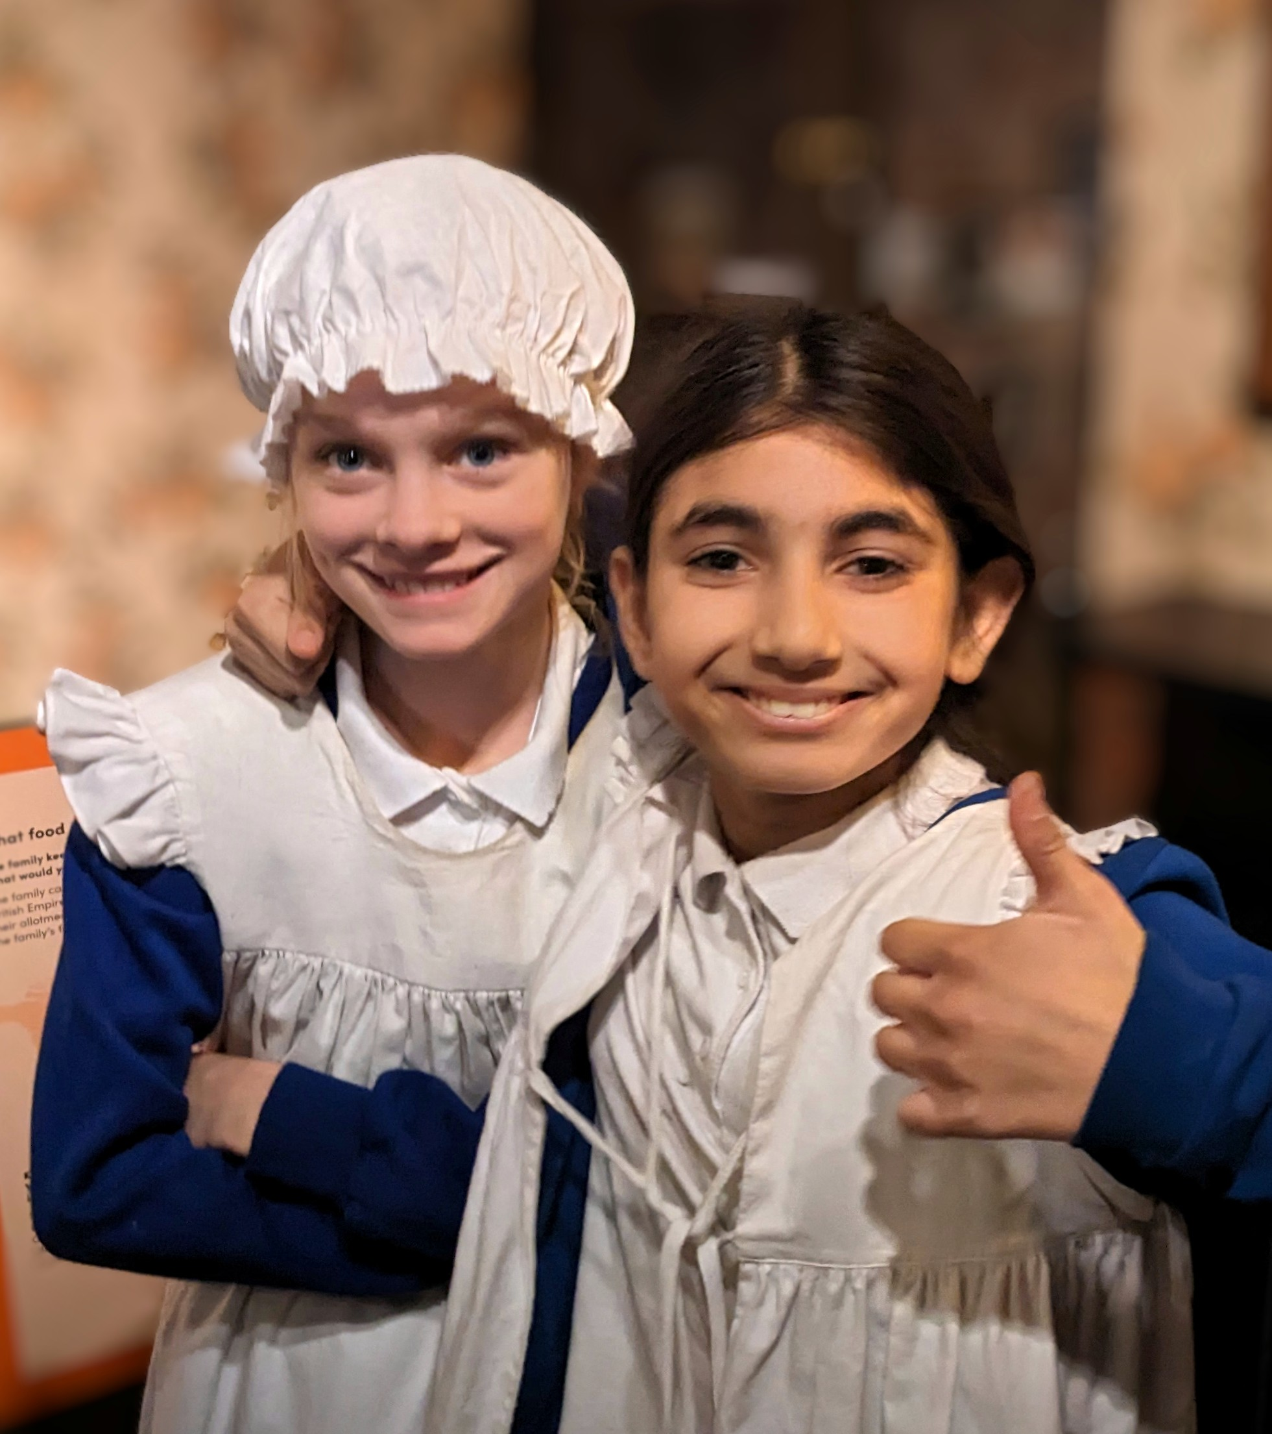

Slide 22
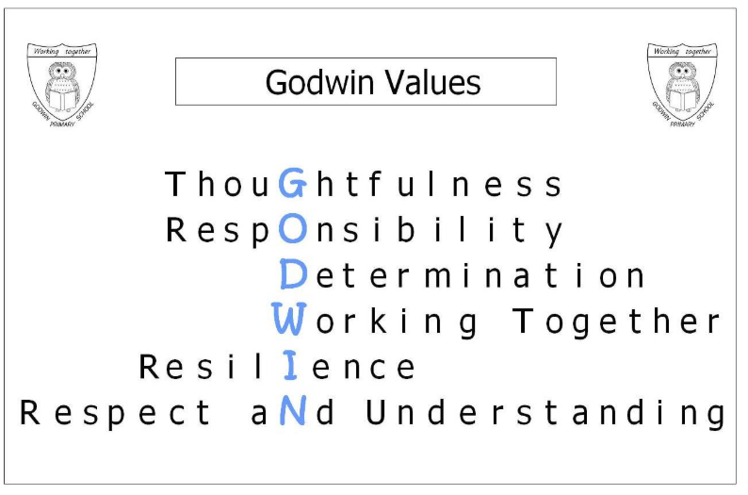

Slide 23
… provides experiences and opportunities that broaden children’s cultural capital and support the mindset that they can achieve anything, in order to encourage ambition and academic aspiration.

Slide 24
Trips:
Swimming – every Friday to Christmas
13th November – Cinema
16th November – London Mitharaeum
10th December – St Alban’s Church
Spring Term – Barking Mosque
Spring Term – Greenwich Planetarium/Observatory

Slide 25
ATTAINMENT | Working at expected level +
 | Godwin | National | +/-
Reading | 90% | 75% | +15%
Writing | 75% | 72% | +3%
Maths | 87% | 74% | +13%
SPAG | 87% | 73% | +14%
R/W/Ma | 71% | 62% | +9%

Slide 26


